Slide 1
OnDataSuite PEIMS Forum Discussion

Slide 2
Your Presenter:
Kenneth Cloud, PEIMS Coordinator,
Tomball ISD

Slide 3
Agenda
How Did Tomball ISD Launch OnDataSuite
How Does Tomball ISD Work Our Leaver

Slide 4
A Little About Tomball ISD
We are 35 minutes from downtown Houston in North West Harris County.
1 EE-Pre-K Center
11 Elementary Schools
3 Intermediate Schools
4 Junior High Schools
2 High Schools
1 Early College
1 DAEP Campus
Under Construction: 1 High School, 1 Junior High, 1 Intermediate, 2 Elementary
The student count is around 23,000 – TISD is a Fast Growth LEA.
The staff count is around 3,000 employees.

Slide 5
How Did Tomball ISD Launch ODS
TISD started with a slow process:
Year 1: PEIMS and MIS Team had access. (this allowed my teams to learn the ODS system fully).
Year 2: We opened it up to the District Cabinet Team and Program Directors (all Chefs, SPED, Federal, EB, ERI, DYS, etc.)
Year 3: We then introduced it out to Campus Principals and APs. (this helped with TISD Campus/District improvement planning).
Year 4: TISD stopped introducing ODS to do more in-depth training with our groups to build their capacity in ODS.
Year 5: We are just now introducing it to our Campus Registrars and Campus PEIMS Teams.

Slide 6
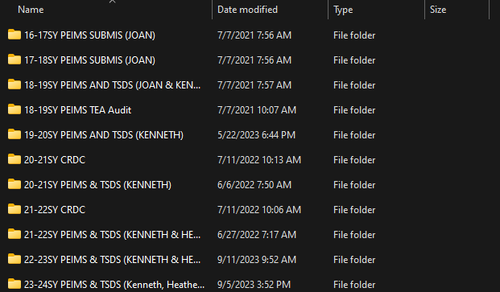
Tomball ISD Success with ODS
TISD has invested in archiving all of the PEIMS and Core XML files. This is so we can load all the data into ODS.

Slide 7
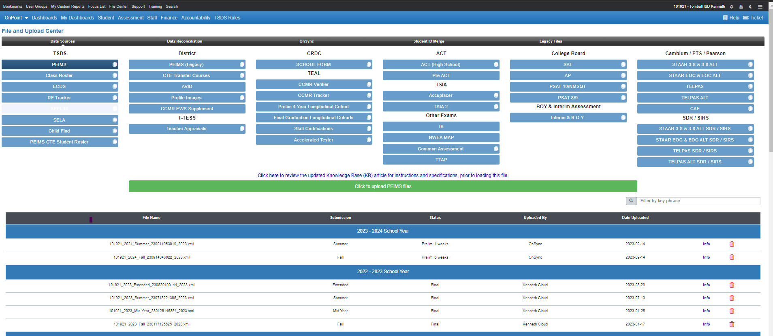
Tomball ISD Success with ODS

Slide 8
Any Questions?

Slide 9
School Start Window
School Start Window closes on Friday, SEP 29, 2023.
Leaver Information TEA Website: TEA Leaver Info
Sample Email:
“I hope this message finds you well. As we approach the closing date of the School Start Window on Friday, SEP 29, 2023, there are some crucial points we'd like to bring to your attention regarding leaver coding for TISD students in grades 7th – 12th who left Tomball ISD from SEP 30, 2022 - Sep 29, 2023.
It is imperative that any student falling into this category must be properly coded as a GOOD LEAVER with the appropriate documentation before the school start window closes. Tomball ISD's goal is to report 0 dropouts, and achieving this goal requires us to have accurate data on our leavers. Incorrect coding can negatively impact our accountability.”

Slide 10
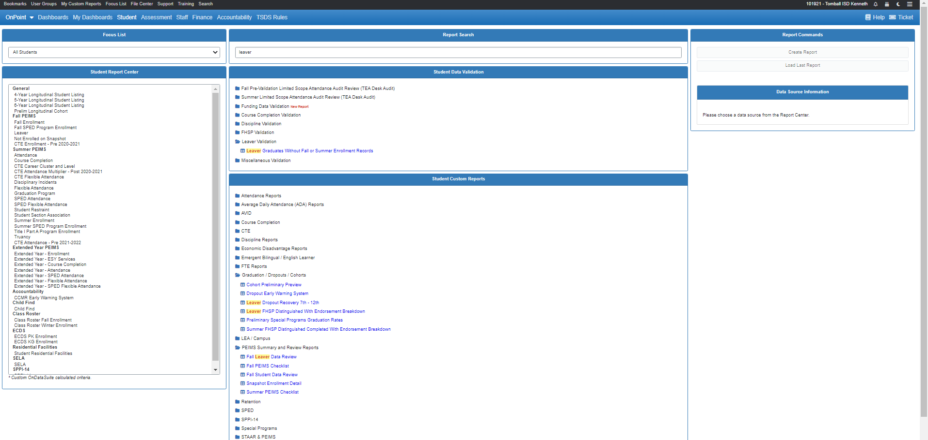
How Does Tomball Work our Leavers?
TISD starts with loading our 2023-2024 Fall PEIMS File into ODS as soon as possible to start reviewing the data. This year our district started loading Fall files on 08/15/2023 our first day of school.

Slide 11
How Does Tomball Work our Leavers
SIS Steps eSchoolPLUS
Run an Advanced Search out of eSchoolPLUS for students who have withdrawn after the last day in September of the prior school year.
Pull W/D Dates, W/D Codes (not graduated or another Tomball school), and any available comments entered by the Registrar.
Export to Excel
*For eSchool, the Advanced Search adds extra space characters at the ends of the Student IDs which we have to remove later. I take the Student IDs from the Excel spreadsheet and paste them into OneNote. I then highlight the spaces at the end of the first ID, use Replace, and leave the Replace With field blank. I click Replace All to remove all spaces at the end of the Student IDs and paste these clean values back into the Excel spreadsheet.

Slide 12
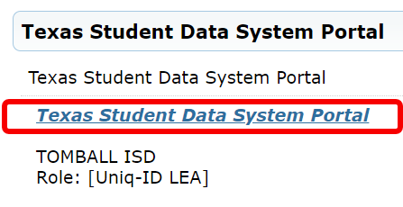
How Does Tomball Work our Leavers
TEAL Steps
Go to TEAL >Texas Student Data System Portal > Unique ID >View ET Reports >Click the Run button for UID0-000-004 Enrollment Status of Prior School Year Students
Select All Campuses
Select All Reports
Select Full SSN/Alt ID
Run
Once you run the report the Status will display “IN PROGRESS”
Download the report once it is complete.

Slide 13
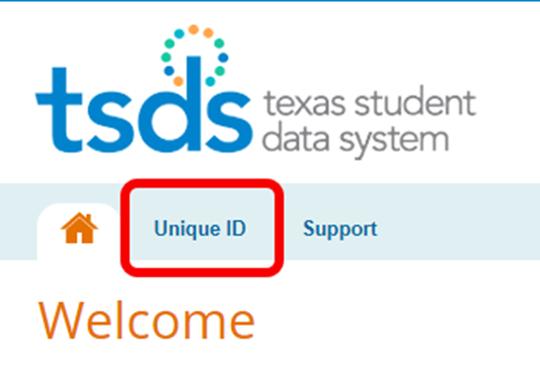
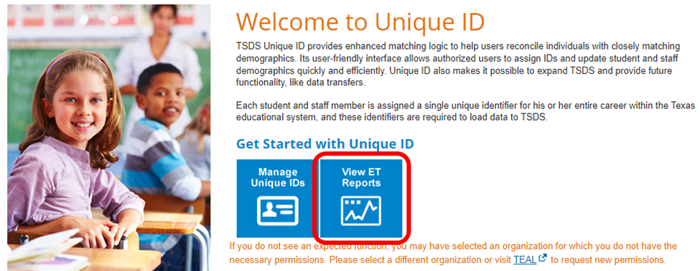
How Does Tomball Work our Leavers
TEAL Steps
Go to TEAL >Texas Student Data System Portal > Unique ID >View ET Reports >Click the Run button for UID0-000-004 Enrollment Status of Prior School Year Students

Slide 14
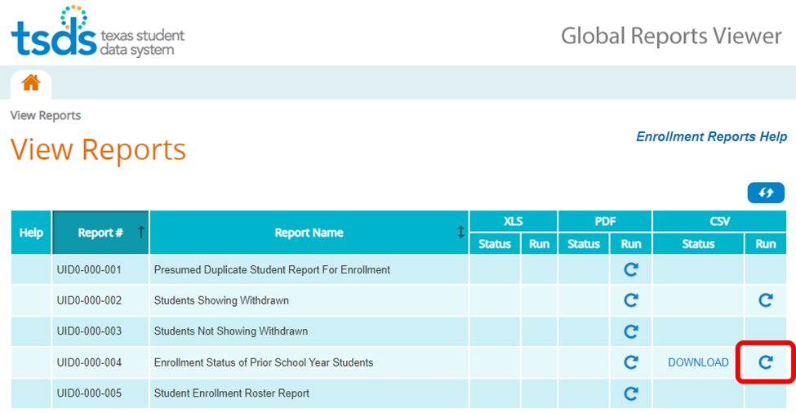
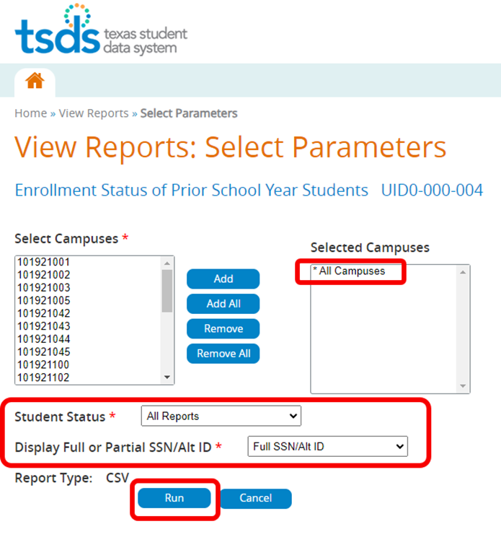
How Does Tomball Work our Leavers
TEAL Steps
Go to TEAL >Texas Student Data System Portal > Unique ID >View ET Reports >Click the Run button for UID0-000-004 Enrollment Status of Prior School Year Students

Slide 15
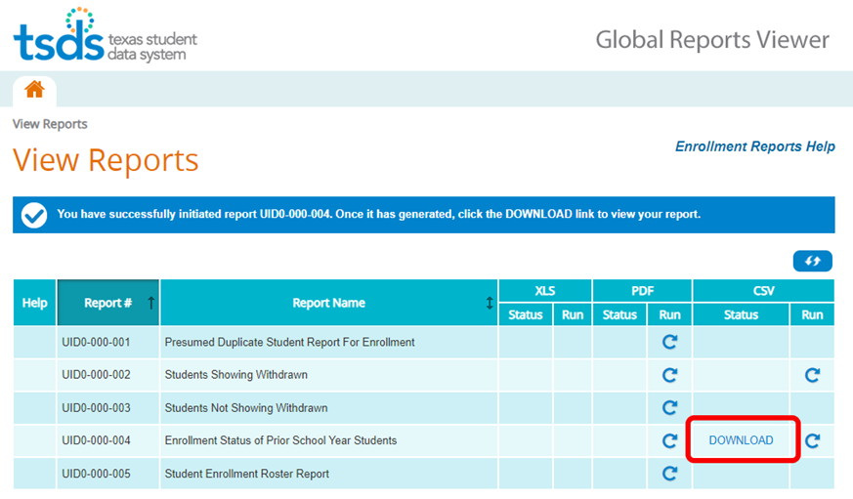
How Does Tomball Work our Leavers
TEAL Steps
Go to TEAL >Texas Student Data System Portal > Unique ID >View ET Reports >Click the Run button for UID0-000-004 Enrollment Status of Prior School Year Students

Slide 16
How Does Tomball Work our Leavers
VLOOKUP Steps
I add both the eSchool extract and the TSDS extract into a new Excel Spreadsheet so I can keep my original extracts.
Always make sure that the Student ID is in the first column of both the eSchool extract and the TSDS extract. In the TSDS extract it will be in Column J. Move this to Column A by Inserting a Column to the Left of Column A and dragging and dropping the Prior Year Local ID data. Delete the Empty column remaining after this process.
Insert a new column in between Column A and Column B to run the VLOOKUP.
*I always rename my Tabs with eSchool and TSDS for clarity.
Example: =IFNA(VLOOKUP(A8,Sheet1!$A$2:$G$886,1,FALSE),”N/A”)
*Always enter $ signs for the SIS table (there will be 4 total in the formula) to “lock in” the entire table of data from eSchool.
Once I enter the $ signs to “lock in” the SIS data, double-click the small box on the bottom right-hand corner of your VLOOKUP cell. This will auto-populate the formula for all IDs.

Slide 17
How Does Tomball Work our Leavers
VLOOKUP Steps
Example: In the TSDS tab, add the IFNA VLOOKUP formula to compare the Student ID from the SIS to the Prior Year Local ID from TSDS.
=IFNA(VLOOKUP(A8,Sheet1!$A$2:$G$886,1,FALSE),"N/A")
*Always enter $ signs for SIS table (there will be 4 total) to lock in the entire table of data.

Slide 18
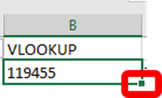
How Does Tomball Work our Leavers
VLOOKUP Steps
Once entering the $ signs to “lock in” the SIS data, I double click the small box on the bottom right-hand corner of the VLOOKUP cell. This will auto populate the formula for all IDs.

Slide 19
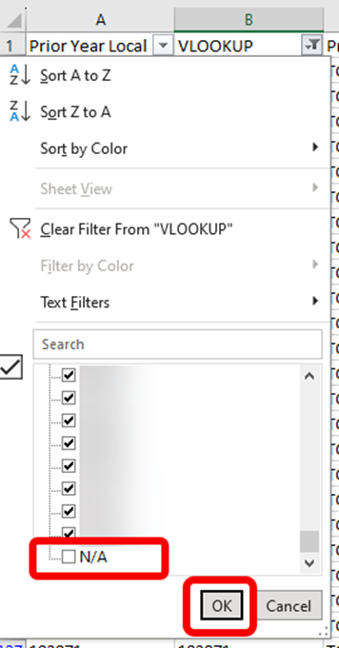
How Does Tomball Work our Leavers
VLOOKUP Steps
Select Data >Filter uncheck the N/A at the bottom and click OK to find the matching students.
Once you have your matches, Add columns for the SIS W/D Code and the SIS W/D Date. I usually add a column for the W/D Comments as well to have as much information as possible about where the student may have enrolled.
Copy the matching IDs and paste them into a new tab in the same spreadsheet for clarity.
Follow the same steps and use a simple VLOOKUP formula to pull the W/D Code, W/D Date, and W/D Comments (if applicable). Because the Student IDs match, you do not need an IFNA function for these additional columns of data because all of the IDs have data in the SIS tab.
Example: =VLOOKUP(A3,eSchool!$A$2:$G$883,6,FALSE)

Slide 20
How Does Tomball Work our Leavers
What to look for:
W/D 98 with ‘Current LEA Names’ that are not blank. We verify the Enrollment Event in TSDS and print for our Registrars.
W/D 80 with no ‘Current LEA Names’.
All W/D Codes except for W/D 80 with ‘Current LEA Names’ that are not blank.
Example of W/D Code 98 with ‘Current LEA Names’ not blank:

Slide 21
Any Questions?

