Slide 1
PEIMS, Payroll & Personnel Getting through Fall PEIMS

Slide 2
Agenda
PEIMS Requirements
Public's Perception
PEIMS Reports
Staff and Payroll Data Elements
Who are your Who’s?
Timelines & Due Dates
Resources

Slide 3
PEIMS submissions includes a large amount of information in coded form. All of the data elements (600) have to be correct, all of the of the data elements have to be documented and ALL PEIMS data has to be verified by campus or district personnel Data Elements – There are close to 50 data elements that can be reported for each staff through Fall PEIMS

Slide 4
Financial Accountability System Resource Guide 1.5.2.4
Fall submission includes organization and campus data, shared service arrangement data, campus-related data, current fiscal year budget data, staff data, and student data.
The student data include identification/demographic information, enrollment information, special program information, and dropout and graduated student information.

Slide 5
Non-Student Fall PEIMS Data Includes:
School Budget
All staff employed on Snapshot
Each staff's Payroll Accounting Code

Slide 6
What staff members are reported through PEIMS?
All school staff who are LEA employees, professionals providing contracted services, or volunteers providing professional services, must be reported with the Staff Extension Complex Type.

Slide 7
Which staff members are not reported through PEIMS?
Staff who have left employment before the PEIMS Fall snapshot date
Staff who have not begun employment as of the PEIMS Fall snapshot date
Short-term substitutes who are not serving in a vacant position
Volunteers who are not providing a professional service

Slide 8
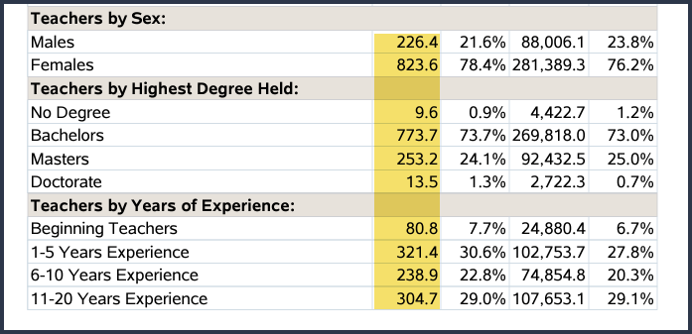
How does the public view your district?

Slide 9
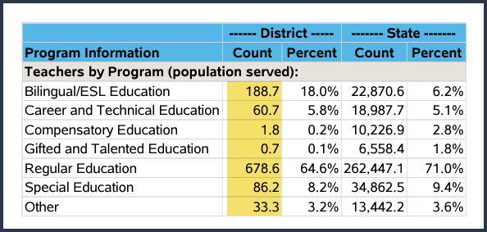
How does the public view New Caney ISD?

Slide 10
How does the public view New Caney ISD?

Slide 11
Fall PEIMS Reports
PDM1-XXX-XXX

Slide 12
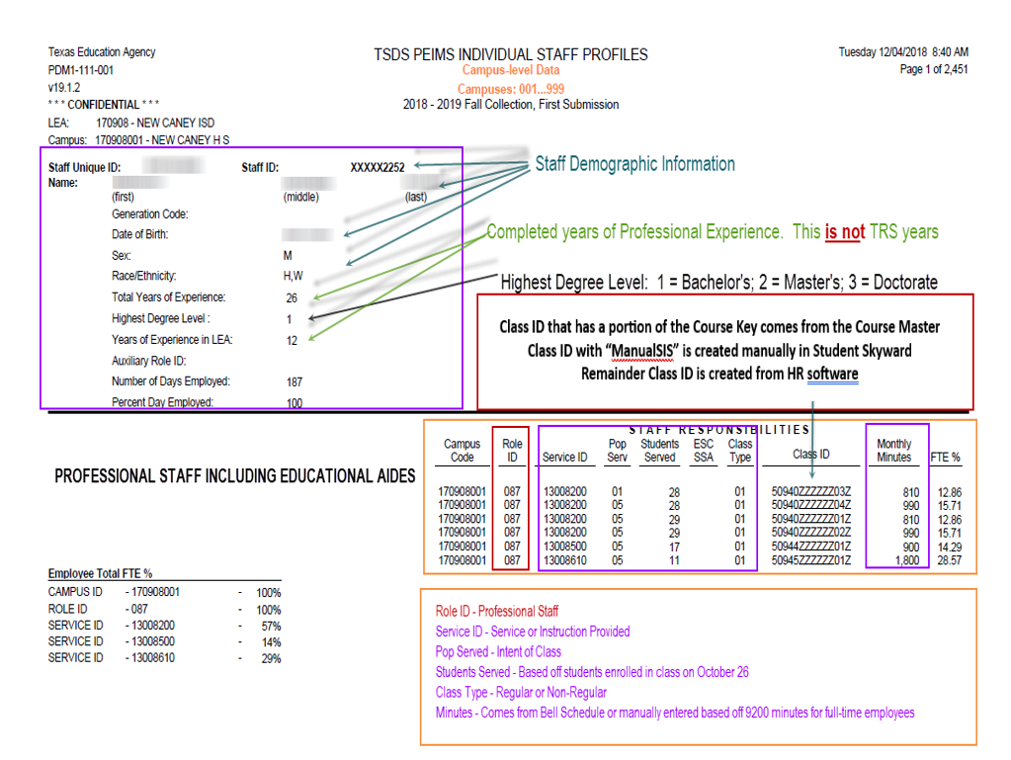

Slide 16
Additional Reports
Budget Reports – PDM1-100-001-PDM1-100-014
Fall Financial Accountability Rating Indicators – PDM1-100-011 – CFO
Staff Reports – PDM1-110-001 – PDM1-110-007
Payroll Information by Special Program Intent Code PIC 21-PIC 43
Staff Reports – PDM1-111-006
Physical Education Teacher Roster

Slide 17
On Data Suite Reports
Staff Data Validation Reports
Fall CTE Class Service IDs With Less than 45 Minutes
Inaccurate Role ID Reporting to PEIMS
Payroll to Responsibility Campus Mismatch
Payroll PIC to Responsibility Pop Served Mismatch
Responsibility Pop Served to Payroll PIC Mismatch
Sped Grade Level Staff Verification

Slide 18
On Data Suite Reports
Staff Custom Reports
Teacher Summary Reports
Staff Responsibilities
Staff Miscellaneous Reports

Slide 19
Staff Association Extension
30040 – Staff Extension Complex Type
30050 – Staff Education Org Employment Association Extension Complex Type
30055 – Contracted Instructional Staff FTE Extension Complex Type
30060 – Payroll Extension Complex Type
30090 - Staff Responsibility Extension Complex Type

Slide 20
30040 Staff Extension Complex Type
Staff Demographics
E1073 Staff Type C181
E0730 Highest Degree Level C015
E0161 Years in District
E0130 Years in Local Education Agency
E1670 Paraprofessional Certification Indicator Code

Slide 21
30050 Staff Organization Association Extension Complex Type
E0760 Percent of Days Employed
E0160 Number of Days Employed
E1594 Auxiliary Role ID C213

Slide 22
30055 Contracted Instruction Staff FTE
E0320 Program Intent Code C147
E0980 Total Contract Instructional Staff FTE’s

Slide 23
30060 Payroll Extension Complex Type
E0425 Payroll Amount
E0316 Fund Code C145
E0317 Function Code C146
E0318 Object Code C159
E0319 Organization Code
E0320 Program Intent Code C147
E0424 Payroll Activity Code C018

Slide 24
30090 – Staff Responsibilities Extension Complex Type
E0721 Role ID C021
E0724 Service ID C022
E1056 Class ID Number – SIS or HR System
E0747 Population Served C030
E0017 Grade Level SIS or HR System
E0170 Number Students in Class SIS or HR System
E1055 Class Type Code C179
E1057 Monthly Minutes SIS or HR System
E1604-E1606 Number of Minutes Taught Week 1-4
02530002," "02530003," "02530004,” “02530005,” “02530006,” “02530007,” “02530008,” 02850000," "03823000," "PES00051,” "PES00053," “PES00056," "82210XXX," "82931XXX," "82310XXX,” or "84200XXX"
E1608-1611 Number of Minutes Taught Week 1-4

Slide 25
When does a staff receive a Staff Responsibility Record?
Auxiliary Role ID - C213 – Typically do not receive a Staff Responsibility Record
Role ID – C021 – Typically do receive a Staff Responsibility Record
Teachers and Aides with Object Code 6119 and 6129 typically do receive a Staff Responsibility Record

Slide 26
Service ID Matrix
Charts D-G

Slide 27
Substitutes (Three Types)
•Typical Substitute – hired on a daily basis to substitute teach but is not on the regular district payroll. (NOT reported to PEIMS)
•Floating Substitute – Professional district employee who is hired on a long-term basis to substitute as needed in whatever classroom falls vacant on a given day due to a teacher calling in sick or taking a personal day. (Reported to PEIMS)
•Substitute for classroom staff not returning to classroom. Teaching position has become vacant through death, resignation or termination. (Always Reported to PEIMS). This includes Summer Submission. CTE weighted funding may be affected.

Slide 28
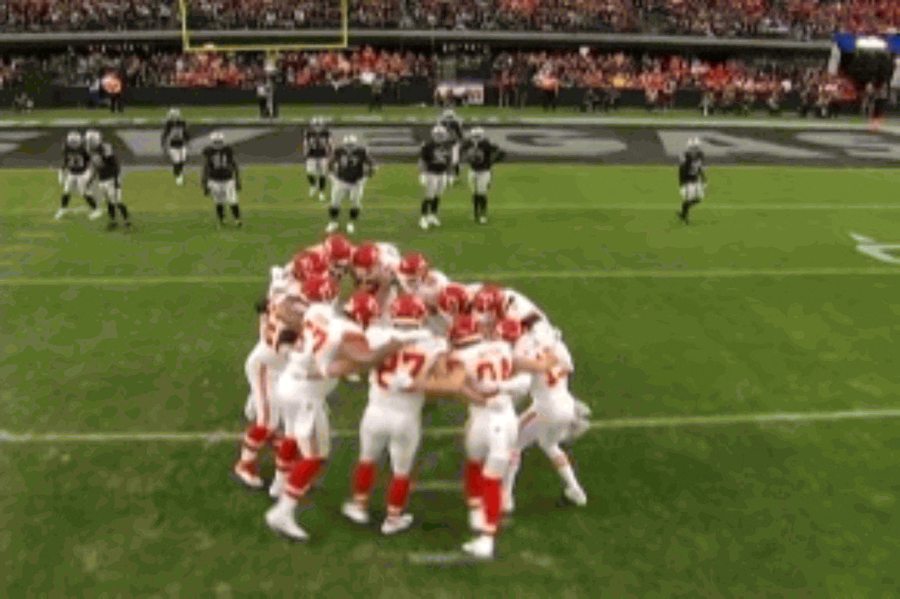
Who are your teammates?
Human Resources
Payroll
Finance/Budget
Principals
Counselors
Campus Master Schedulers
Special Programs

Slide 29
Example of Timelines & Due Dates
UIDs are assigned beginning mid-July and throughout the school year
HR data ready to be extracted September 1, 2022, for Fall Class Rosters
HR/Payroll & Budget data ready to be extracted September 15, 2022, for Fall PEIMS
HR data ready to be extracted February 1, 2023, for Winter Class Rosters (TIA)
Once PEIMS is fatal free, reports will be sent to appropriate staff for review

Slide 30
Resources
TSDS Web-Enabled Data Standards
https://tealprod.tea.state.tx.us/TWEDS/96/475/0/0/Introduction/List/754
Financial Accountability System Resource Guide
On Data Suite

