Slide 1
OnDataSuite
PEIMS Data Review
Build IT
Link IT
Share IT
Teach IT

Slide 2
BUILD IT
How To Build Data Element List
How To Build User Access List
How To Build User Group List
How To Build Verifier List
How To Build District & Campus Shared Folders
How To Build AdHoc Reports (DIY) Fall PEIMS/Summer PEIMS (Six Weeks Reports)
How To Use Custom ODS Reports
LINK IT
How To Link Reports To PEIMS Dashboard
How To Link Reports To Verification List
How To Link Reports To PEIMS Webpage
SHARE IT
How To Share Reports In OnDataSuite (Share Folders/Bookmarks)
How To Share Reports In Links in Email
How To Share Reports In in Email
How To Share Reports In OnDataSuite (Automatic Notifications)
TEACH IT
How Teach Users To Locate Data
How Teach Users To Navigate PEIMS Dashboard
“BUILD IT….LINK IT…SHARE IT…TEACH IT”

Slide 3
BUILD
IT

Slide 4
BUILD IT…
Build Data Element List
Build User Access List
Build User Group List
Build Verifier List
Build District & Campus Folders
Build AdHoc Reports (DIY) & Custom ODS Reports
Student Report (Fall24_)
Staff Reports (Fall24_)
Six Weeks Reports (Sum24_SixWeeks_)
Validation Reports
Error Reports
How To Do You Build Reports OnDataSuite?

Slide 5
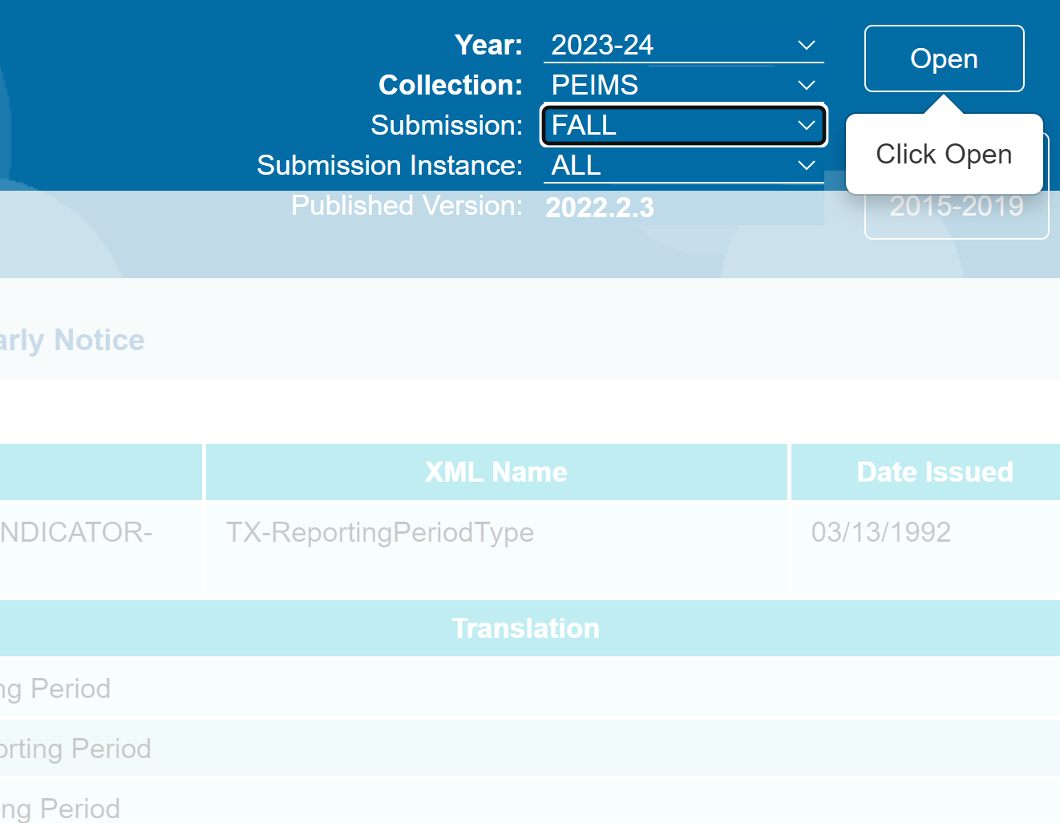
BUILD DATA ELEMENT LIST : TWEDS
Year
Collection
Submission

Slide 6
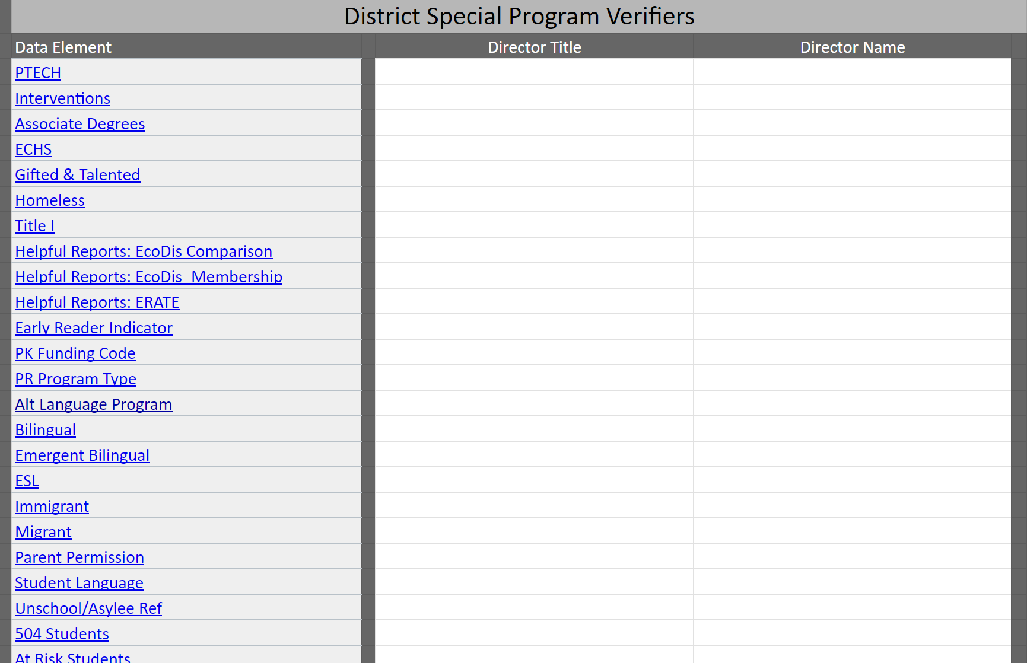
BUILD DATA VERIFIER LIST

Slide 7
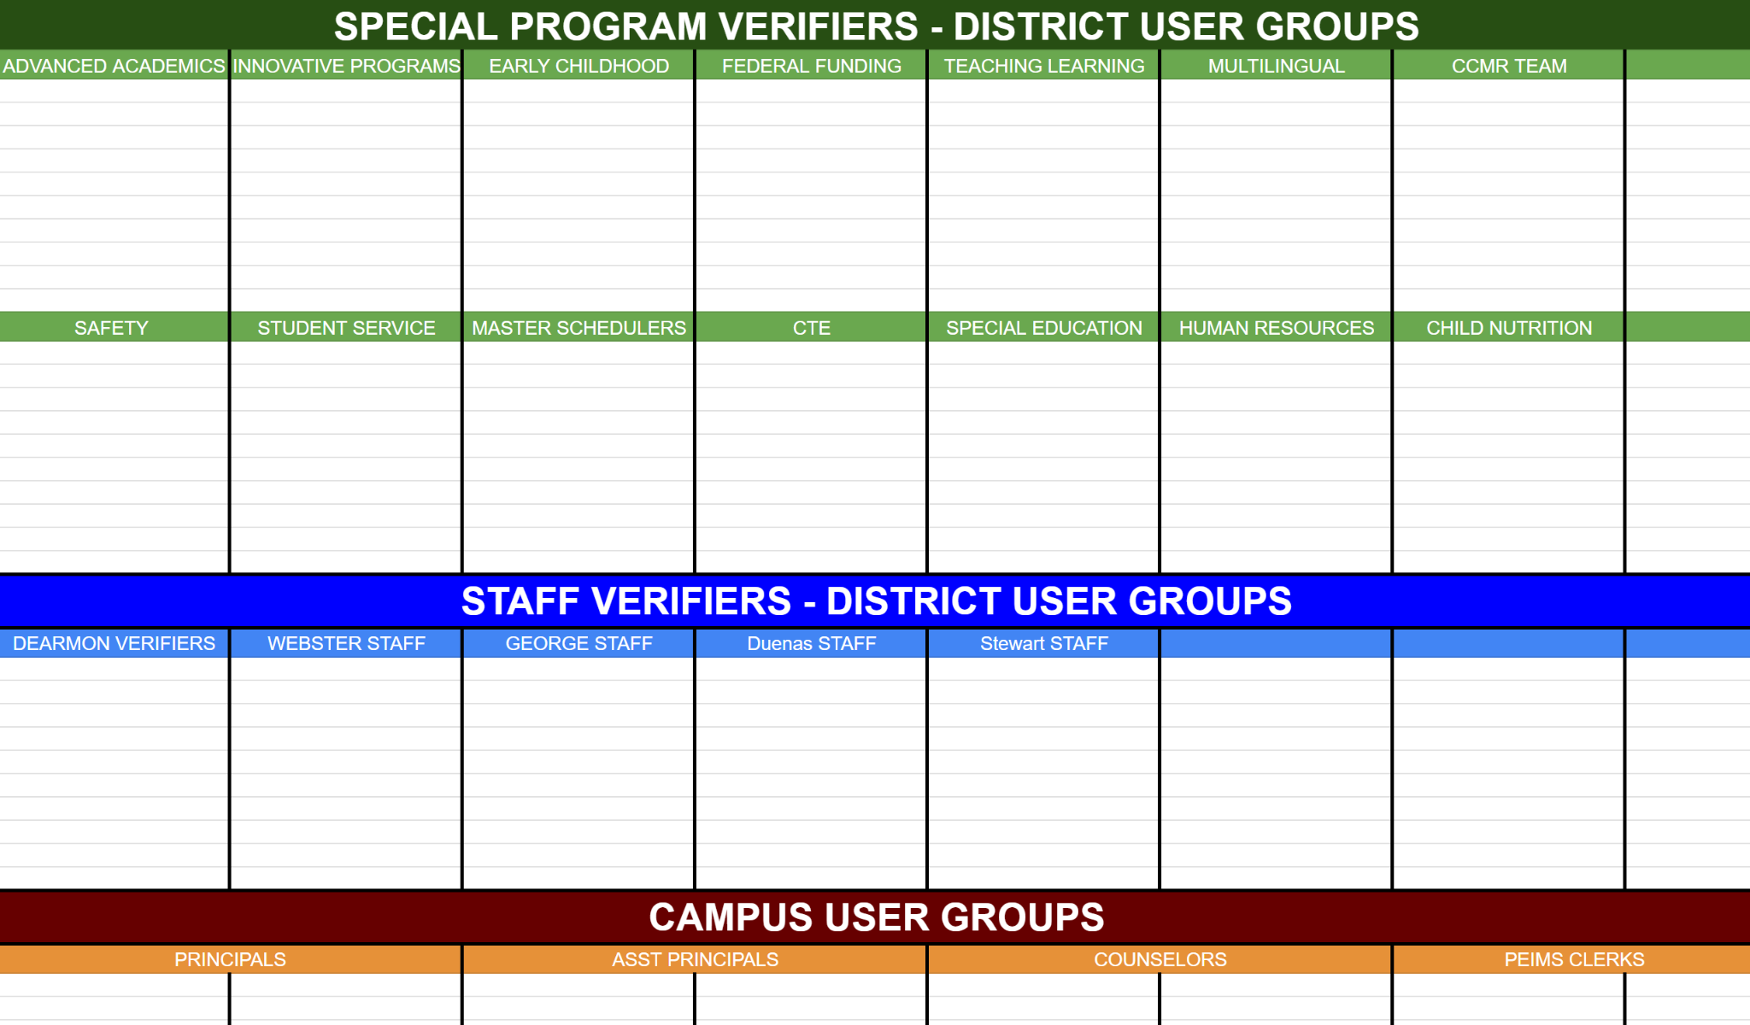
BUILD USER GROUP LIST
List Users By Groups
Check User Access

Slide 8
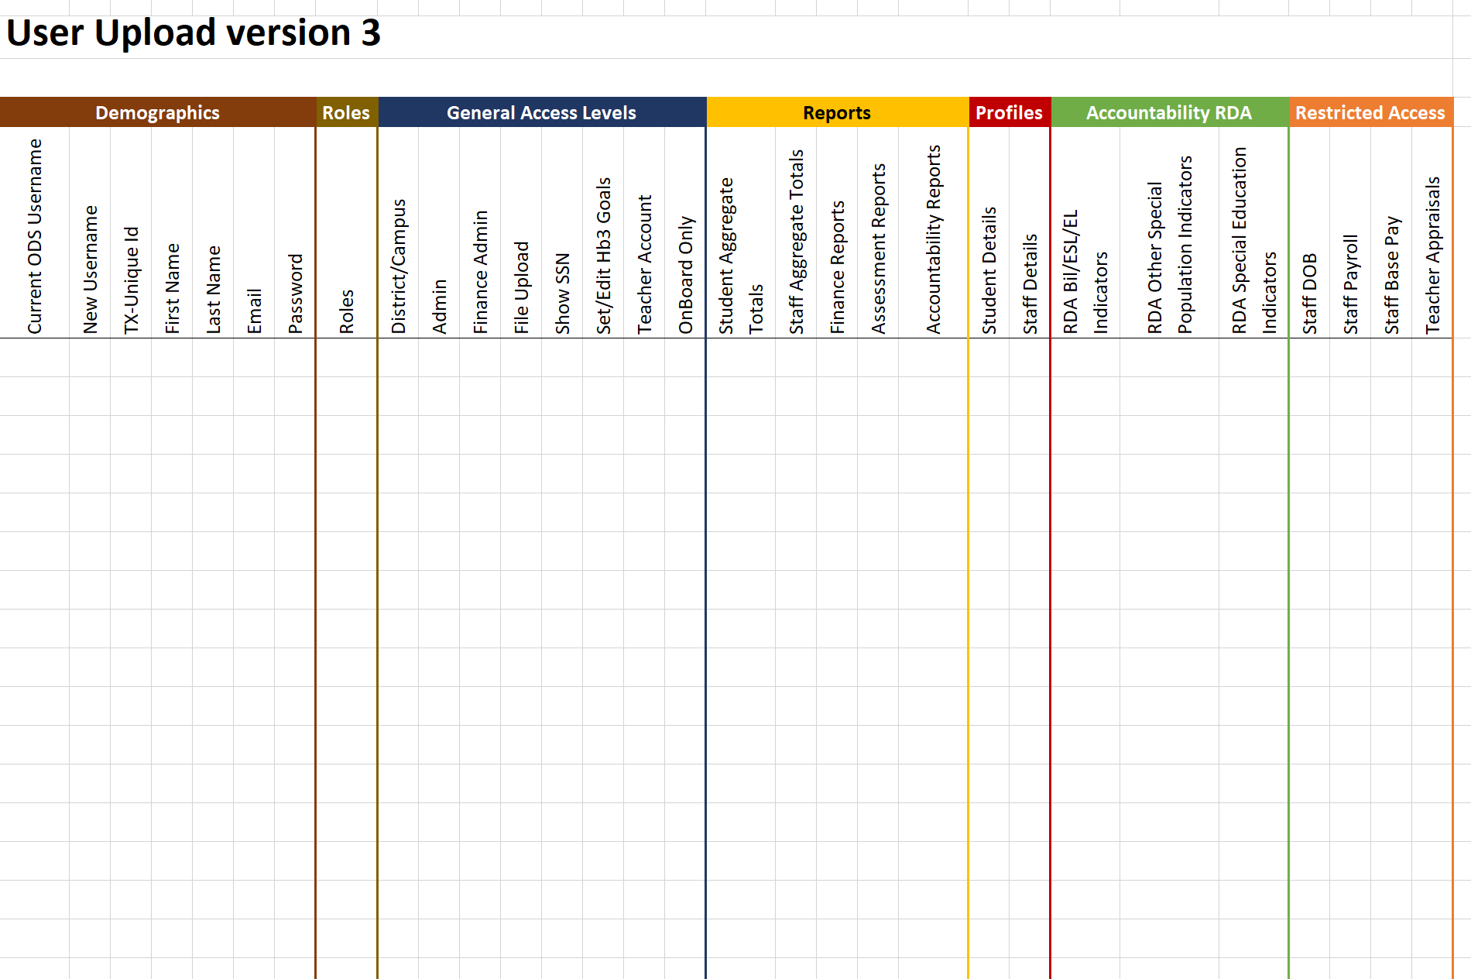
BUILD USER ACCESS LIST
BATCH UPLOAD
List Users
Determine User Access
Upload to Update
KB ARTICLE

Slide 9
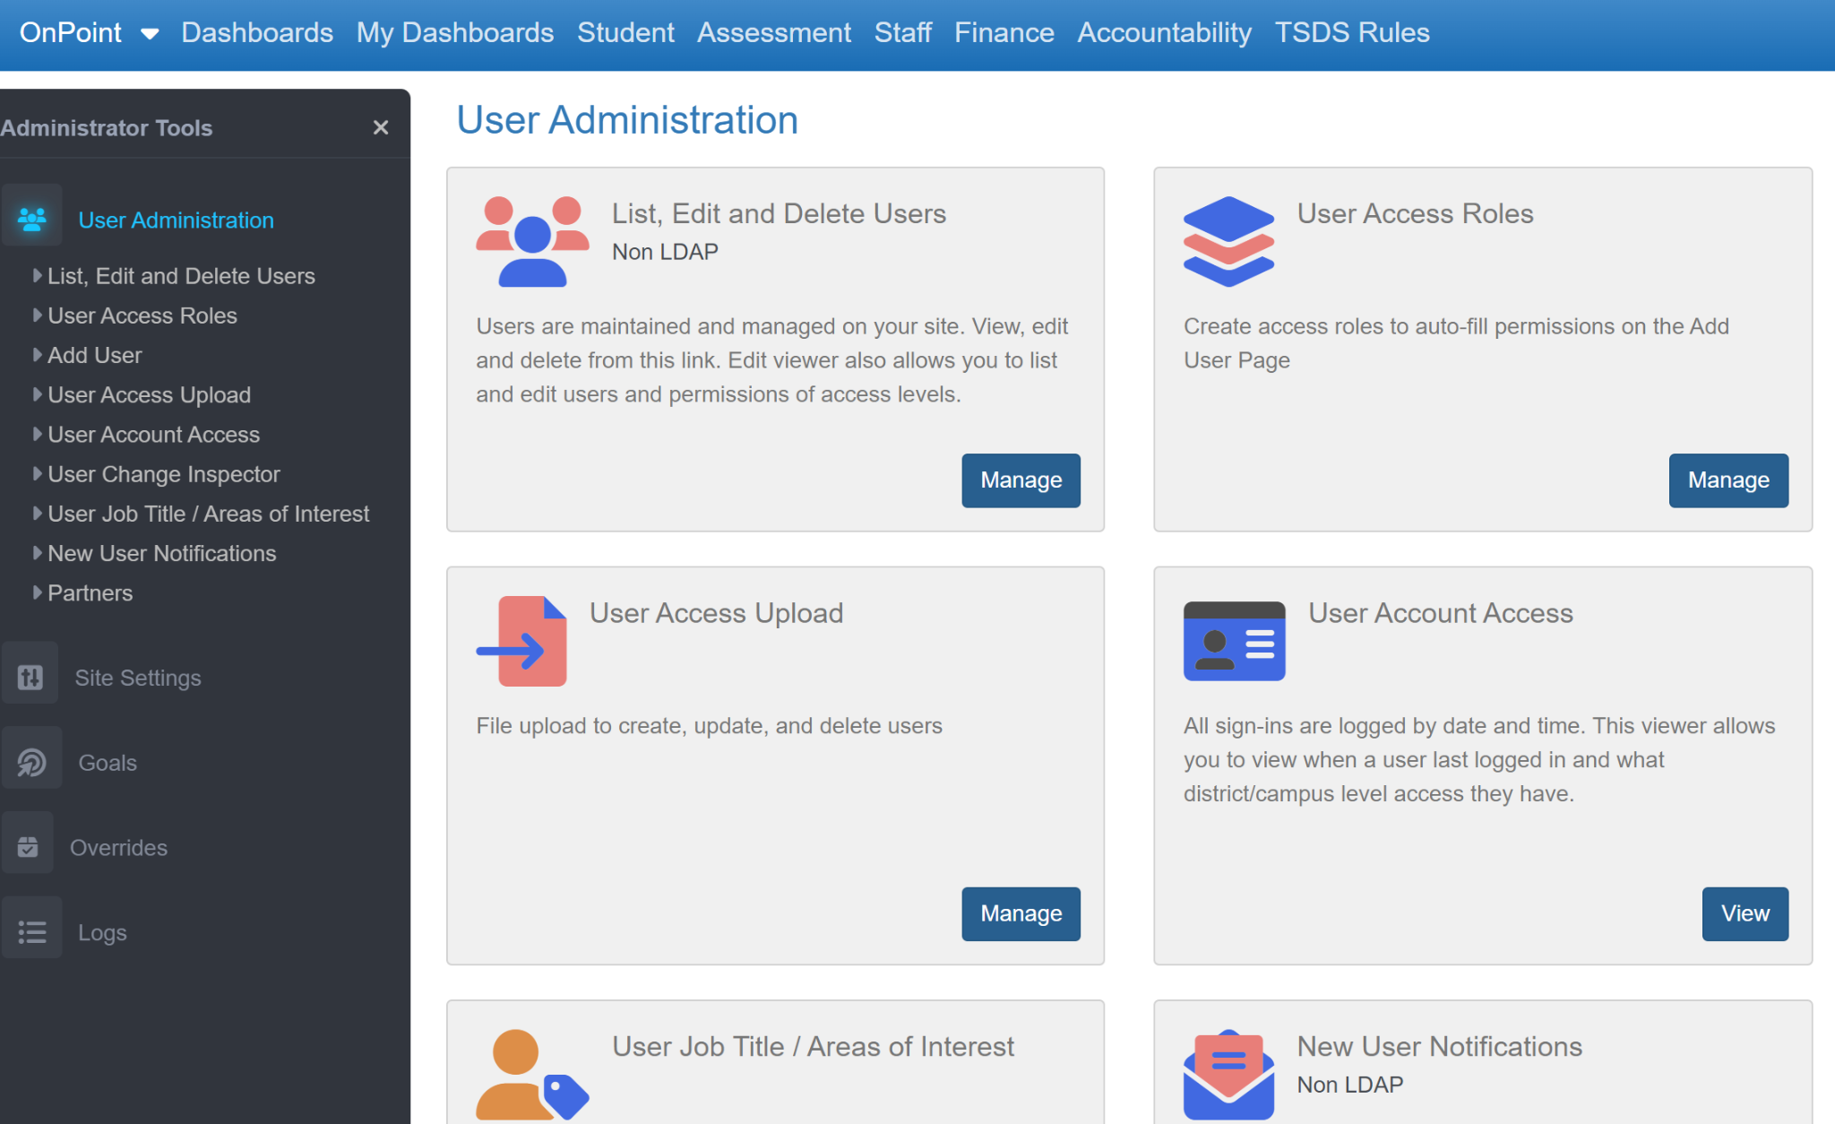
BUILD USER ACCESS LIST

Slide 10
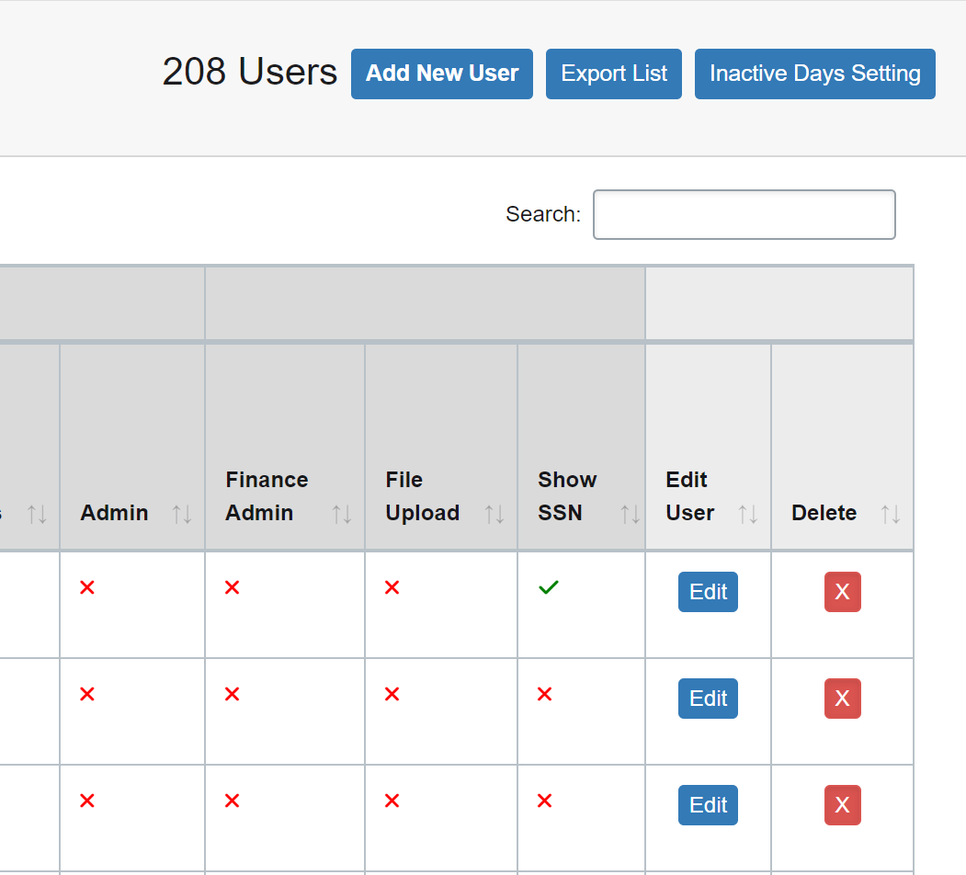
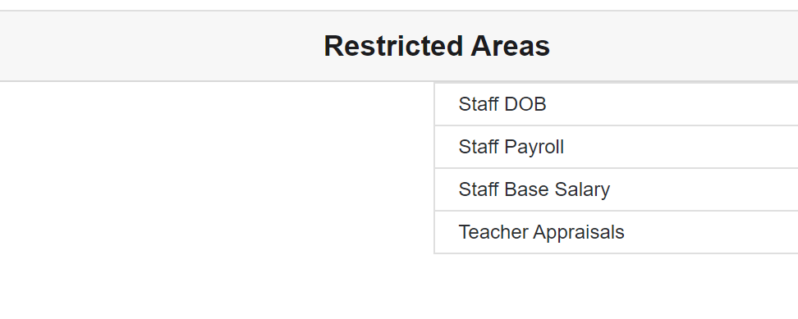
BUILD ACCESS LIST
Manually Add New Users
Be sure to add new district users and remove access for anyone who has left
Export List
Export to Excel
Update Access
**Be careful with STAFF access,
Superintendent approval may be required

Slide 11
Option 1
Option 2
Build Your Own Reports For Verification
(DIY)
Use OnDataSuite Custom Reports For Verification
< OR >

Slide 12
OPTION 1:
DIY (Do It Yourself)
Student Program Verification Sheet

Slide 13
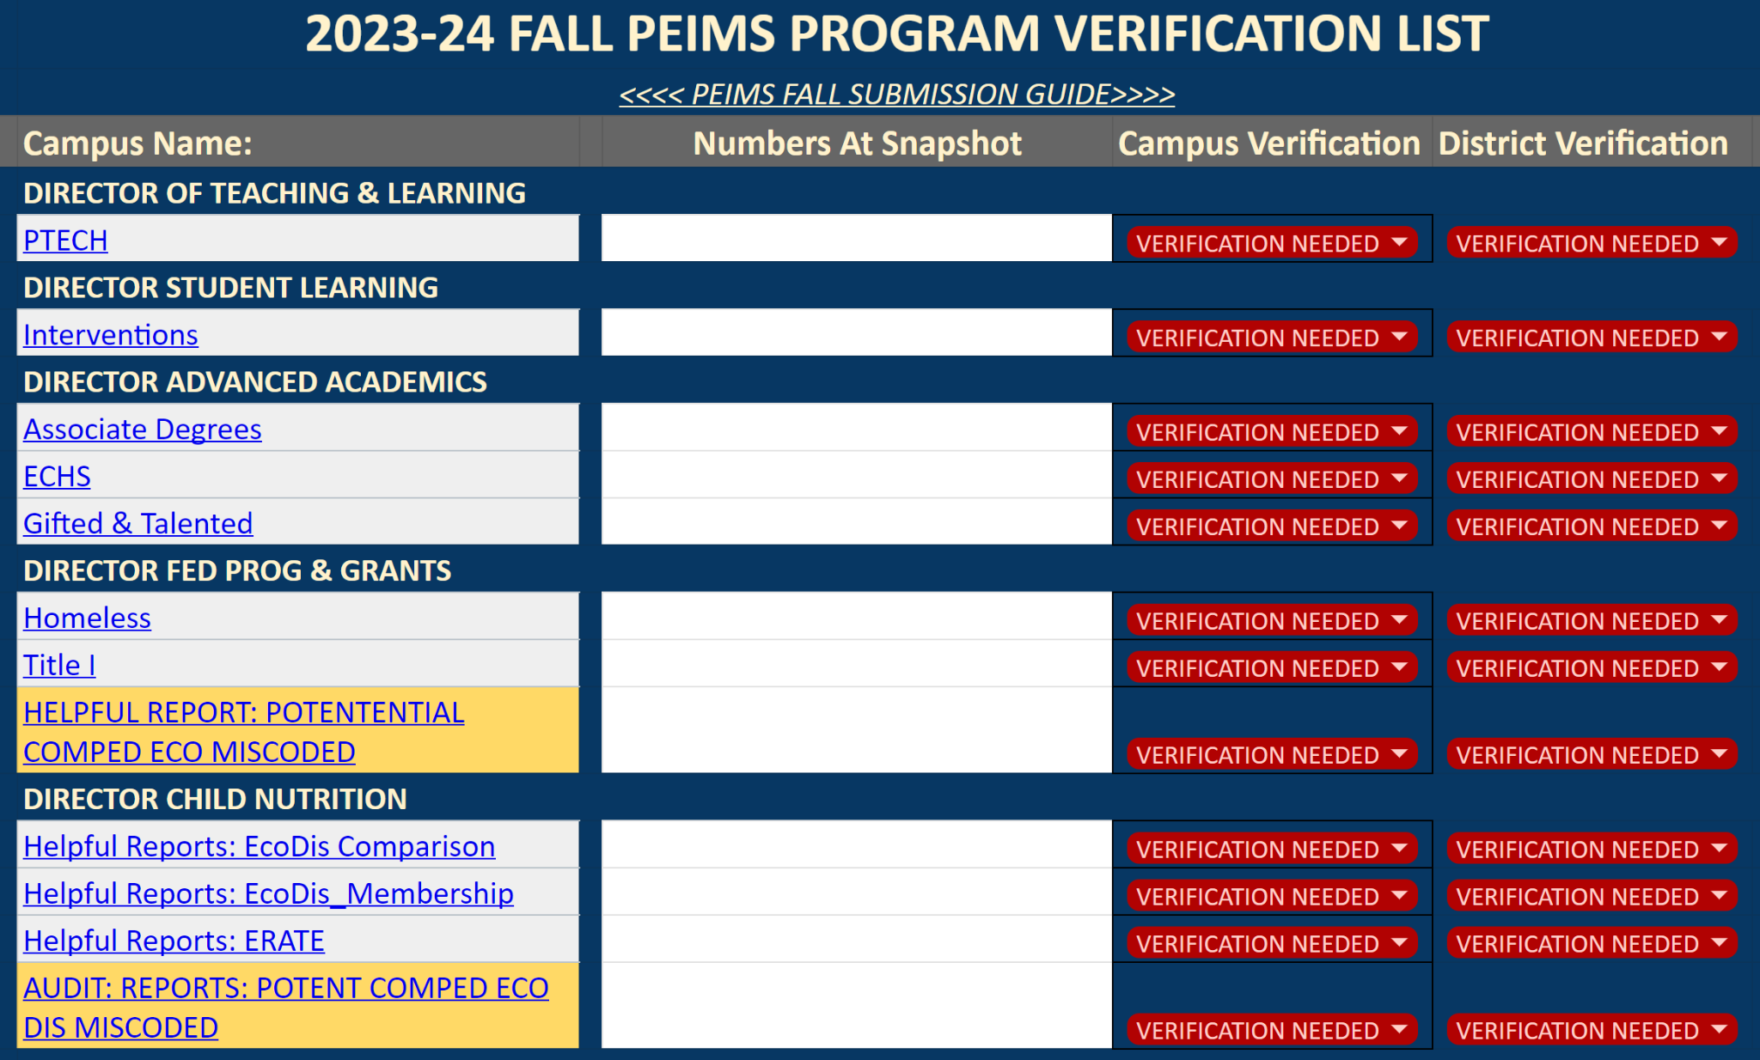
DIY Example

Slide 14
Campus Name
List Who
Will Verify
AdHoc
Reports
Notate Numbers On Snap Shot Day
Verification
Status

Slide 15
OPTION 1:
DIY (Do It Yourself)
Staff Verification Sheet

Slide 16
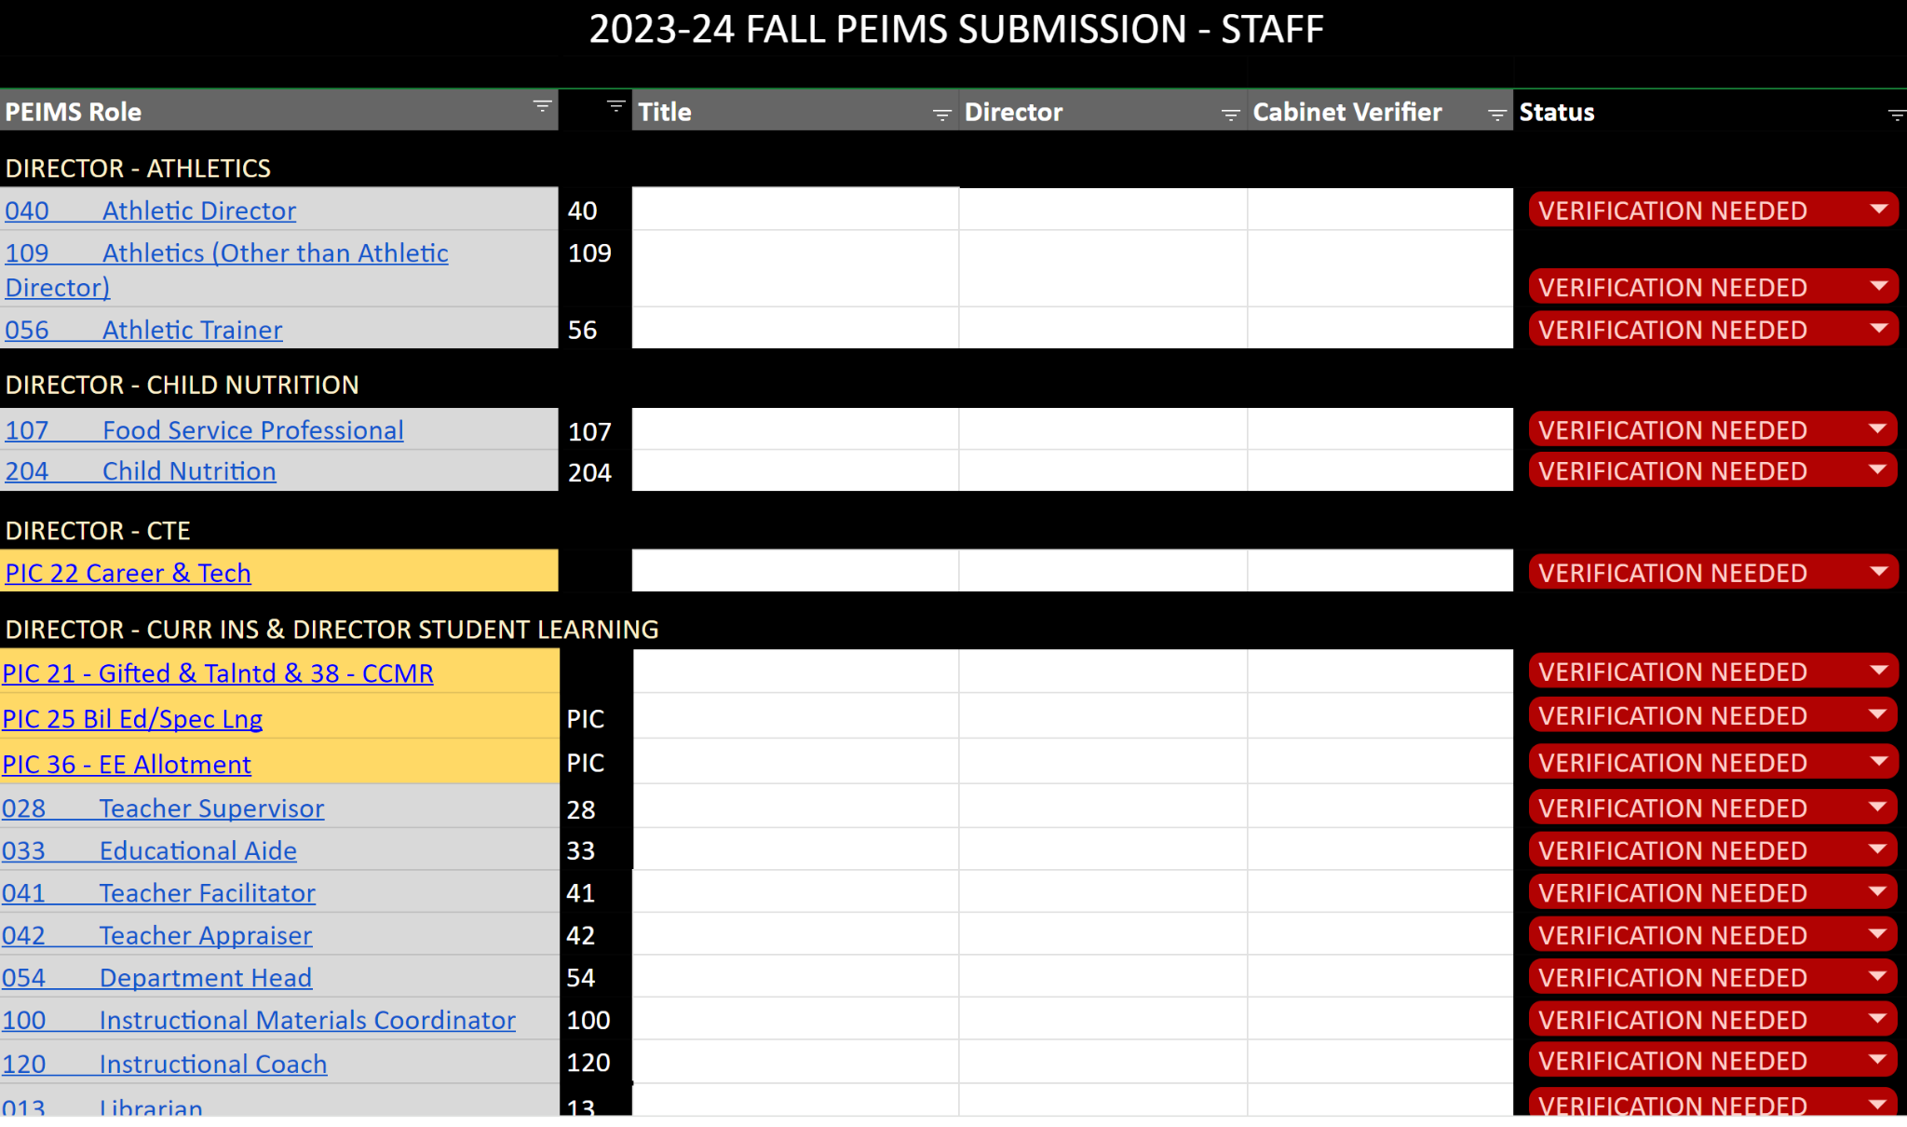
DIY Example

Slide 17
List Who
Will Verify
AdHoc
Reports
Has Data Been Verified?
Verification Status

Slide 18
OPTION 2:
OnDataSuite Custom
Student Program Verification Sheet
KB ARTICLE

Slide 19
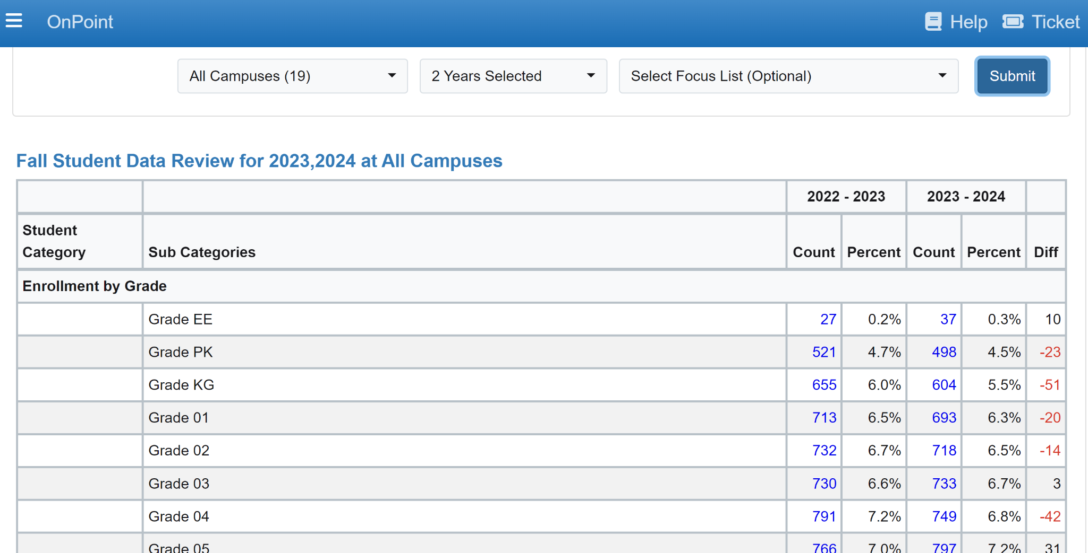
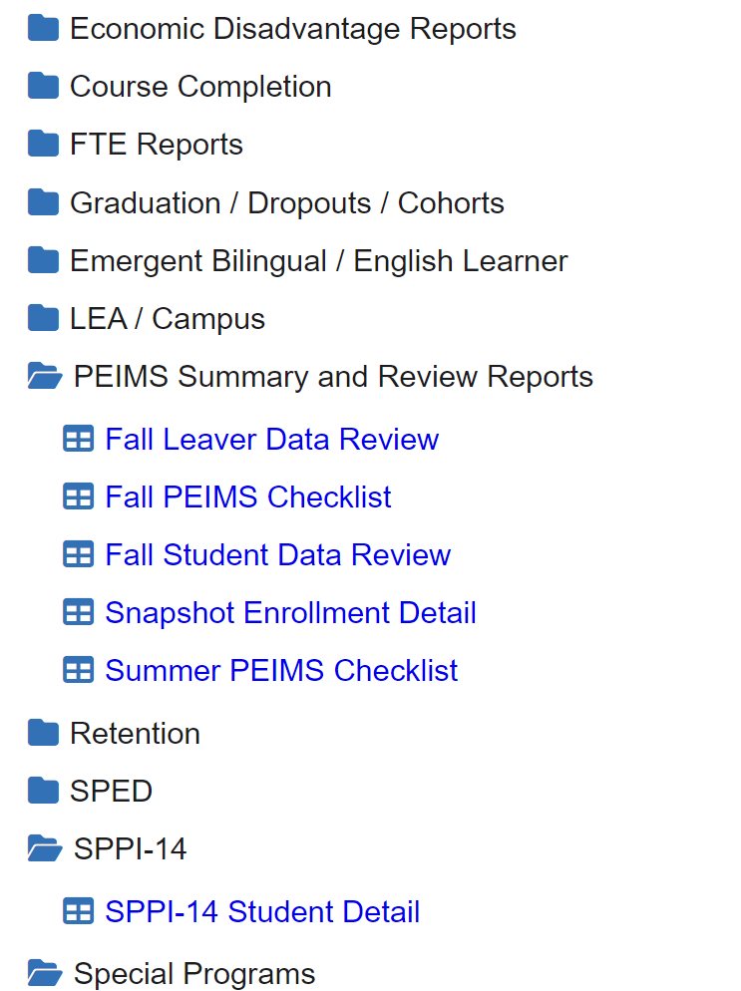
Select one campus
at a time and bookmark
Select TWO years for campus comparison

Slide 20
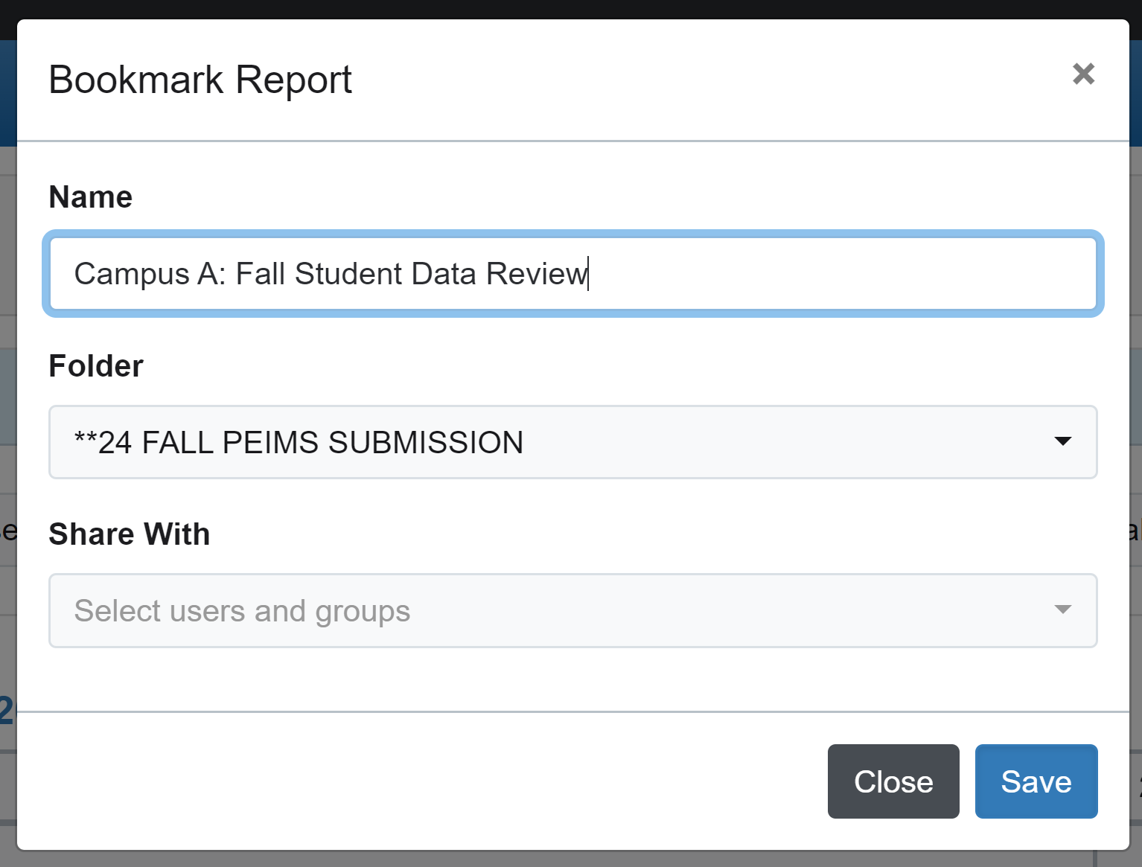
Create a Fall Student Data Review Bookmark for each campus in your district.
Once you bookmark campus data pages, you can share with Campus and District leaders

Slide 21
OPTION 2:
OnDataSuite Custom
Staff Verification Report
KB ARTICLE

Slide 22
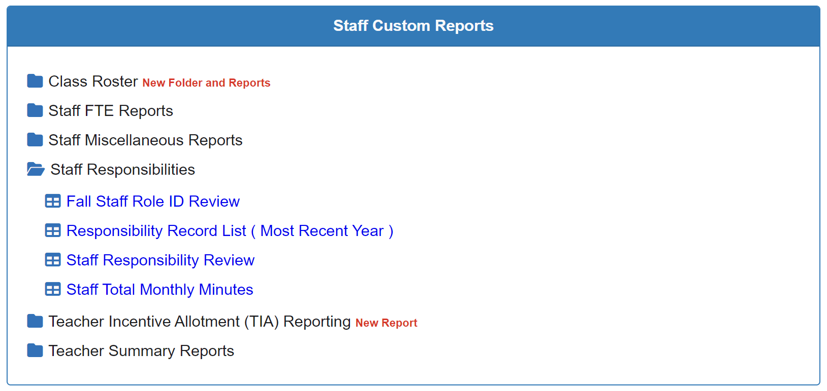
Only Grant Access To STAFF DATA To Approved Users
(Superintendent/Asst Superintendent Approval May Be Required)

Slide 23
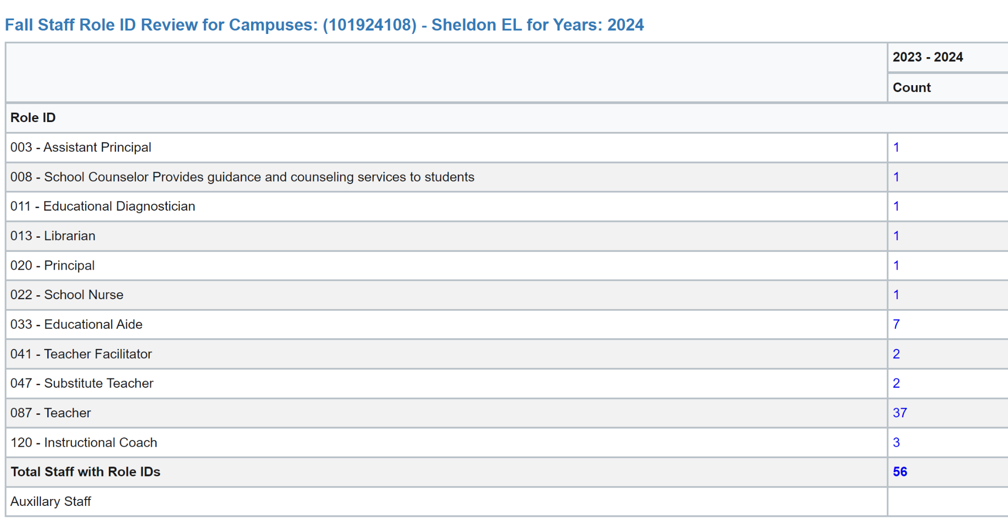
Click on the total number and export to excel for staff verification

Slide 24
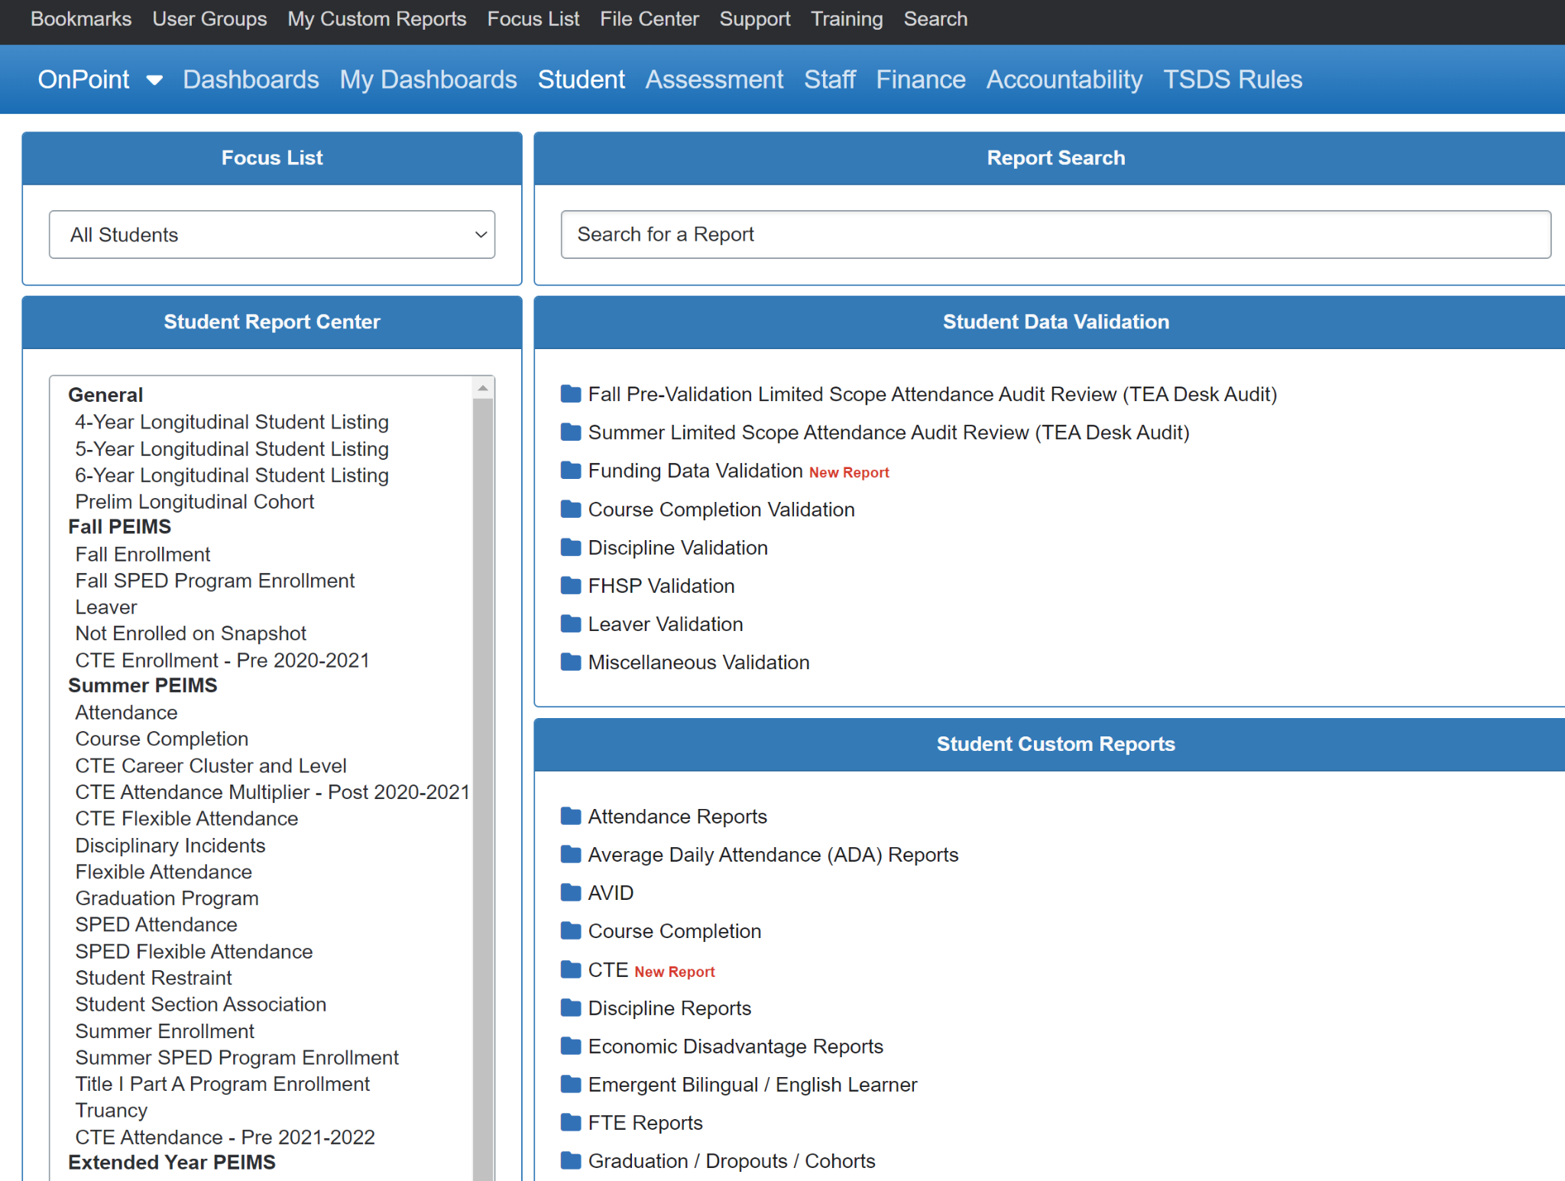
BUILD ADHOC REPORTS
Select Student
Select Fall Enrollment

Slide 25
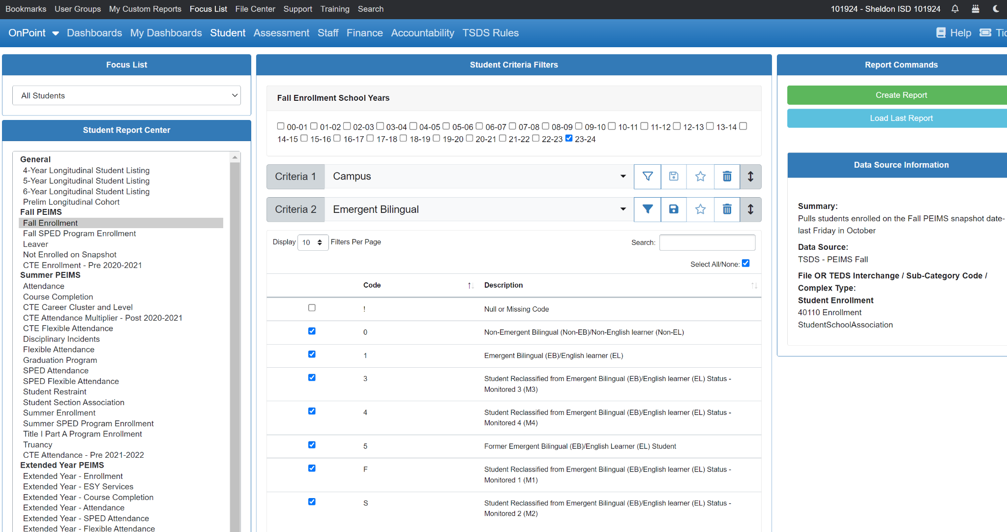
Select Year
Select Criteria
Open Report

Slide 26
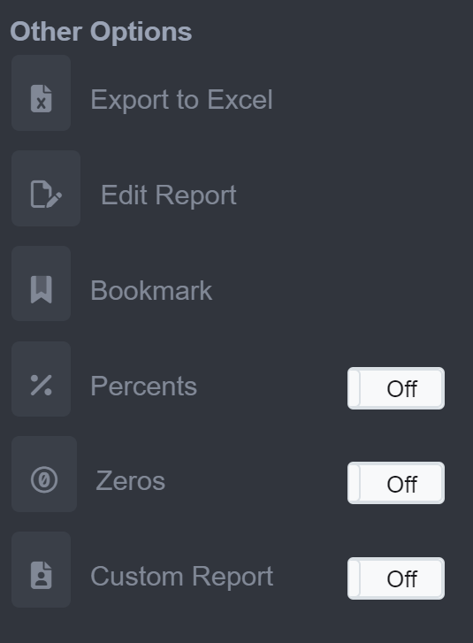
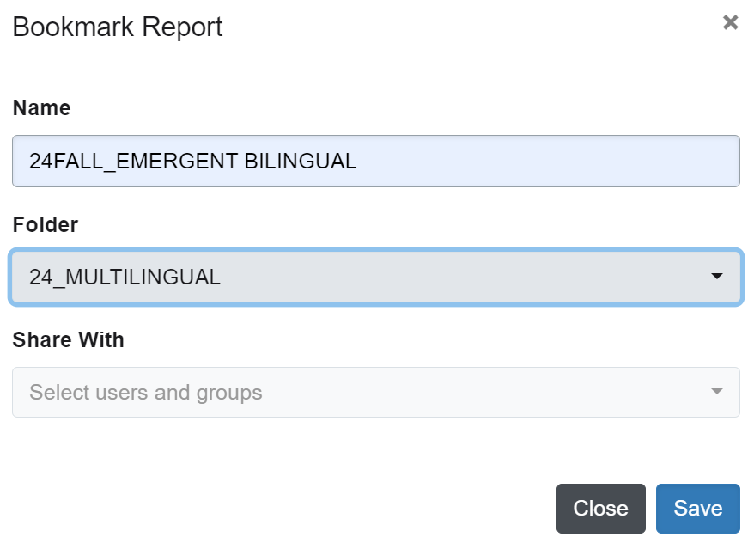
Bookmark
Click on the Bookmark link on the left side of screen
Change name of the your reports to make them identifiable (ex. FALL24_ and SUM24_)
Select the Department Shared Folder who will verify this data

Slide 27
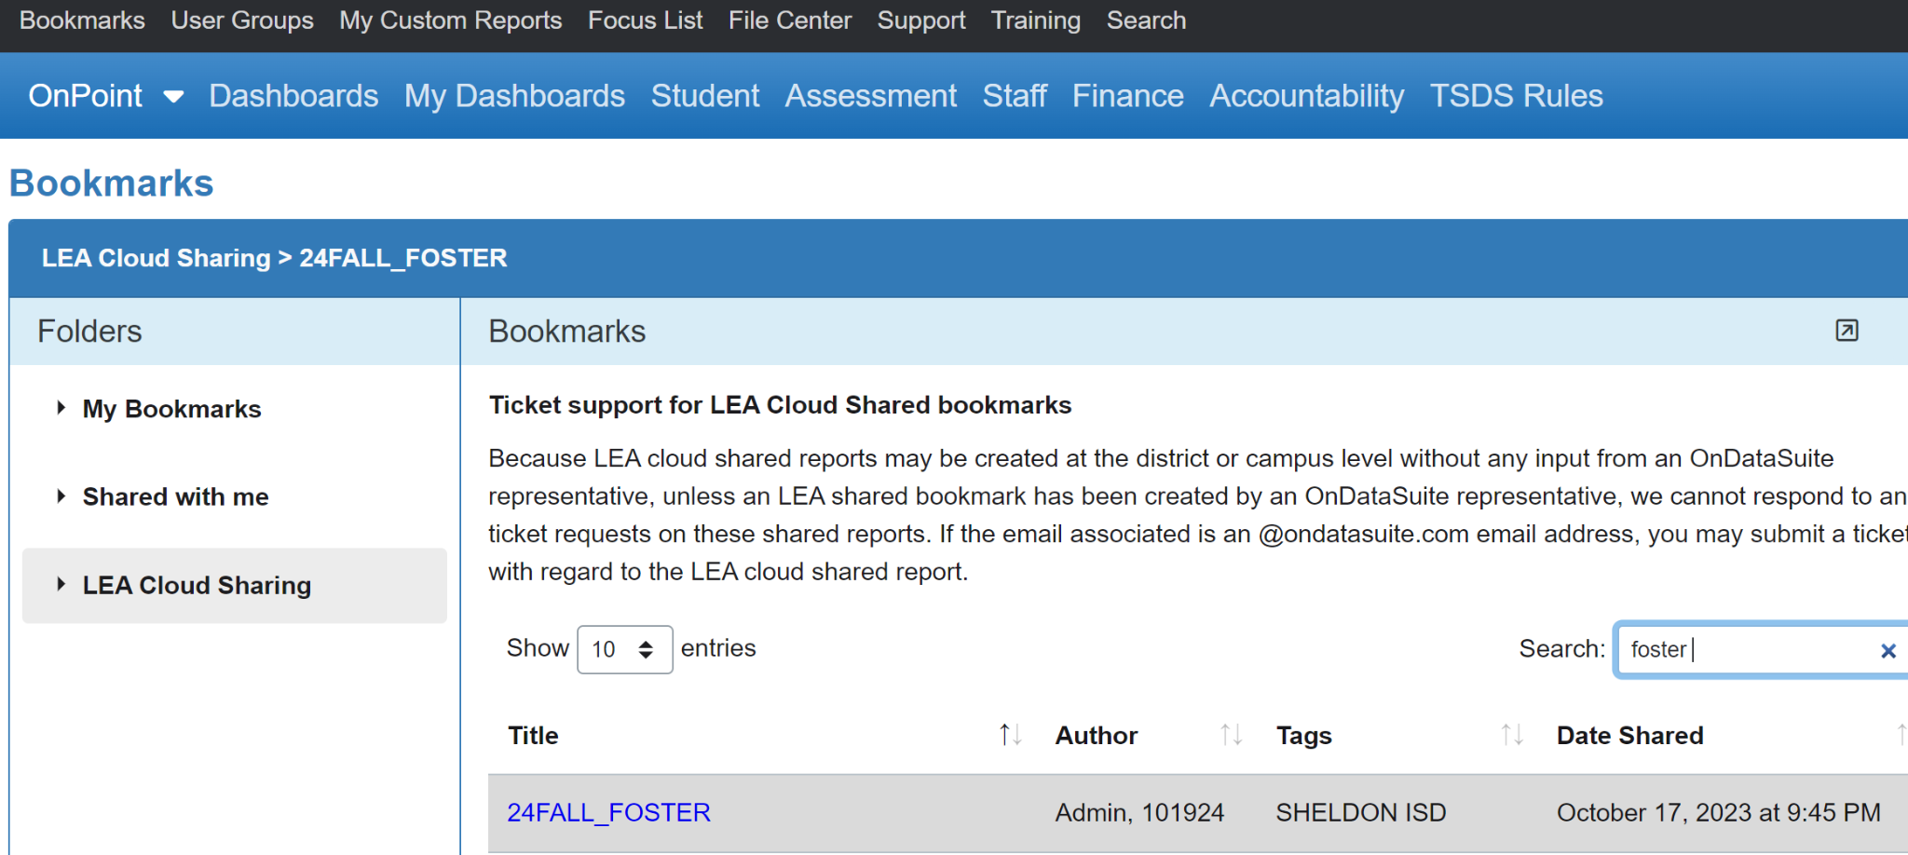
LEA Cloud Sharing: Search “Sheldon ISD” to view

Slide 28
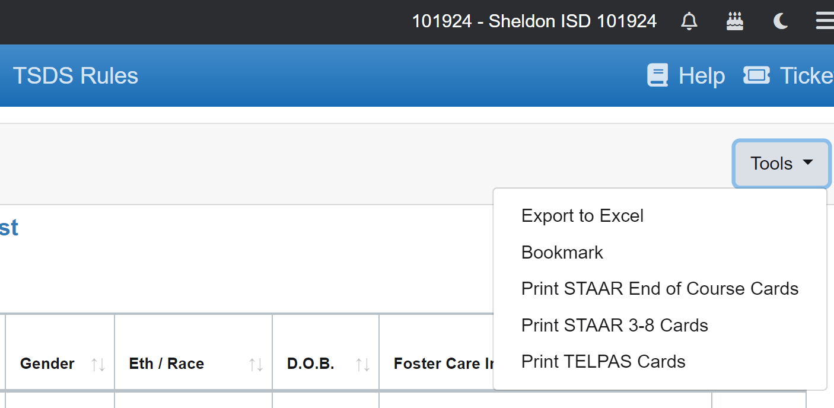
Once you find reports in the Cloud,
click “Tools” and select “Bookmark”

Slide 29
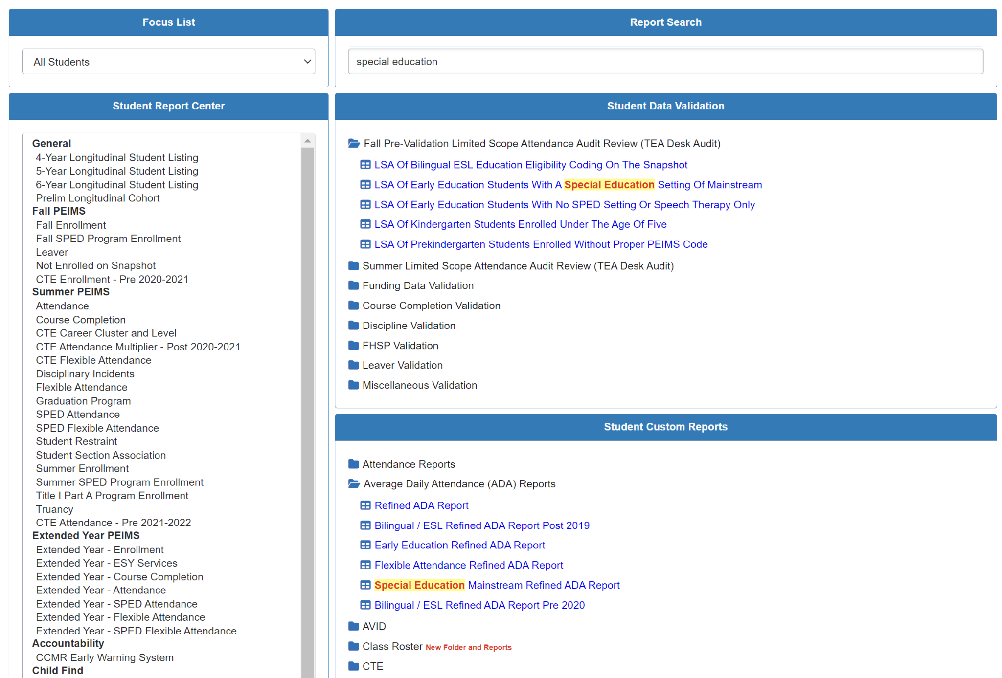
Custom OnDataSuite Reports
Use the search bar to find pre-built reports for your departments

Slide 30
Build Six Weeks Reports
For Departments
To Review/Verify
Search: SUM3_SIX WEEKS
Summer PEIMS Data

Slide 31
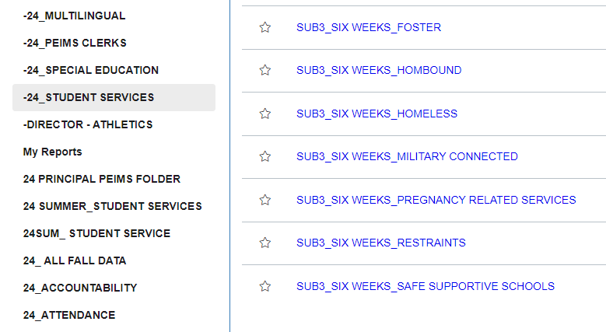
Search Six Weeks Reports
Summer PEIMS: SUM3_Six Weeks_

Slide 32
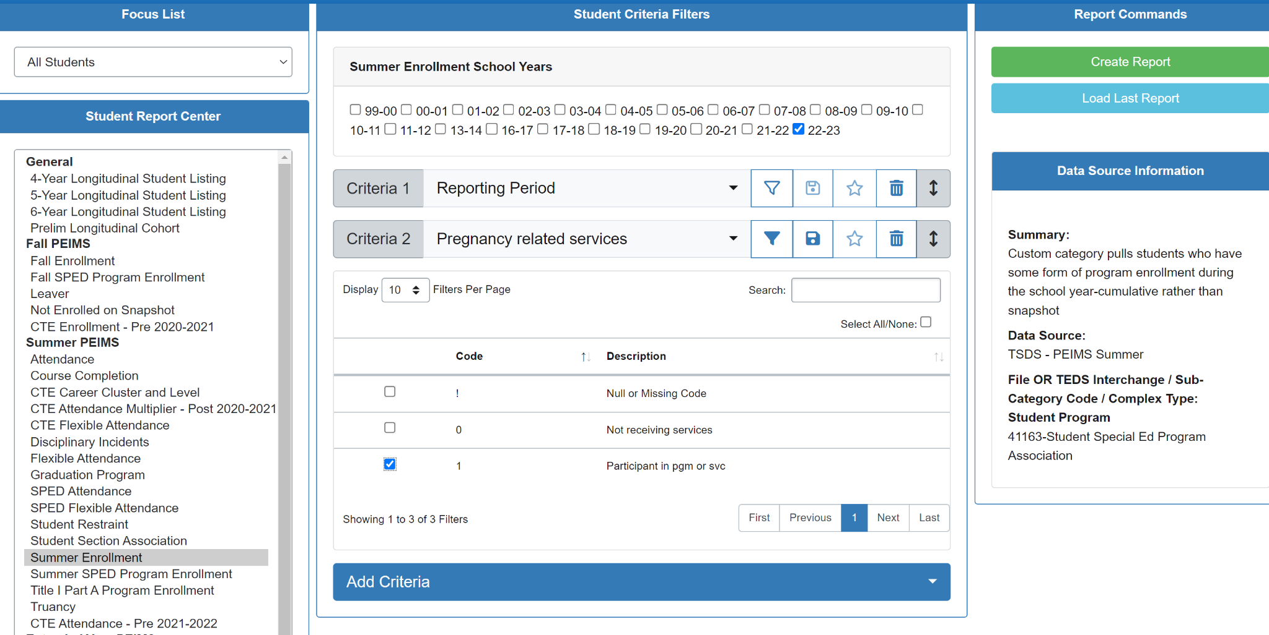

Slide 33
Six Weeks Report - Example 1 (PRS)
Six Weeks Report - Example 2 (EB)

Slide 34
Six Weeks Report - Example 3 (SpEd)
Six Weeks Report - Example 4 (Attendance _Instruct Setting)

Slide 35
More SUM3_SixWks Reports are coming soon.
Fill out the link in the chat
and let us know which
Six Weeks reports
you would
like us to build
for Part II of this
training.

Slide 36
LINK
IT

Slide 37
LINK IT…
Adding Links Fall PEIMS Dashboard
Adding Links Verification List
Adding Links PEIMS Intranet Page
How To Do You Get Links To Your Data Reports?

Slide 38
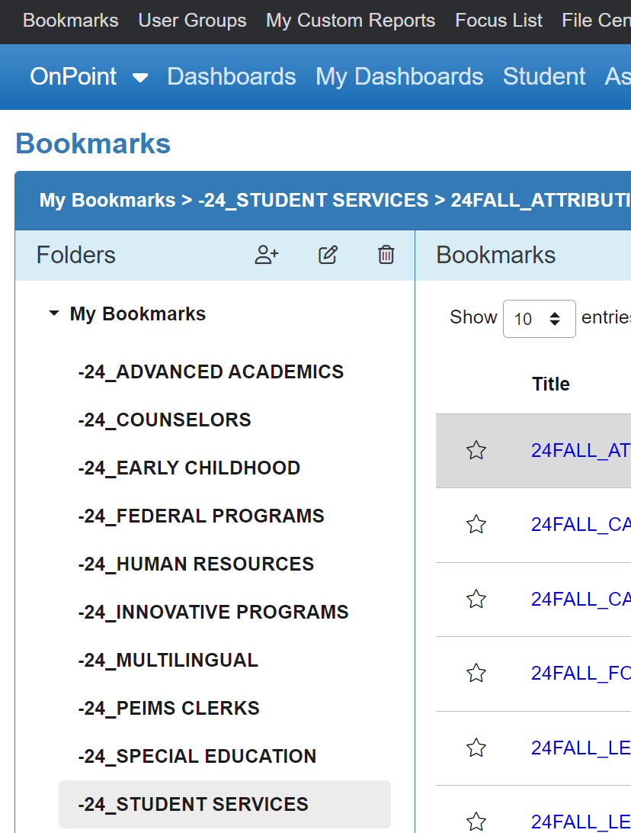
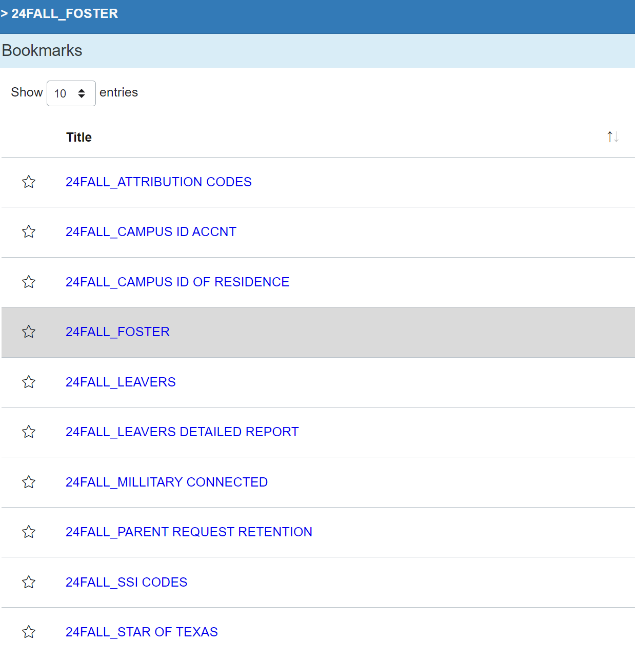
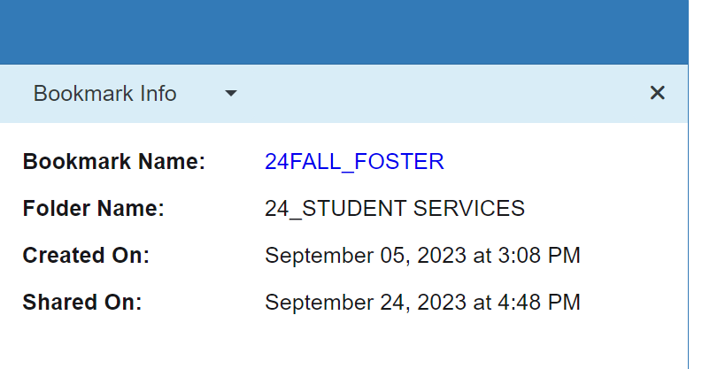
HOW TO COPY LINKS
Click on Shared Folder > Find report >
Right click report link under Bookmark Info “COPY LINK ADDRESS”

Slide 39
Here is an example of how you can LINK REPORTS to
Fall Dashboard to help user easily locate their data
Campus Leaders District Leader Resources
Student Data Student Data Program Verifier List
Staff Data Staff Data PEIMS Website/Resources
Campus Fatal Errors District Fatal Errors Fall Submission Guide

Slide 40
Campus Name
List Who
Will Verify
Link AdHoc
Reports
Notate Numbers On Snap Shot Day
Has Data Been Verified?

Slide 41
Add links to PEIMS intranet page for each department

Slide 42
SHARE
IT

Slide 43
SHARE IT…
Sharing Errors OnDataSuite Notifications
Sharing Folders/Bookmarks
Sharing Report Links via Email
Sharing Report via Email
Sharing OnDataSuite Trainings To Users
How To Share Reports To District & Campus Leaders
How To Do You Share Reports To Users?

Slide 44
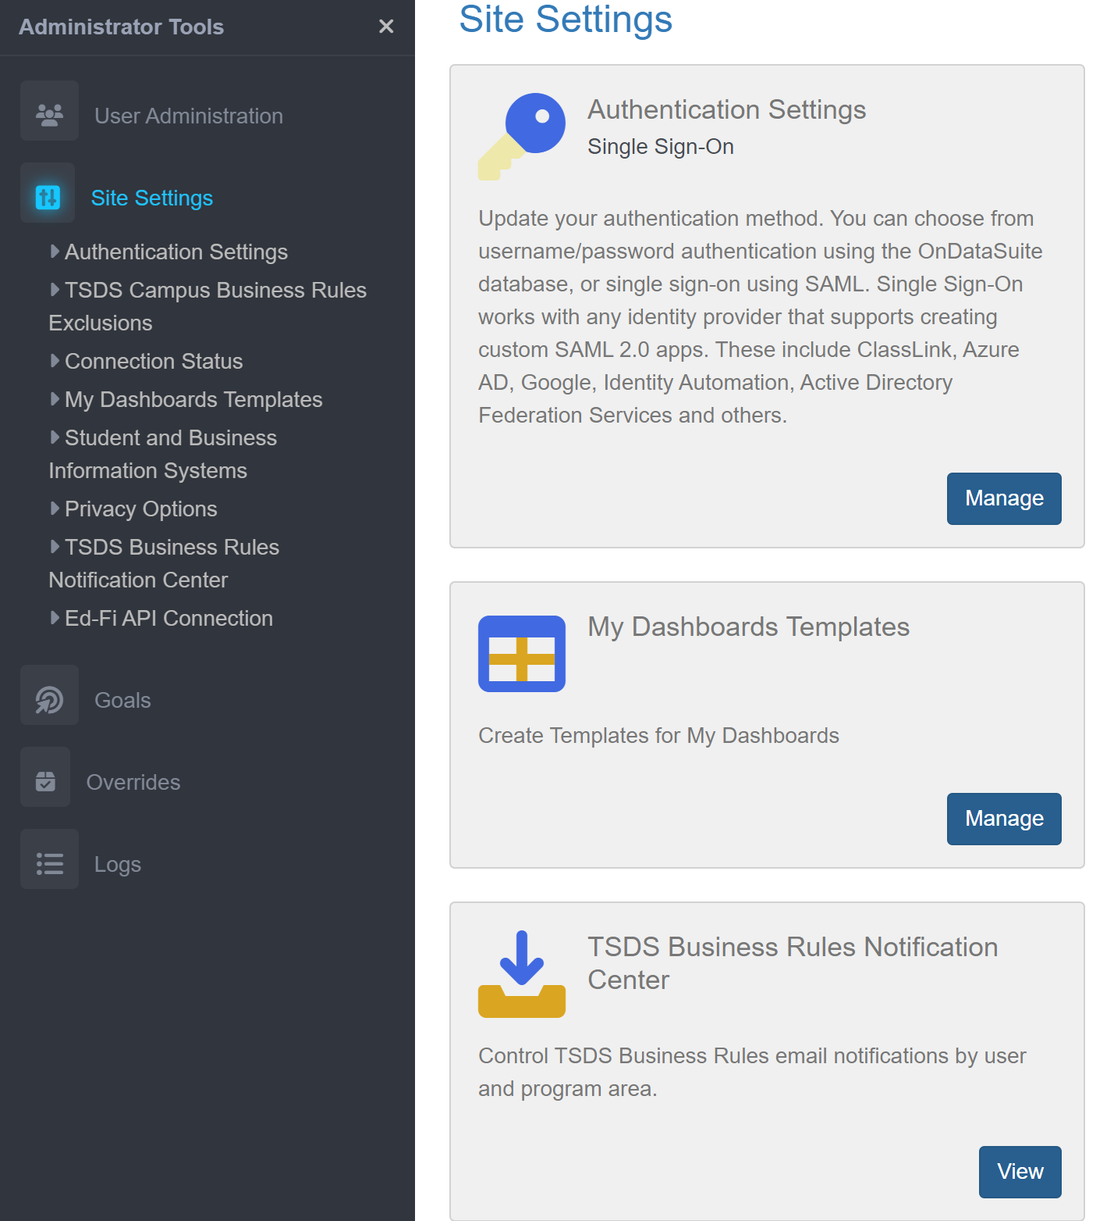
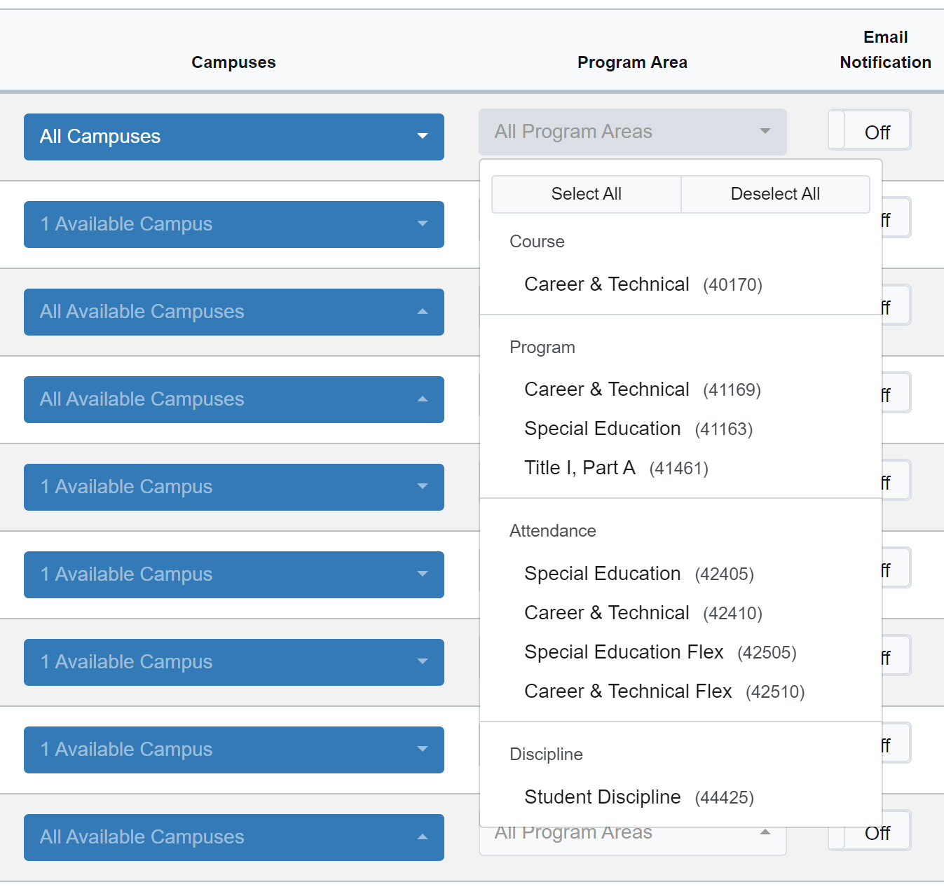
Share It - Turn on Automatic Notifications
Example:
Error Notifications For Assistant Principals
KB ARTICLE

Slide 45
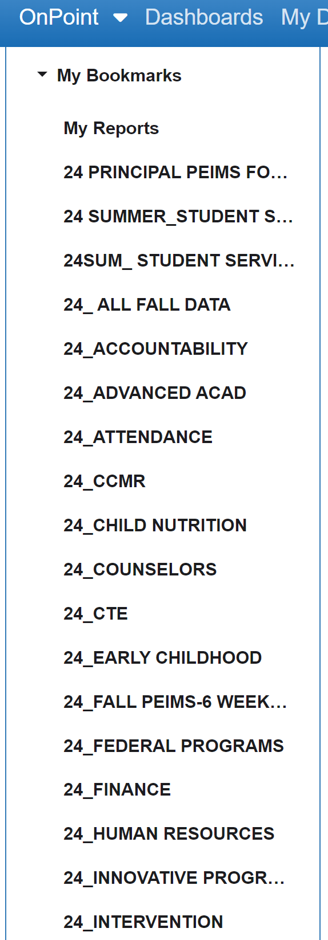
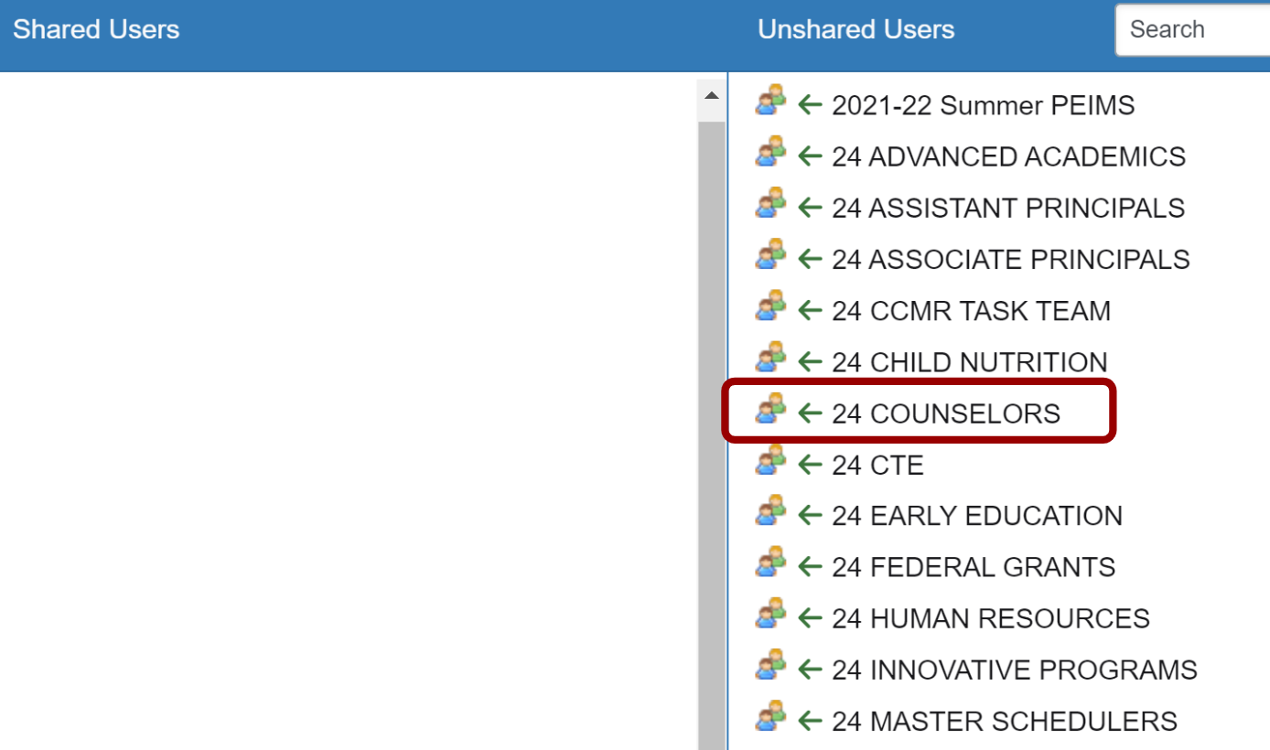
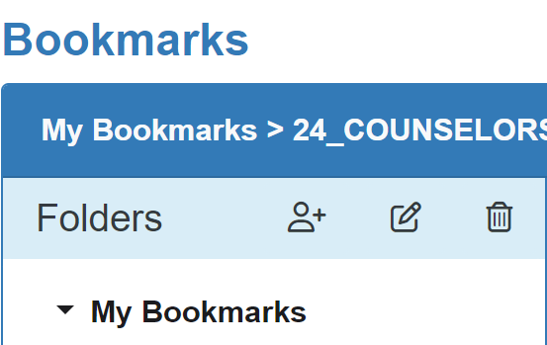
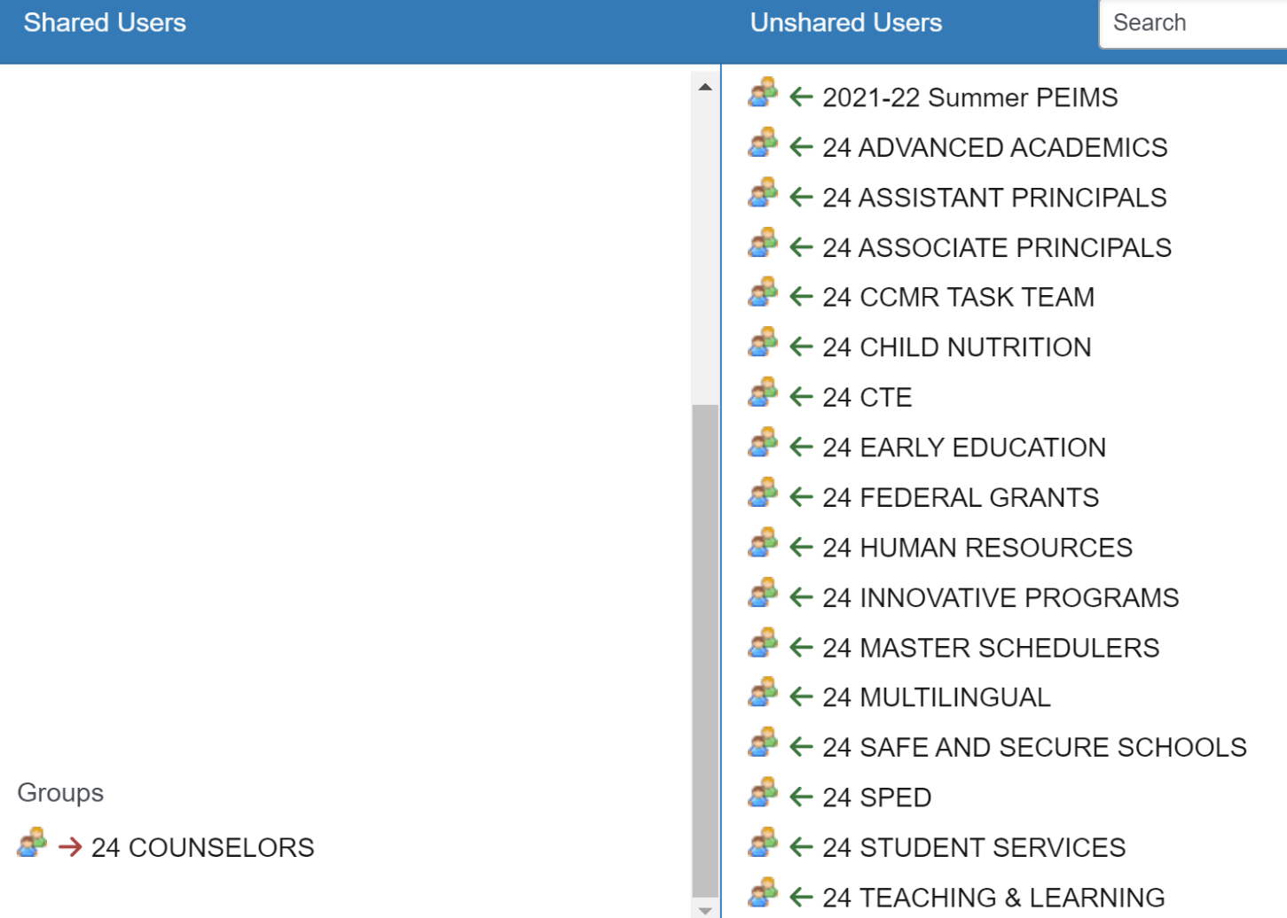
Share It: Build and distribute
data through Shared Folders

Slide 46
Sample Weekly Email To Campus & District Leaders
Good morning,
Each week we will send out helpful OnDataSuite reports to Directors and Campus Teams to assist with verifying data leading up to the 23-24 PEIMS Submission.
Please review your data thoroughly and work with your teams to make adjustments in Skyward as needed.
You can also review your SHARED FOLDERS by visiting: OnDataSuite→Bookmarks (top left corner)—>Shared With Me Folder (bottom left side)
Have an AMAZING week!!!

Slide 47
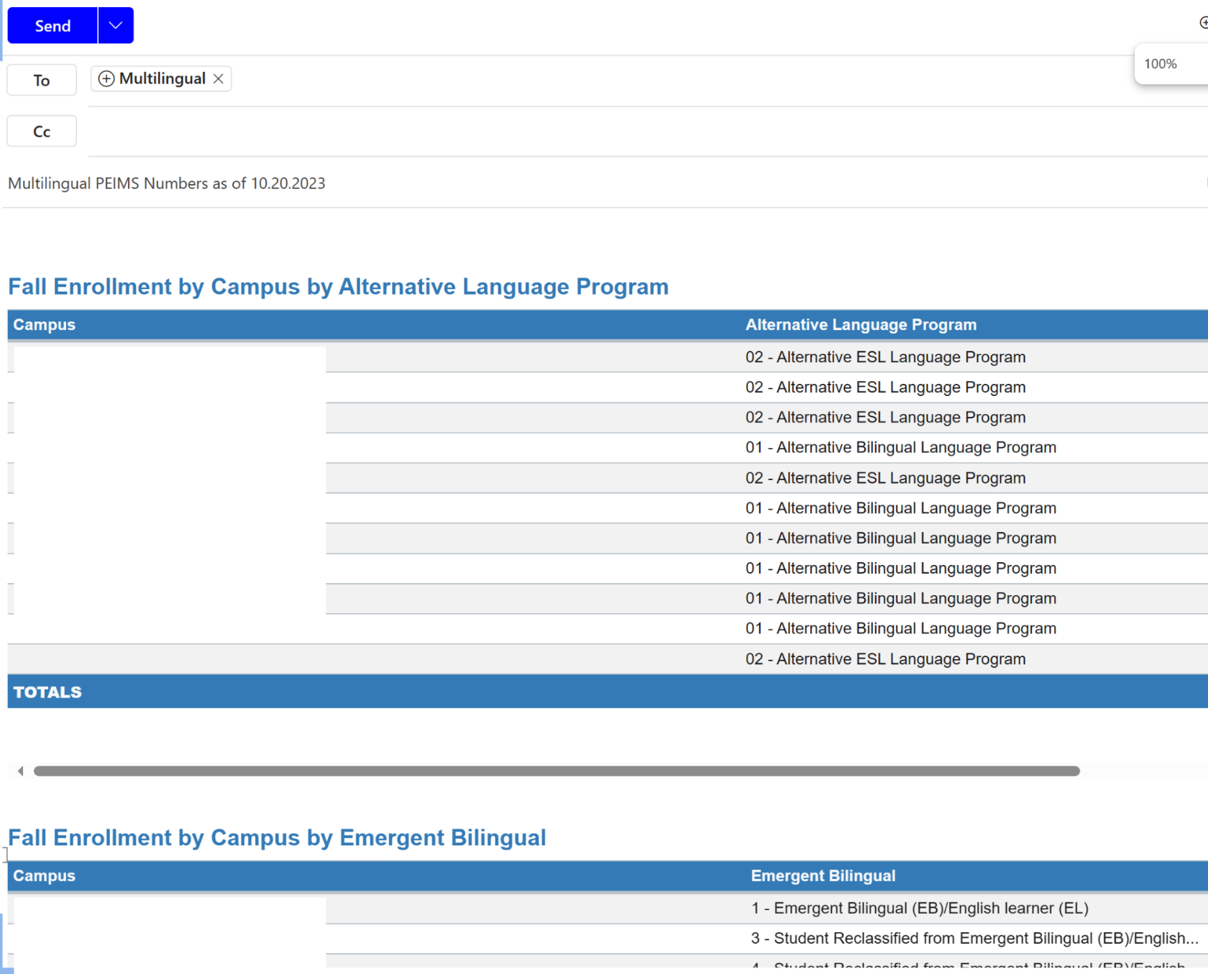
Sample Email
#1
Reports
Fall Sub

Slide 48
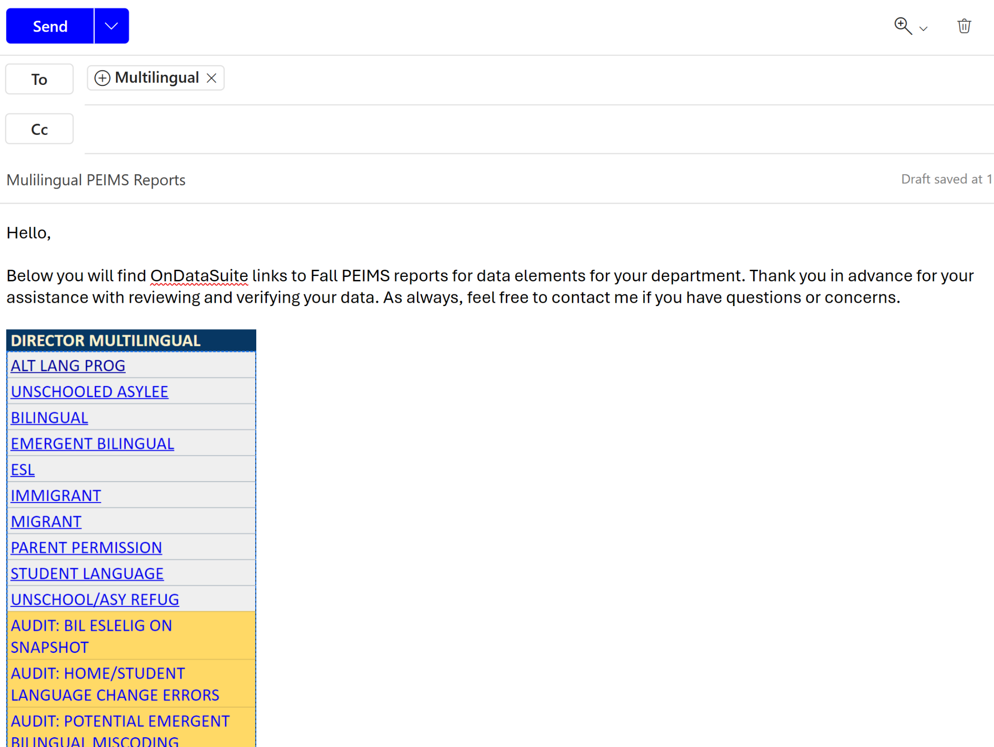
Sample Email
#2
Links Only
Fall Sub

Slide 49
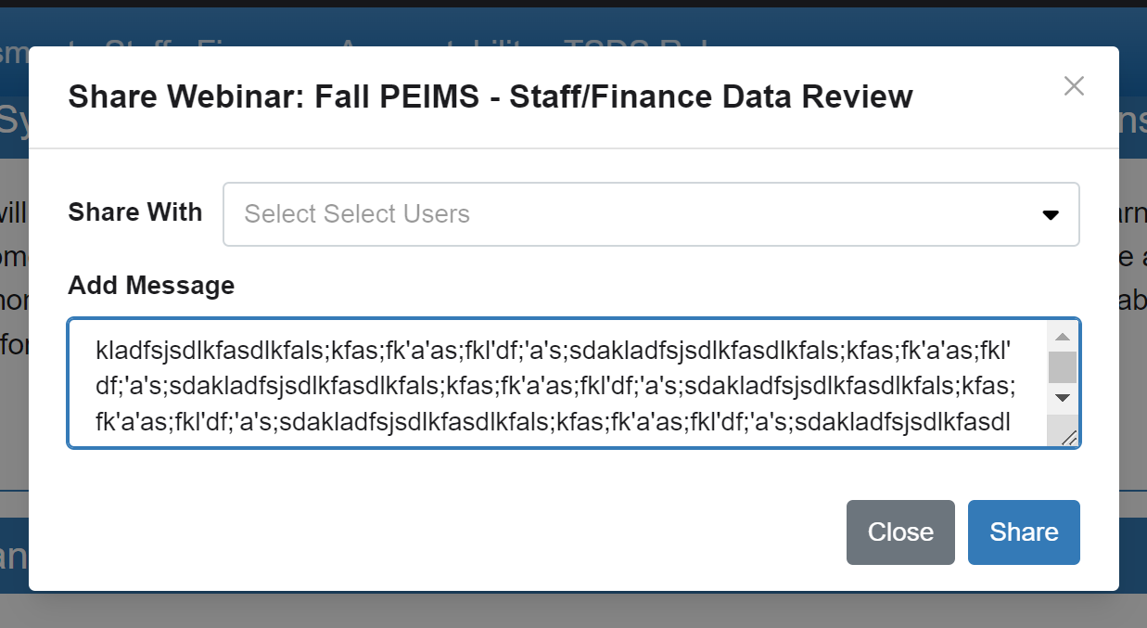
Invite Leaders To Training Session
Select Users
Compose Message
Share Invite

Slide 50
TEACH
IT

Slide 51
TEACH IT…
Teach users where data is located
Teach how to navigate Dashboard
Teach users how to access OnDataSuite Training Videos
How To Do You Teach Users About OnDataSuite?

Slide 52
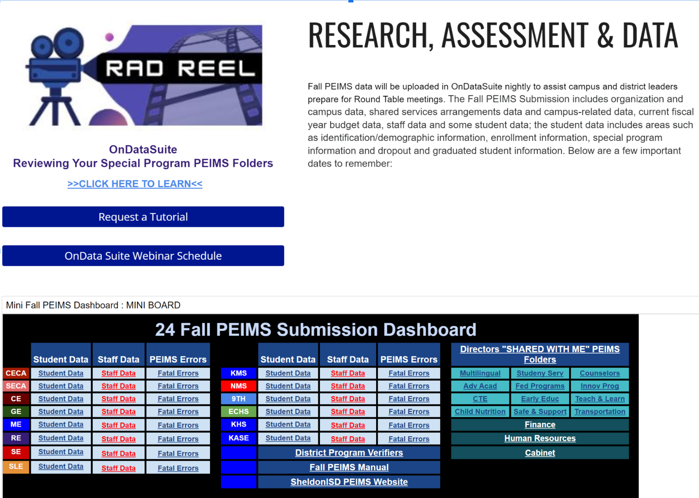
Weekly District
Newsletter
Add helpful OnDataSuite tutorials for district and campus leaders
Include Mini Fall Submission Dashboard to the newsletter weekly for data reviews.

Slide 53
Provide Learning Opportunities On Your
PEIMS Page

Slide 54
Thank You For Joining Us

