Slide 1
ODS Summary of Finance Reports
December 14, 2023

Slide 2
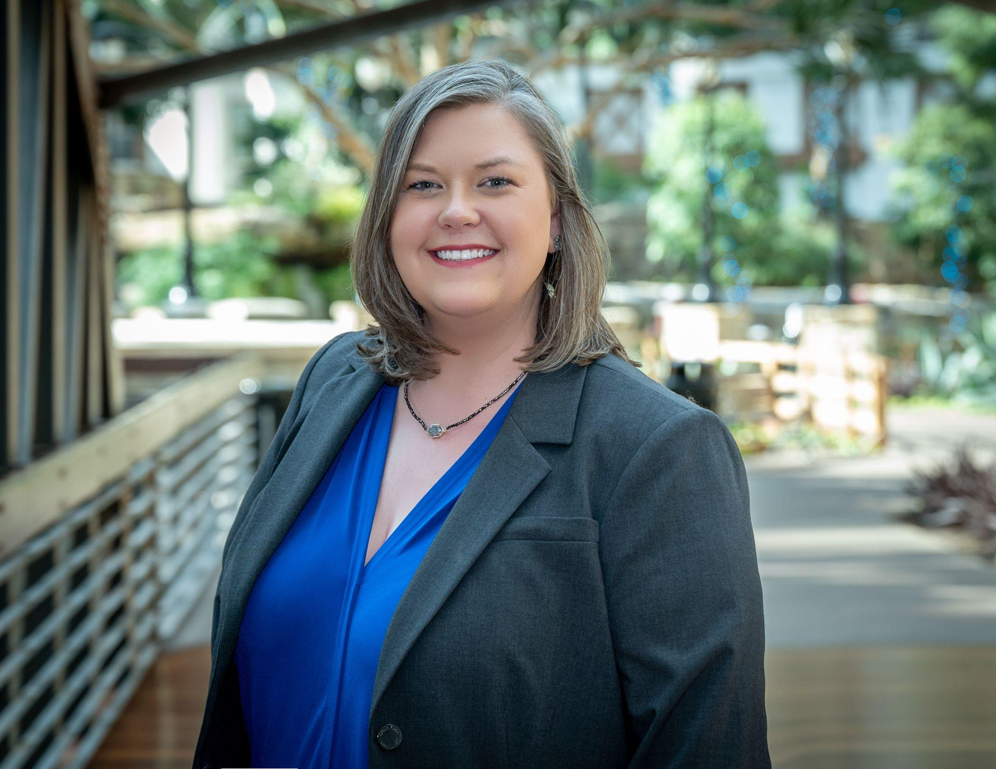
Presenter
Jeffri Orosco, RTSBA
CFO - Elgin ISD
School Finance Experience - 10 years
Districts of various sizes
TASBO Board Member, Mentor, and Capital Area Affiliate Past-President
Contact Information:
Email: jeffri.orosco@elginisd.net
Phone: 512-281-3434

Slide 3
Today’s Workshop
Accessing the Knowledge Base (KB) for resources, training, and support
Overview of using OnDataSuite (ODS) reports to assist with monitoring and completing the Summary of Finance (SOF) template
Please note: PEIMS data files, including Summer PEIMS files, need to be loaded into ODS to begin looking at data and reports
If any files or data is missing, the reports will still generate but have incomplete, inaccurate, or no data

Slide 4
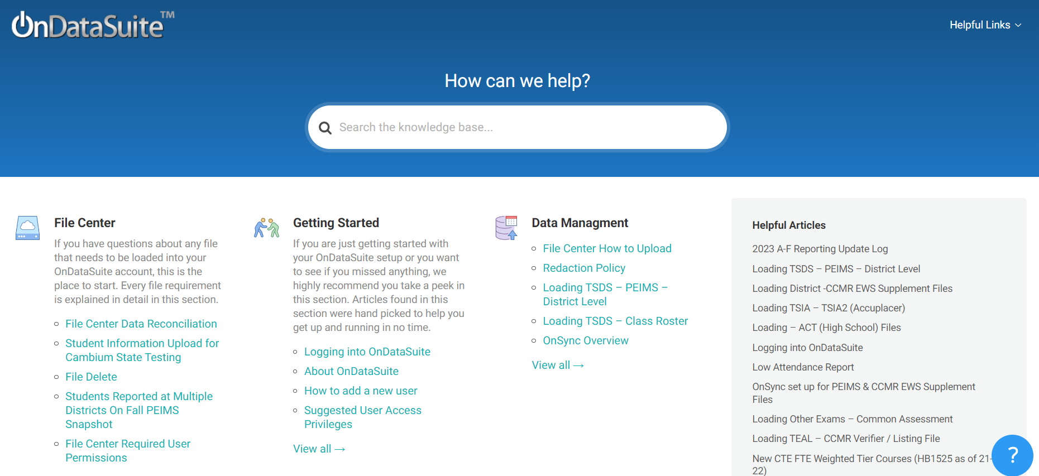
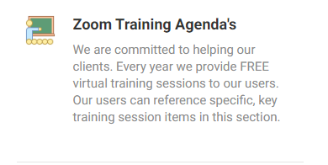
Getting Started - OnDataSuite Knowledge Base (KB)
https://kb.ondatasuite.com/ or by clicking on Help from your OnDataSuite screen in the top right corner
Select Zoom Training
Agendas

Slide 5
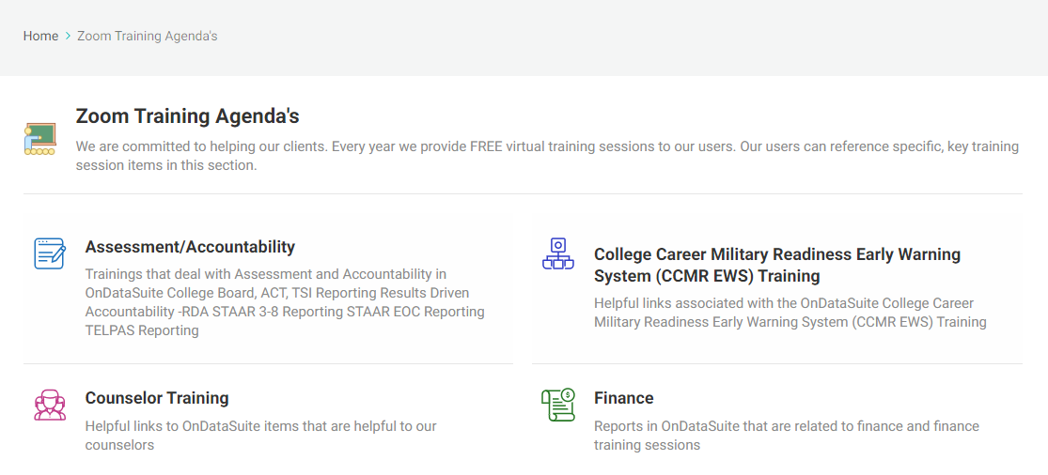
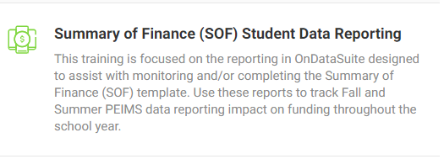
OnDataSuite Knowledge Base
Select Finance
Select Summary of Finance (SOF) Student Data Reporting

Slide 6
Getting Started - Loading Reports
Load your Student Information System (SIS) and Enterprise Resource Planning (ERP/Business & HR side) PEIMS Files into ODS - Must have Administrative Access
File Center in top Black Menu Bar
Data Sources
TSDS - PEIMS
Go down to Green Upload Tab
Browse for Files - all files must be in the same folder before upload if ERP and SIS files are loaded at the same time
Mark as preliminary until final file is ready to be sent to TEA
File Center has helpful video on the process

Slide 7
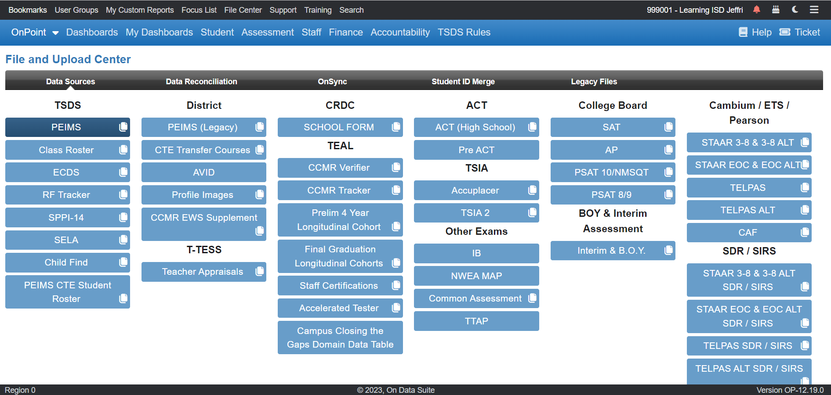

Slide 8
Getting Started - Reports Needed
Reports needed for Summary of Finance (SOF) student data reports based upon HB3 and HB1525 funding requirements are based primarily on Fall and Summer TSDS PEIMS files extracted from district’s Student Information System (SIS)
Required Reports
Prior Years - Fall PEIMS and Summer PEIMS
Current Year - Fall PEIMS and Summer PEIMS
*Current year can be preliminary files but should have the file marked as Final as submitted to TEA TSDS once it is available
*Best practice - update data at least monthly to every six weeks to monitor projected revenue

Slide 9
Getting Started - Reports and Data Generated
HB3 Compensatory Education - Eco Dis/Census Tiers - based upon Fall PEIMS
HB 3 Outcome Bonus (CCMR) Graduate Funding Estimate - based upon OnDataSuite CCMR Early Warning System data sources and Fall PEIMS and Summer PEIMS
HB3 Student ADA - Refined, Flex Attend, SPED Mainstrm, Bil, Early Ed, PEG, Res Facility - based upon Summer PEIMS
HB3 Student FTE - Special Ed, CTE, PRS Post 2021 - based upon Summer PEIMS
HB3 Student Count - Dyslexia Services Report - based upon Summer PEIMS
Gifted/Talented (GT) Funding (HB1525) - based upon Summer PEIMS

Slide 10
OnDataSuite Summary of Finance (SOF) Reports
Log in to your district’s OnDataSuite - OnPoint account
Select Finance in blue bar at top

Slide 11
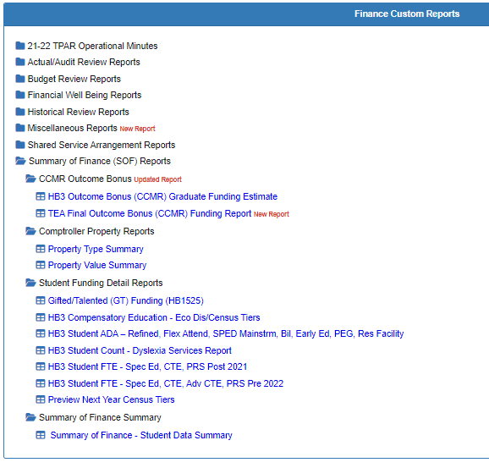
OnDataSuite Summary of Finance (SOF) Reports
Under Finance Custom Reports - select Summary of Finance (SOF) Reports
A listing of folders and reports will be available
*Please note: earliest year to report on SOF is 21-22 based on CTE data restructure; years prior to this would not be comparable

Slide 12
Summary of Finance (SOF) Access and Templates
Finance users will need Finance Administrator, Student Aggregate Total, Finance Reports, and Accountability permissions to access reports
Summary of Finance templates are provided by TEA, under State Funding - District/Charter Planning Tools - State Aide Template 2022-2025
And by Omar Garcia (BOK Financial Securities) with Region 13 - Summary of Finance template (Omar’s Template)

Slide 13
Summary of Finance Summary
Single report of Student PEIMS data needed to complete the SOF template
Report layout follows TEA’s template and closely aligns with Omar’s template
No drilldowns are available on this report
Able to add and see multiple years (back to 2022 when CTE FTE was restructured)
Able to see differences - can toggle this on or off
Prior year numbers are based on prior school year Final Summer PEIMS files
Current year values are based on latest current year Summer PEIMS file loaded, which could include a partial six-weeks period
Unless Finance Reporting Period Override is utilized

Slide 14
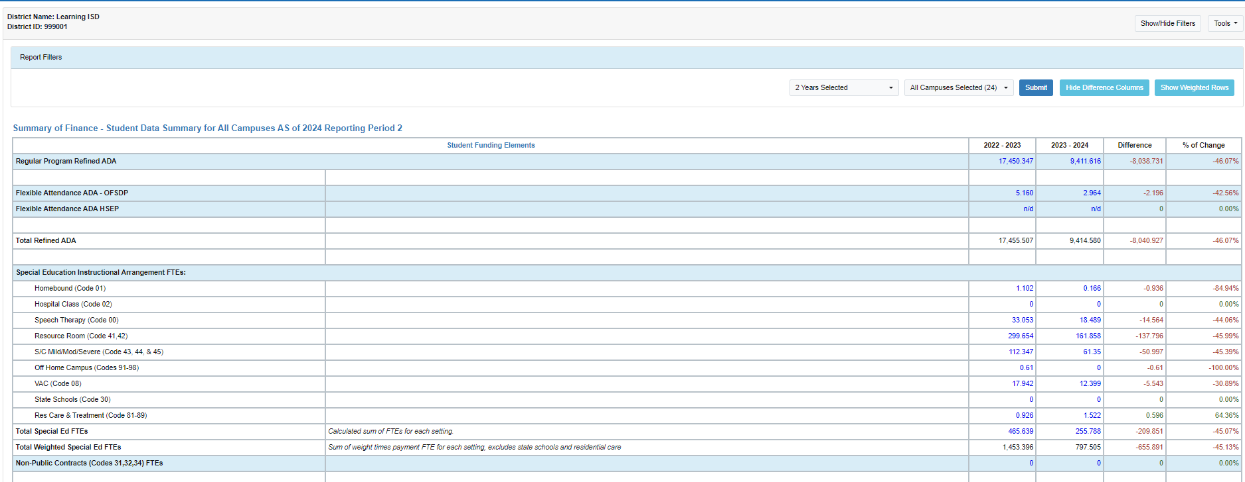
Summary of Finance Summary

Slide 15
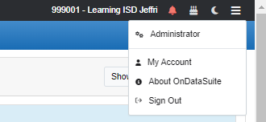
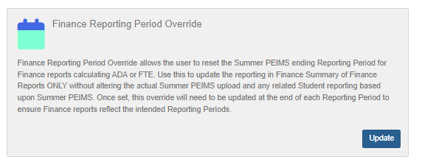
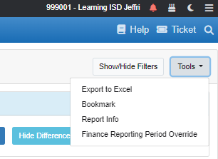
Finance Reporting Period Override
Gives finance users the ability to reset current year Summer PEIMS file reporting period for the SOF reports
Used to adjust when a data file uploaded reflects a partial six weeks reporting period
Can be used to only show attendance related reporting projections through completed six-weeks
Accessable from Administrator Access (top right) - Overrides OR Tools menu on the Summary of Finance Reports
Student Funding Detail Reports
Summary of Finance Summary Report
Select six-weeks period to report on in drop down

Slide 16
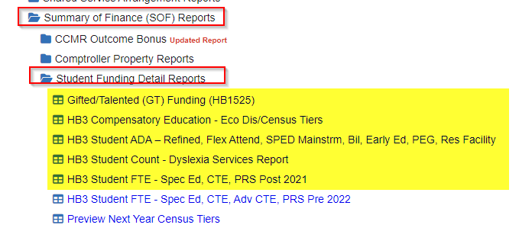
Student Funding Detail Reports
Started with HB3 in 2019 as Student-HB3 Funding reports
As HB1525 and other legislation has impacted school funding, new reports were developed
Includes:
Gifted/Talented (GT) Funding (HB1525)
HB3 Compensatory Education - Eco Dis/Census Tiers
HB3 Student ADA - Refined, Flex Attend, SPED Mainstrm, Bil, Early Ed, PEG, Res Facility
HB 3 Student Count - Dyslexia Services Report
HB3 Student FTE - Spec Ed, CTE, PRS Post 2021

Slide 17
Student Funding Detail Reports
Gifted/Talented (GT) Funding (HB1525)
Provides student data specific to the HB1525 funding as of 2021-22
Allotment was reinstated allowing up to 5% of the LEA’s ADA to receive a GT allotment for TG students served
Student Count - participating in GT indicator code for Summer PEIMS
Limited to 5% of current year refined ADA - other columns show this calculation through Current Year ADA and 5% of this number for the GT limit

Slide 18
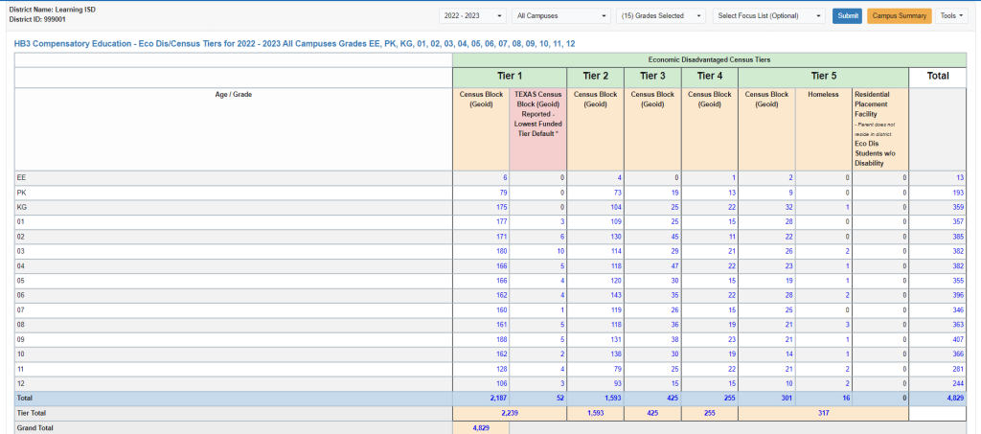
Student Funding Detail Reports
HB3 Compensatory Education - Eco Dis/Census Tiers
Census Tiers are mapped during TSDS Fall PEIMS files based on the Student Census Block Group and respective year TEA Census Block Tier Mapping file
This is preliminary for 2024, as after Fall PEIMS counts are reviewed and reconciled will a new and rebalanced SCE tier to Census Block Group Code spreadsheet be provided
NOTE: Funding may change - TEA’s updated file is expected in spring 2024 (March-April), ODS will reload everyone's data with new reports

Slide 19
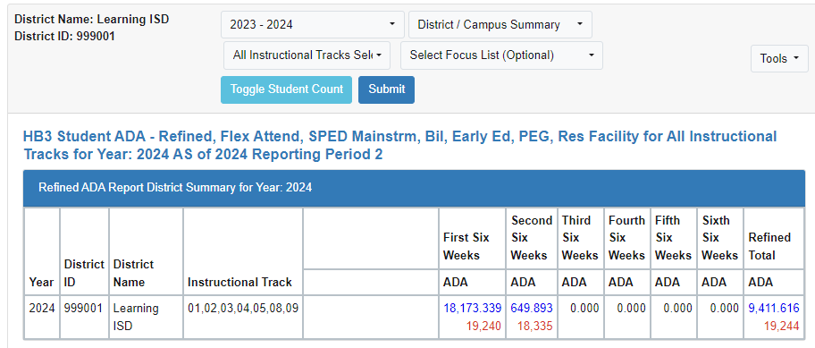
Student Funding Detail Reports
HB3 Student ADA - Refined, Flex Attend, SPED Mainstrm, Bil, Early Ed, PEG, Res Facility
Compiles individual student custom ADA reports by funding area into a singled report
Individual ADA reports are also available in Student - Average Daily Attendance (ADA) Reports
This report is able to filter on year, campus, instructional tracks, and focus list using the drop downs
Can also show number of students by using the Toggle Student Count button - numbers will show in red

Slide 20
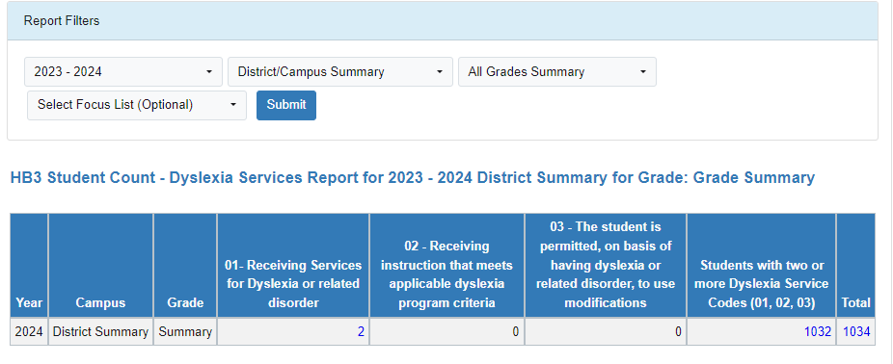
Student Funding Detail Reports
HB3 Student Count - Dyslexia Services Report
Summer PEIMS file must be loaded that includes Dyslexia Services Code
Counts include unduplicated Student count as students may report more than one Dyslexia Service Code
Use Total number for final count for HB3 funding
Can filter on year, campus, grades, and focus list using drop downs

Slide 21
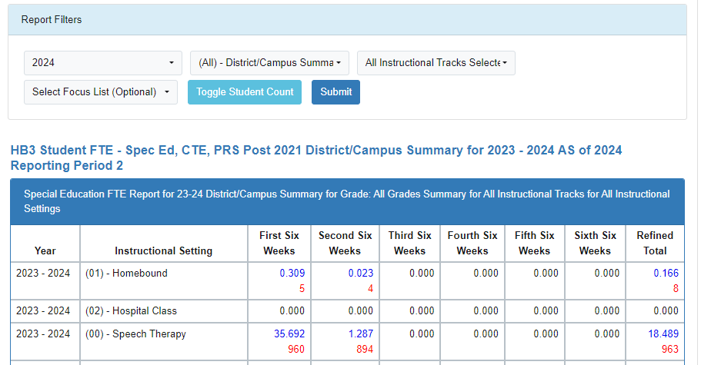
Student Funding Detail Reports
HB3 Student FTE - Spec Ed, CTE, PRS Post 2021
Fall and Summer PEIMS files required
Compiles individual Student Custom FTE Reports for Special Education, Career and Technical Education (CTE), Career and Technology Incentive, and Pregnancy Related Services (PRS)
Can filter on year, campus, instructional tracks, and focus
Can Toggle Student Count - number will be displayed in red

Slide 22
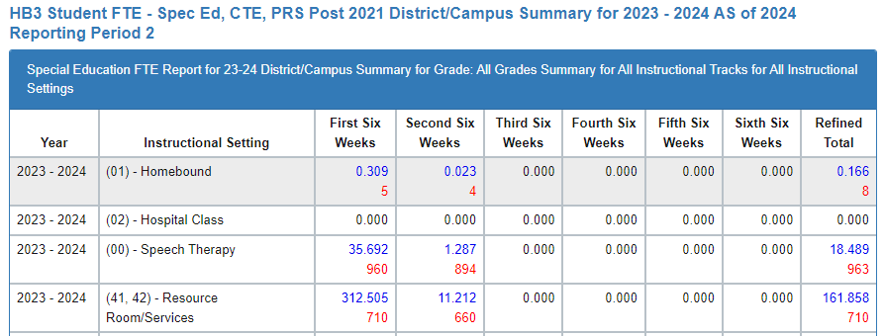
Student Funding Detail Reports
HB3 Student FTE - Spec Ed, CTE, PRS Post 2021
Special Education
Instructional setting groups by six-weeks and Refined Total per SOF template grouping

Slide 23
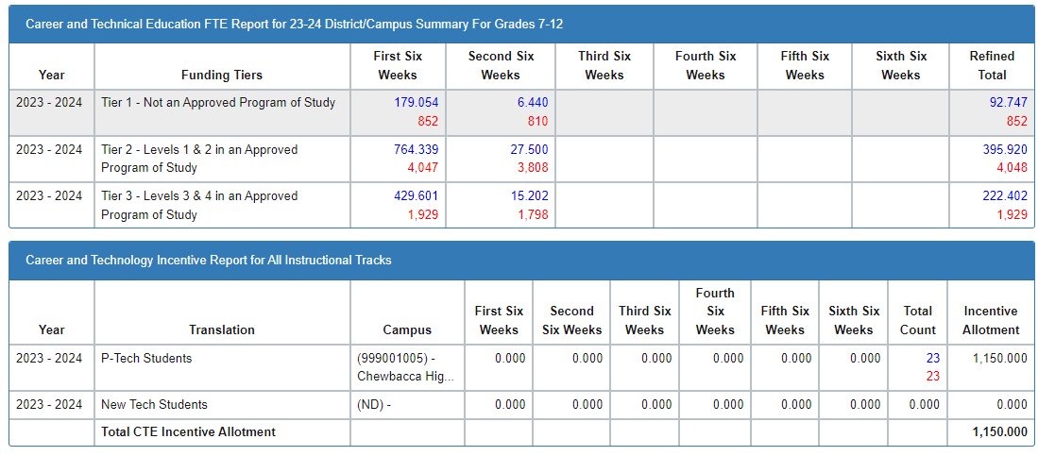
Student Funding Detail Reports
HB3 Student FTE - Spec Ed, CTE, PRS Post 2021
Career and Technical Education (CTE)
Updates per HB1525 to report based upon Funding Tiers assigned to CTE Service ID by six-weeks period
CTE Incentive reporting - HB1525 deleted $50 per FTE/student allotments on students in 2 or more advanced CTE courses for 3 or more credits and continues allotment on P-Tech and New Tech students only

Slide 24
Student Funding Detail Reports
HB3 Student FTE - Spec Ed, CTE, PRS Post 2021
Pregnancy Related Services (PRS)
Reports by instructional tracks by six-weeks periods

Slide 25
CCMR Outcomes Bonus
New report to assist with tracking and estimating the College, Career, Military Readiness (CCMR) Outcomes Bonus
2 year data lag
2023 graduates will be reflected on the 2025 SOF
This year’s SOF (2023-24) is based on 2022 report
Military will come back for 2023 graduates, not for prior years
Potential Higher Ed Enrolled - estimate, may have a variance when final report from TEA is released
Districts can upload TEA preliminary & final rosters
Data Sources - TEAL - CCMR Outcomes Bonus Files

Slide 26
CCMR Outcomes Bonus
HB3 Outcome Bonus (CCMR) Graduate Funding Estimate
Estimate of annual graduates potentially meeting CCMR Outcome Bonus requirements

Slide 27
Comptroller Property Reports
OnDataSuite will utilize reports once published by the State Comptroller’s office
Helpful report if district is located in more than one county
Each year is combined into a single report
Preliminary report will be available in January
Final data published in August
Report will show either Prelim or Final on Property Value Summary

Slide 28
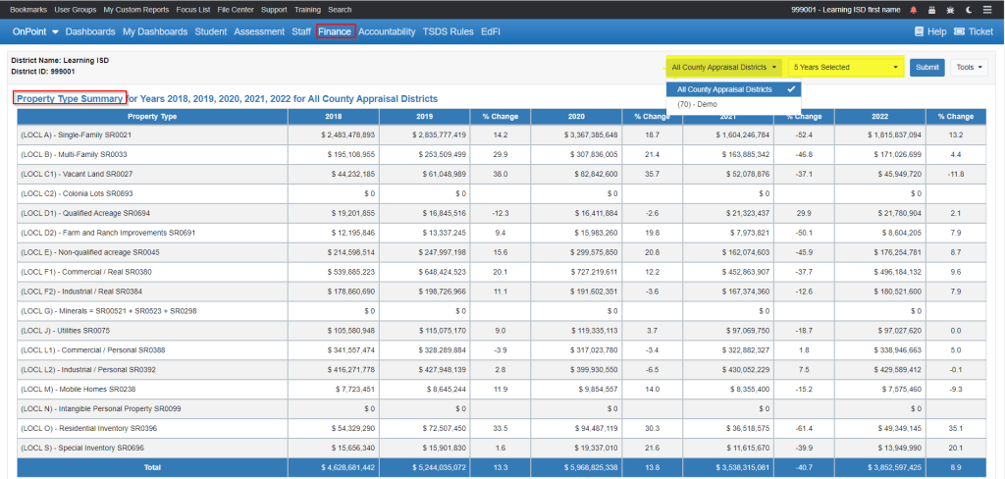
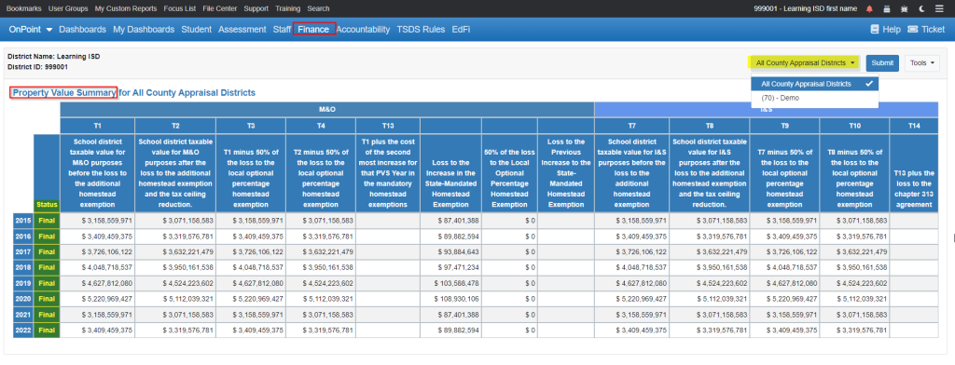
Comptroller Property Reports
Can run reports by Property Type Summary or by Property Value Summary

Slide 29
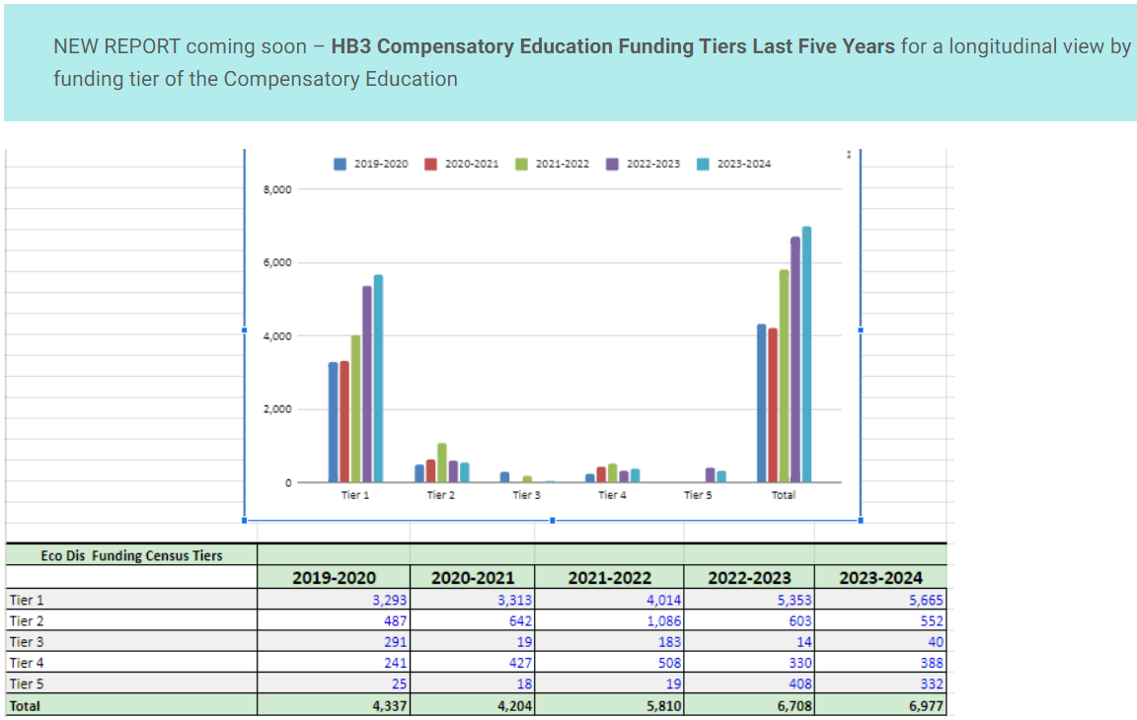
Coming Soon in Early Spring 2024!
State Compensatory Education (SCE) Longitudinal Report Currently in Development

Slide 30
Don’t Forget!!!
Support and Training - OnDataSuite Knowledge Base
https://kb.ondatasuite.com/ or by clicking on Help from your OnDataSuite screen in the top right corner
Select Zoom Training
Agendas

Slide 31
OnDataSuite Knowledge Base
Select Finance
Select Summary of Finance (SOF) Student Data Reporting

Slide 32
Questions
Thank you!
Jeffri Orosco, RTSBA
CFO - Elgin ISD
Email: jeffri.orosco@elginisd.net
Phone: 512-281-3434

