Slide 1
ODS Summary of Finance Report Overview
March 27, 2025

Slide 2
Today’s Workshop
Accessing the Knowledge Base (KB) for resources, training, and support
Overview of using OnDataSuite (ODS) reports to assist with monitoring and completing the Summary of Finance (SOF) template
Please note:As of 24-25 and Ed-Fi reporting the PEIMS data, including Summer PEIMS entities need to be flowing into ODS to begin looking at the data and reports
If any files or data is missing, the reports will still generate but have incomplete, inaccurate, or no data

Slide 3
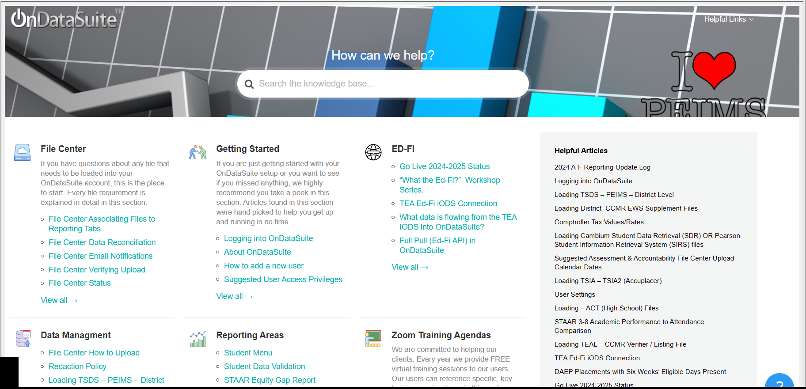
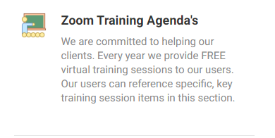
Getting Started - OnDataSuite Knowledge Base (KB)
https://kb.ondatasuite.com/ or by clicking on Help from your OnDataSuite screen in the top right corner
Training presentation availble under
Zoom Training Agendas

Slide 4
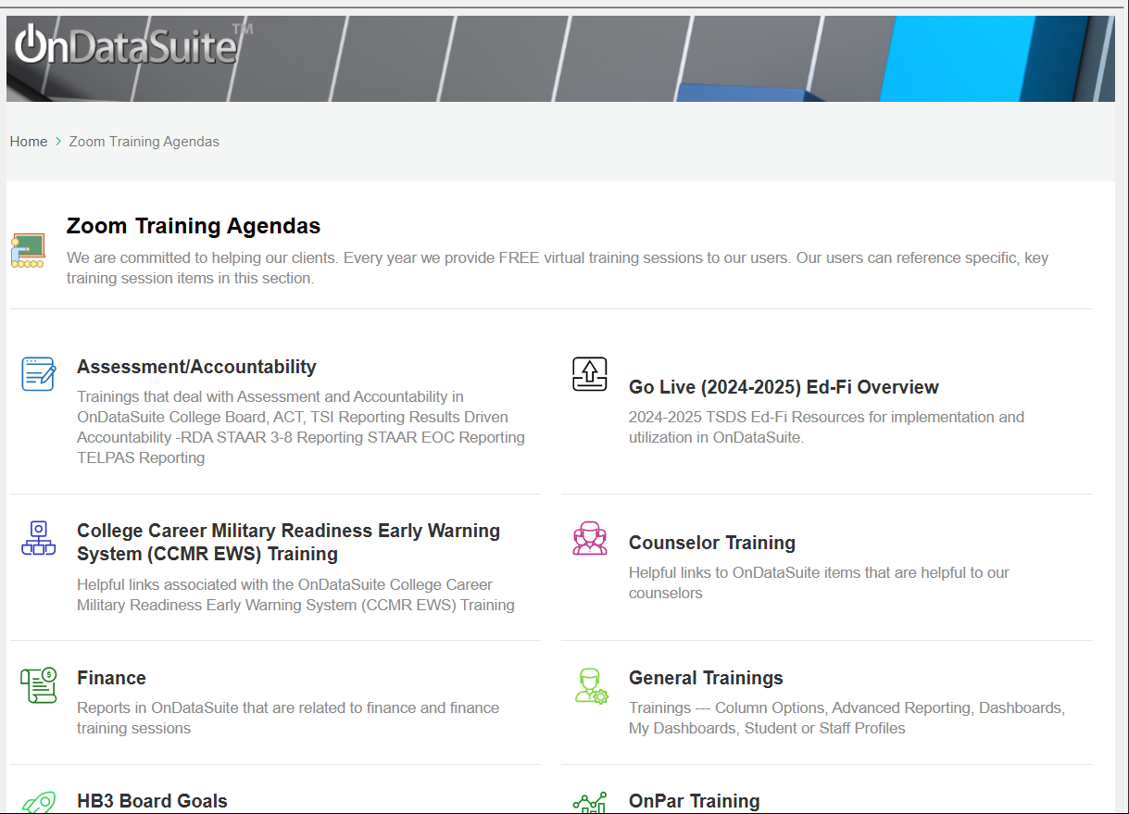
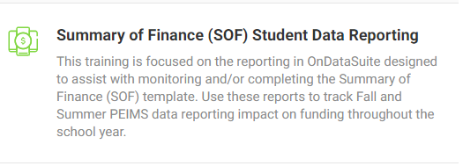
OnDataSuite Knowledge Base
Select Zoom Training Agendas
Select Finance
Select Summary of Finance (SOF) Student Data Reporting

Slide 5
What Changed in Data Reporting for 24-25?
Pre 24-25: XML file loads from your Student Information System (SIS) and Enterprise Resource Planning (ERP/Business & HR side) PEIMS Files into ODS (>>File Center – Data Sources – TSDS XML or CSV – PEIMS)
Prior year Final Files for Fall and Summer PEIMS are crucial to longitudinal reporting in Finance. Reference KB Loading TSDS - PEIMS - District Level
24-25 data reported in Ed-Fi API data flow to TEA at a more granular level. ODS pulls the data from TEA now instead of files being loaded. Reference KB What data is flowing from the TEA IODS into OnDataSuite?

Slide 6
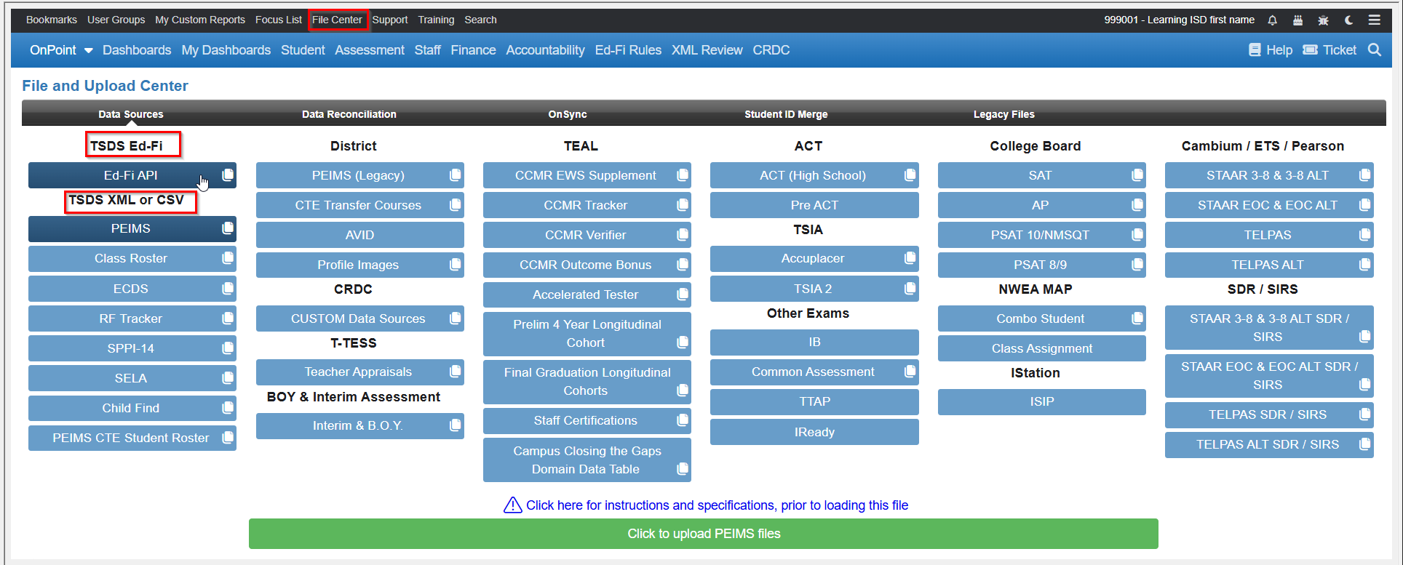

Slide 7
Getting Started – Ed-Fi Transition Current Impact
24-25 Summer Attendance Reporting Summary of Finance Impact References

Slide 8
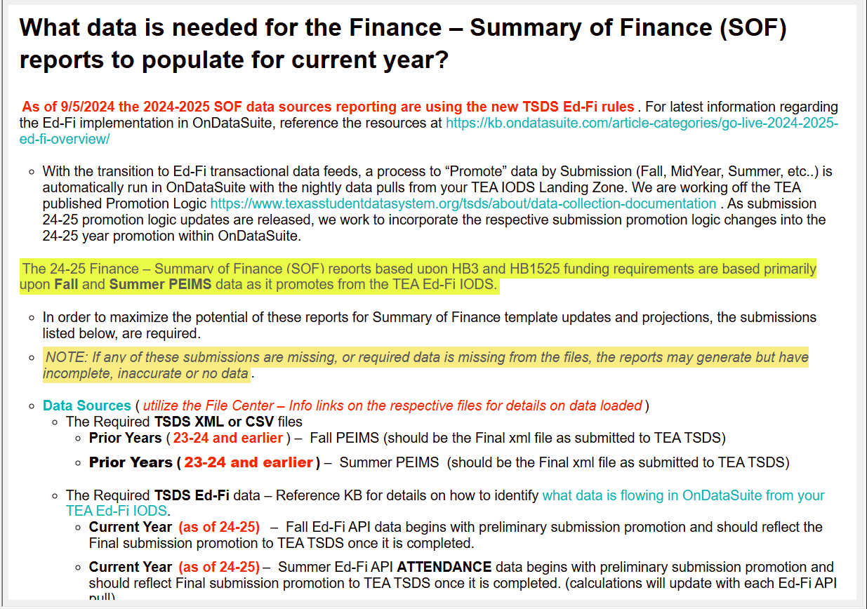
What Data is needed for SOF Reporting
Reports needed for Summary of Finance (SOF) student data reports based upon HB3 and HB1525 funding requirements are based primarily on Fall and Summer TSDS PEIMS . With the move to Ed-Fi the impact on what data is required is outlined in KB What data is needed for SOF Reports to populate current year?

Slide 9
Summer PEIMS Ed-Fi Common Issues
SIS Vendors may not be flowing all Summer Attendance Entities
SIS reports are not matching OnDataSuite reports - reference KB Why are ADA/FTE/Attendance calculations different..?

Slide 10
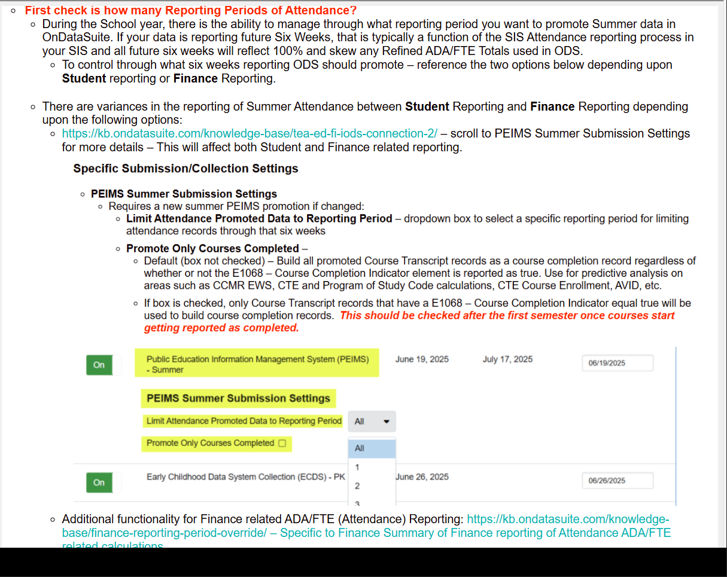
Summer PEIMS Ed-Fi Common Issues
Verifying and managing Reporting Periods in Attendance reports in OnDataSuite – section within the Why are ADA/FTE/Attendance calculations different..?

Slide 11
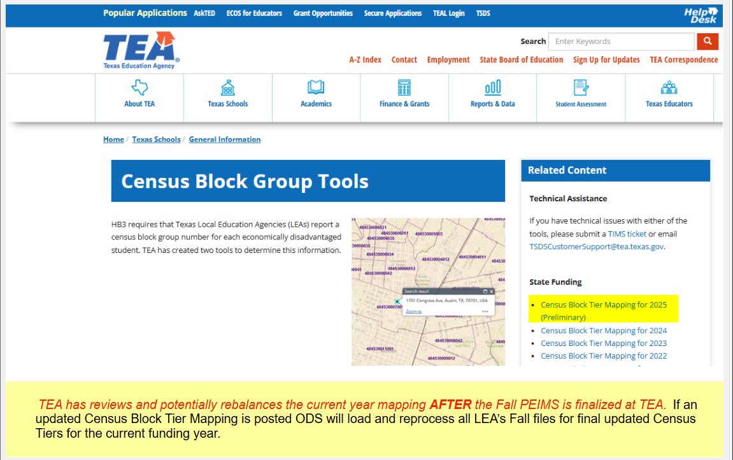
Summer PEIMS Ed-Fi Common Issues
OnDataSuite Annual TEA Data Updates
Fall PEIMS reporting affected by Census Block Group Tier Mapping - Compensatory Education Census Tier Mapping Status

Slide 12
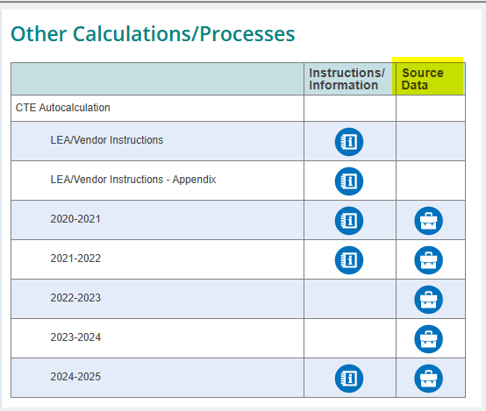
Summer PEIMS Ed-Fi Common Issues
OnDataSuite Annual TEA Data Updates
Summer PEIMS CTE FTE Tier fund mapping

Slide 13
OnDataSuite Finance- Reports and Data Generated
HB 3 Outcome Bonus (CCMR) Graduate Funding Estimate - based upon OnDataSuite CCMR Early Warning System data sources and Fall PEIMS and Summer PEIMS
HB3 Compensatory Education - Eco Dis/Census Tiers - based upon Fall PEIMS
Gifted/Talented (GT) Funding (HB1525) - based upon Summer PEIMS
HB3 Student ADA - Refined, Flex Attend, SPED Mainstrm, Bil, Early Ed, PEG, Res Facility - based upon Summer PEIMS
HB3 Student Count - Dyslexia Services Report - based upon Summer PEIMS
HB3 Student FTE - Special Ed, CTE, PRS Post 2021 - based upon Summer PEIMS

Slide 14
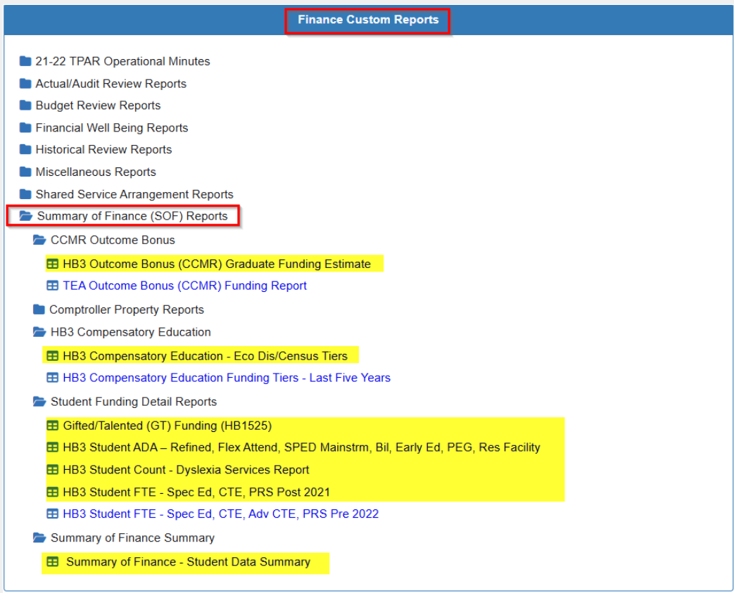
OnDataSuite Summary of Finance (SOF) Reports
Under Finance Custom Reports - select Summary of Finance (SOF) Reports
A listing of folders and reports will be available
*Please note: earliest year to report on SOF is 21-22 based on CTE data restructure; years prior to this would not be comparable

Slide 15
Summary of Finance (SOF) Access and Templates
Finance users will need Finance Administrator, Student Aggregate Total, Finance Reports, and Accountability permissions to access reports
Summary of Finance templates are provided by TEA, under State Funding - District/Charter Planning Tools - State Aide Template 2022-2025
And by Omar Garcia (BOK Financial Securities) with Region 13 - Summary of Finance template (Omar’s Template)

Slide 16
Summary of Finance – Student Data Summary
Single report of Student PEIMS data needed to complete the SOF template
Report layout follows TEA’s template and closely aligns with Omar’s template
Drilldowns are available on this report – utilize to see calculation details.
Able to add and see multiple years (back to 2022 when CTE FTE was restructured)
Able to see differences - can toggle this on or off
Prior year numbers are based on prior school year Final Summer PEIMS files
Current year values are based on latest current year Summer PEIMS processed by ODS, which could include a partial six-weeks period
Unless Finance Reporting Period Override is utilized

Slide 17
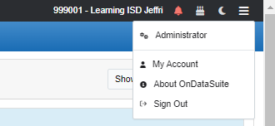
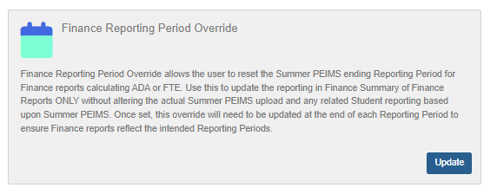
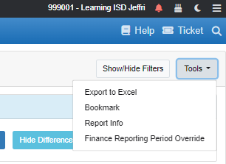
Finance Reporting Period Override
Gives finance users the ability to reset current year Summer PEIMS file reporting period for the SOF reports
Used to adjust when a data file uploaded reflects a partial six weeks reporting period
Can be used to only show attendance related reporting projections through completed six-weeks
Accessable from Administrator Access (top right) - Overrides OR Tools menu on the Summary of Finance Reports
Student Funding Detail Reports
Summary of Finance Summary Report
Select six-weeks period to report on in drop down

Slide 18
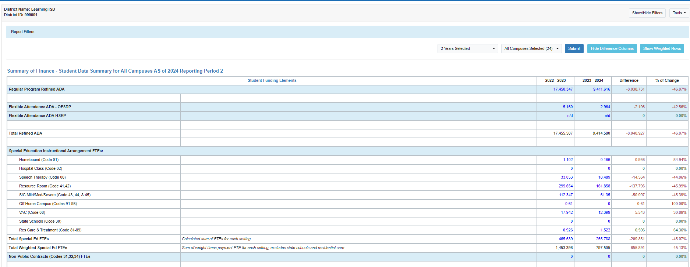
Summary of Finance – Student Data Summary

Slide 19
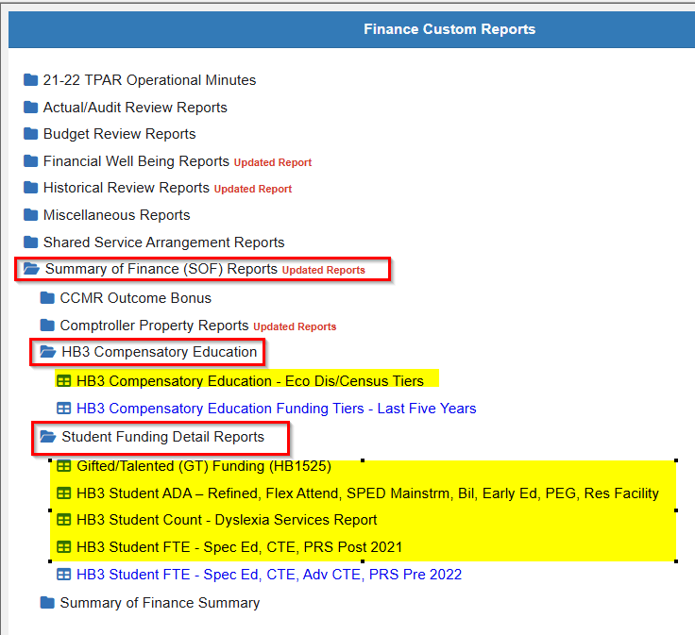
Funding Detail Reports
Started with HB3 in 2019 as Student-HB3 Funding reports
As HB1525 and other legislation has impacted school funding, new reports were developed
ODS is monitoring HB2 for any additional new reporting we may need to add or update as it relates to funding.
Includes:
HB3 Compensatory Education - Eco Dis/Census Tiers
Gifted/Talented (GT) Funding (HB1525)
HB3 Student ADA - Refined, Flex Attend, SPED Mainstrm, Bil, Early Ed, PEG, Res Facility
HB 3 Student Count - Dyslexia Services Report
HB3 Student FTE - Spec Ed, CTE, PRS Post 2021

Slide 20
Student Funding Detail Reports
Gifted/Talented (GT) Funding (HB1525)
Provides student data specific to the HB1525 funding as of 2021-22
Allotment was reinstated allowing up to 5% of the LEA’s ADA to receive a GT allotment for TG students served
Student Count - participating in GT indicator code for Summer PEIMS
Limited to 5% of current year refined ADA - other columns show this calculation through Current Year ADA and 5% of this number for the GT limit

Slide 21
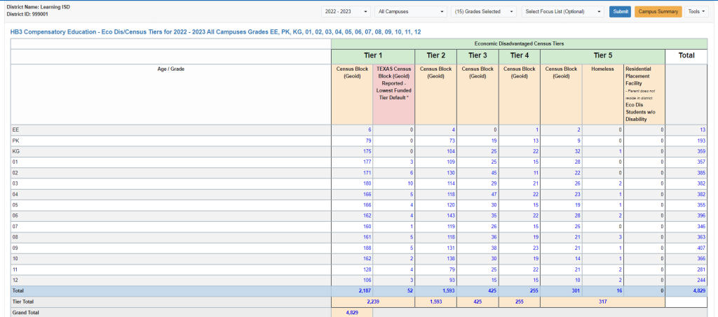
Student Funding Detail Reports
HB3 Compensatory Education - Eco Dis/Census Tiers
Census Tiers are mapped during TSDS Fall PEIMS files based on the Student Census Block Group and respective year TEA Census Block Tier Mapping file
This is preliminary for 2025, as after Fall PEIMS counts are reviewed and reconciled will a new and rebalanced SCE tier to Census Block Group Code spreadsheet be provided
NOTE: Funding may change - TEA’s updated file is expected in end of March/early April.
ODS will reload everyone's data with new reports

Slide 22
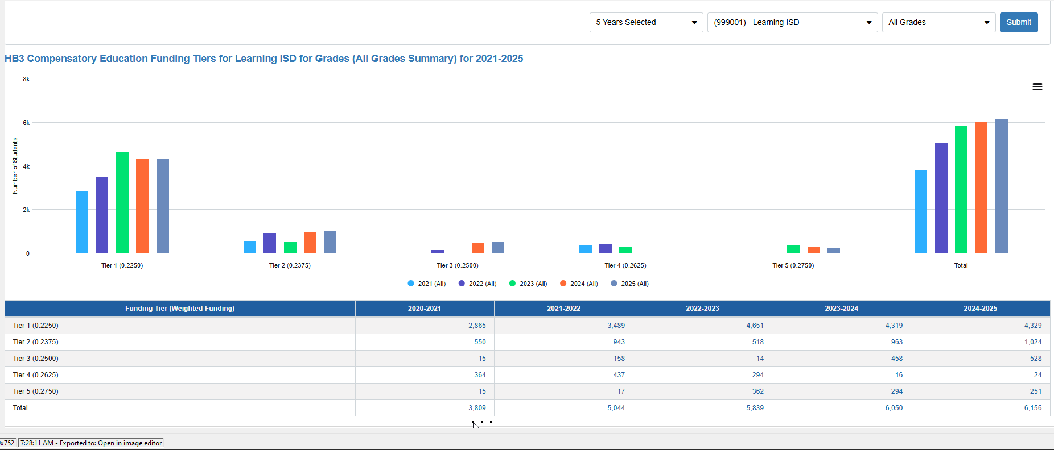
State Compensatory Education (SCE) Longitudinal Report New report in 2023-2024

Slide 23
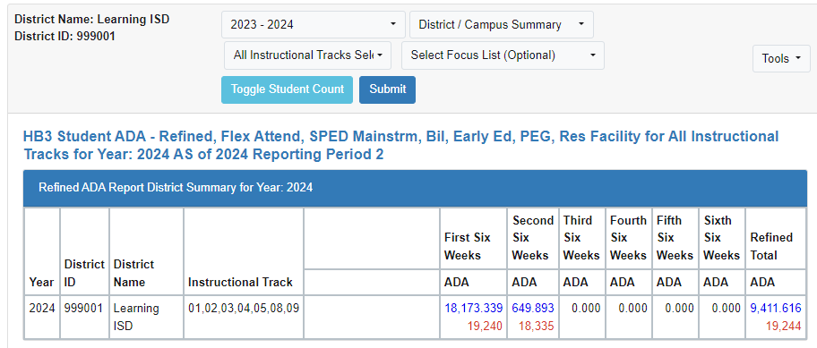
Student Funding Detail Reports
HB3 Student ADA - Refined, Flex Attend, SPED Mainstrm, Bil, Early Ed, PEG, Res Facility
Compiles individual student custom ADA reports by funding area into a singled report
Individual ADA reports are also available in Student - Average Daily Attendance (ADA) Reports
This report is able to filter on year, campus, instructional tracks, and focus list using the drop downs
Can also show number of students by using the Toggle Student Count button - numbers will show in red

Slide 24
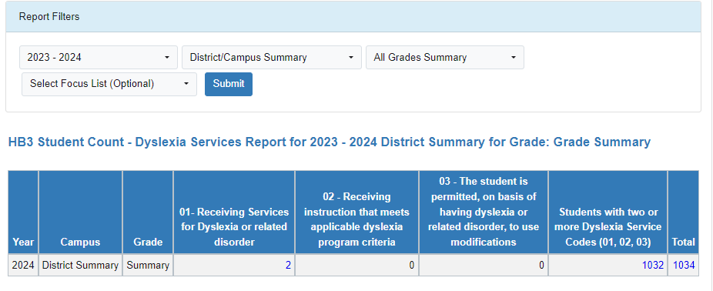
Student Funding Detail Reports
HB3 Student Count - Dyslexia Services Report
Summer PEIMS data is required that includes Dyslexia Services Code reporting (current year issue – data not flowing yet to TEA IODS) Reported on the Student Ed Org Association entity as DyslexiaServices https://tealprod.tea.state.tx.us/TWEDSAPI/23/0/0/DataComponents/DataElements/List/8415
Counts include unduplicated Student count as students may report more than one Dyslexia Service Code
Use Total number for final count for HB3 funding
Can filter on year, campus, grades, and focus list using drop downs

Slide 25
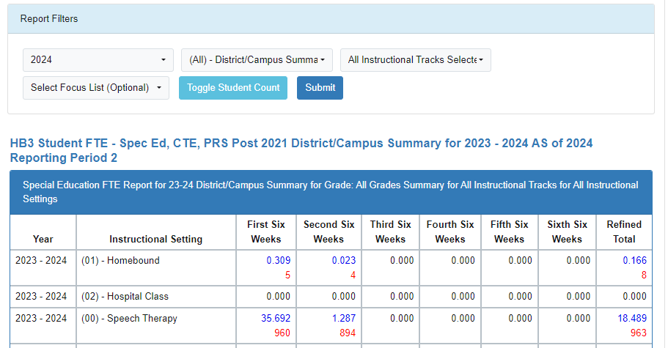
Student Funding Detail Reports
HB3 Student FTE - Spec Ed, CTE, PRS Post 2021
Fall and Summer PEIMS files required
Compiles individual Student Custom FTE Reports for Special Education, Career and Technical Education (CTE), Career and Technology Incentive, and Pregnancy Related Services (PRS)
Can filter on year, campus, instructional tracks, and focus
Can Toggle Student Count - number will be displayed in red

Slide 26
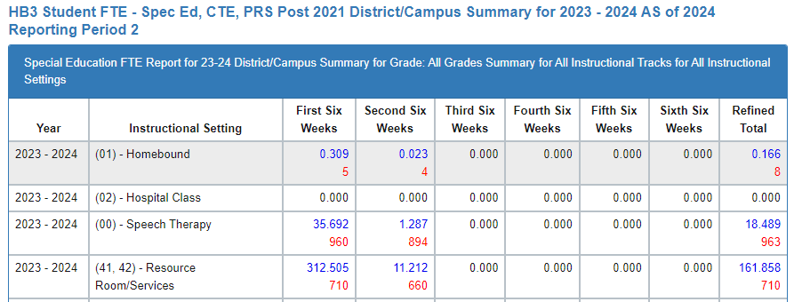
Student Funding Detail Reports
HB3 Student FTE - Spec Ed, CTE, PRS Post 2021
Special Education
Instructional setting groups by six-weeks and Refined Total per SOF template grouping

Slide 27
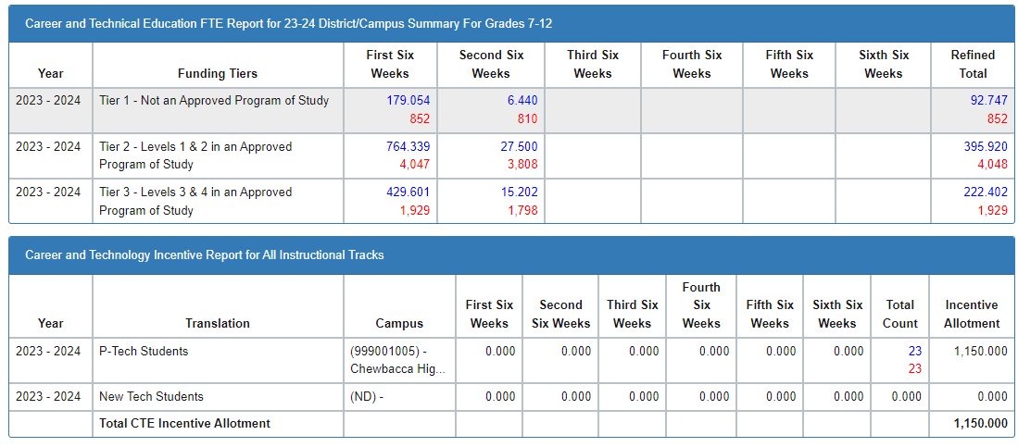
Student Funding Detail Reports
HB3 Student FTE - Spec Ed, CTE, PRS Post 2021
Career and Technical Education (CTE)
Updates per HB1525 to report based upon Funding Tiers assigned to CTE Service ID by six-weeks period
CTE Incentive reporting - HB1525 deleted $50 per FTE/student allotments on students in 2 or more advanced CTE courses for 3 or more credits and continues allotment on P-Tech and New Tech students only

Slide 28
Student Funding Detail Reports
HB3 Student FTE - Spec Ed, CTE, PRS Post 2021
Pregnancy Related Services (PRS)
Reports by instructional tracks by six-weeks periods

Slide 29
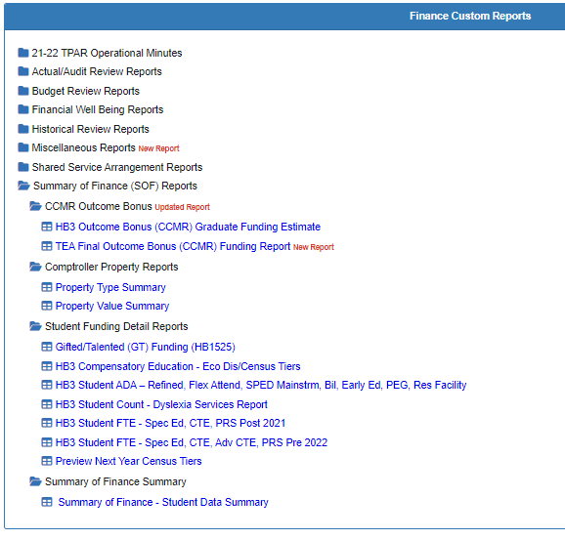
CCMR Outcomes Bonus
Reporting to assist with estimating the College, Career, Military Readiness (CCMR) Outcomes Bonus
2 year data lag
2023 graduates will be reflected on the 2024-2025 SOF
Military will come back for 2023 graduates, not for prior years
Potential Higher Ed Enrolled - estimate, may have a variance when final report from TEA is released
Districts can upload TEA preliminary & final rosters
Data Sources - TEAL - CCMR Outcomes Bonus Files

Slide 30
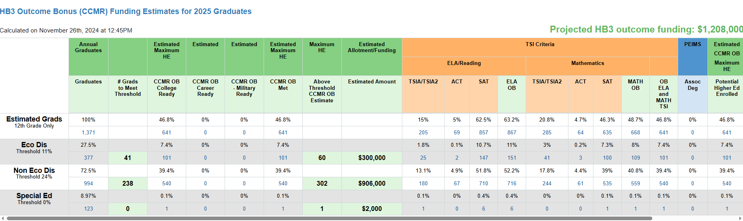
CCMR Outcomes Bonus
HB3 Outcome Bonus (CCMR) Graduate Funding Estimate
Estimate of annual graduates potentially meeting CCMR Outcome Bonus requirements
Added estimated Allotment Funding data

Slide 31
Comptroller Property Reports
OnDataSuite will utilize reports once published by the State Comptroller’s office
Helpful report if district is located in more than one county
Each year is combined into a single report
Preliminary report will be available in January
Final data published in August
Report will show either Prelim or Final on Property Value Summary

Slide 32
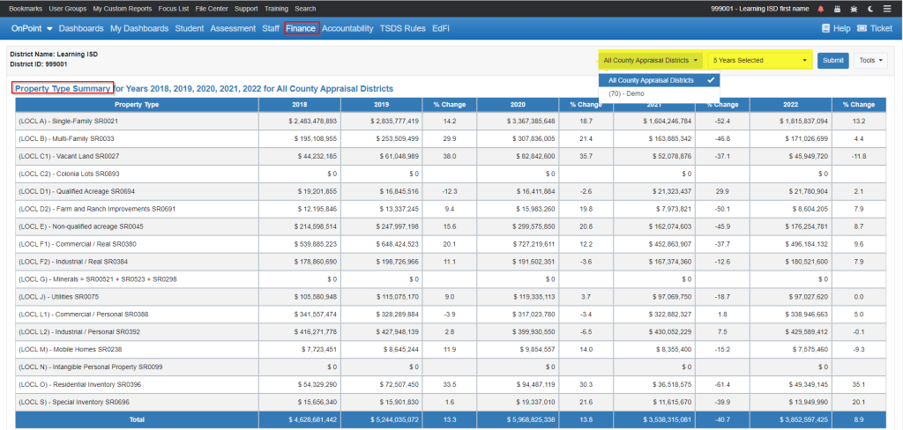
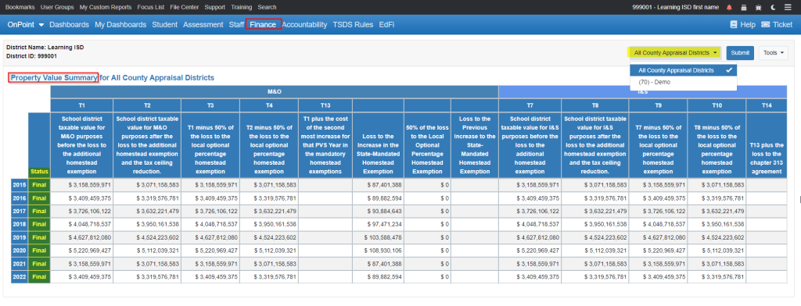
Comptroller Property Reports
Can run reports by Property Type Summary or by Property Value Summary

Slide 33
Don’t Forget!!!
Support and Training - OnDataSuite Knowledge Base
https://kb.ondatasuite.com/ or by clicking on Help from your OnDataSuite screen in the top right corner
Recording of this session will post https://999001.esc3.net/support/training/webinars and link to session documentation for sharing or reviewing.

Slide 34
Questions
Thank you!

