Slide 1
Finance Overview
September 17, 2024

Slide 2
Agenda
OnDataSuite (ODS) Introduction
24-25 : TSDS Finance Reporting - What is Changing and What is Not
ODS 24-25 Finance related reporting status (How Do I Know?)
Resources for ODS Finance

Slide 3
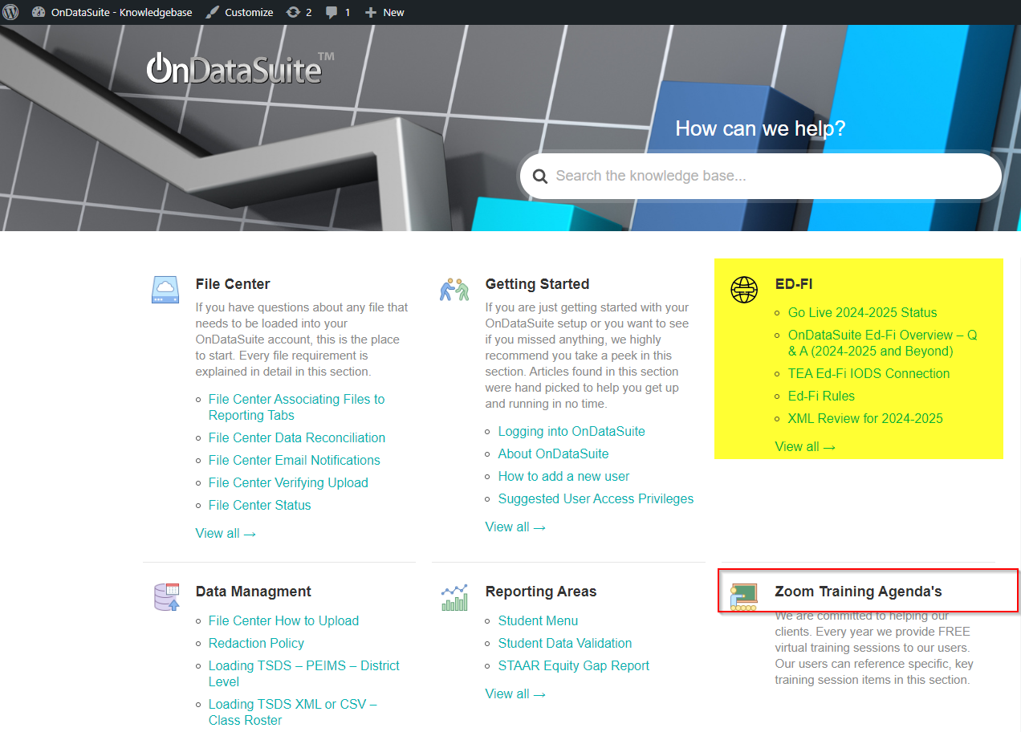
OnDataSuite(ODS) Introduction
Documentation References: https://kb.ondatasuite.com

Slide 4
24-25 : TSDS Finance Reporting - What is Changing and What is Not
1 – Where does TSDS PEIMS data come from that impacts Finance reporting?
Fall PEIMS: Budget, Staff, Student and Prior Year Leaver
MidYear PEIMS: Actual Finance (prior year)
Summer PEIMS: Attendance (Basic and Special Programs) and Student Course Completions
Extended Year PEIMS: Attendance
2 - Finance values:
ADA – calculated from Summer/Extended Year PEIMS
FTE – calculated from Summer/Extended Year PEIMS
Compensatory Education counts – calculated from Fall PEIMS
CCMR Outcome Bonus counts – calculated based upon graduate reporting in Fall/Summer PEIMS.
Reference KB for specific ODS Summary of Finance Reporting data sources: What Files are needed for Summary of Finance Reporting
2 - Prior to 24-25: XML submissions
Vendors managed and created specific extracts for each submission to meet TEA reporting requirements by TEA TSDS PEIMS Submission timelines

Slide 5
24-25 : TSDS Finance Reporting - What is Changing and What is Not
3 – As of 24-25: Ed-Fi API transmissions
Vendors submit transactional data to TEA IODS Landing Zone. This is the data OnDataSuite is collecting and “promoting” on a nightly schedule.
Your LEA initiates a promotion process with TEA by submission on the data – this is not an automatic process in TSDS.
*Note- “Promotion logic” was the vendor process in creating prior XML submissions.
4 – What is “Promoted Data”? (the prior XML files generated by your vendor)
OnDataSuite reports "promoted data" in dashboards, ad-hoc (report center), custom reports and Student/Staff Profiles as each nightly pull of Ed-Fi data from the TEA IODS is processed. With the move to Ed-Fi transactional API data feeds to TEA, there is a promotion logic process for each submission that the TEA IODS data is run through as your file is evaluated nightly.
For the latest published TEA Promotion Logic, please reference https://www.texasstudentdatasystem.org/tsds/about/data-collection-documentation
As of 9/10/2024, we are awaiting 24-25 Promotion Logic updates and are working continuously to review and implement the latest TWEDS changes for 24-25.

Slide 6
24-25 : TSDS Finance Reporting - What is Changing and What is Not
5 – So this is NOT Changing.
There is no transactional data flowing for Fall Budget and MidYear Actual at this time.
Fall Budget is reported the exact same detail level you have always reported. https://tealprod.tea.state.tx.us/TWEDSAPI/23/0/0/DataComponents/Entity/List/1932
MidYear Actual (now referenced as PriorYearActual) is reported the exact same detail level you have always reported) https://tealprod.tea.state.tx.us/TWEDSAPI/23/0/0/DataComponents/Entity/List/1931

Slide 7
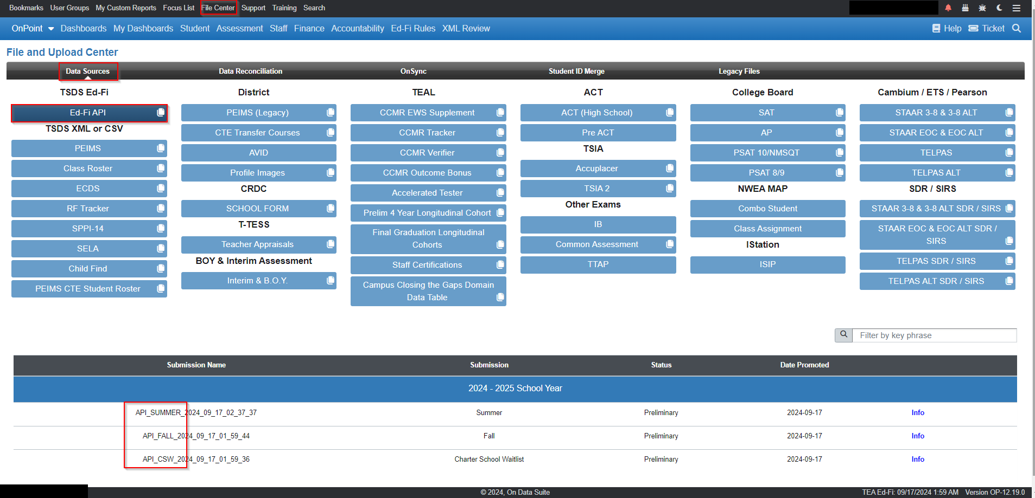
ODS 24-25 Finance related reporting status (How Do I Know?)
How to identify latest Ed-Fi “promoted” data
Lower Right footer TEA Ed-Fi data/time stamp
Every ODS page has a black footer and if TEA Ed-FI data is flowing it is noted on the lower corner
For specific submission details – reference the File Center
New File Center – Data Sources – TSDS Ed-Fi section:

Slide 8
ODS 24-25 Finance related reporting status (How Do I Know?)
How to identify latest Ed-Fi “promoted” data
The Info Link on each submission provides the Category – Sub-category – Domain – Entity as reported (Records) to TEA IODS and Promoted (in OnDataSuite).
The basis of this logic is from TEA TWEDS https://tealprod.tea.state.tx.us/TWEDSAPI/23/0/0/DataComponents/CategoryDomainEntityRelations with relationship to Submission promotion logic applied.

Slide 9
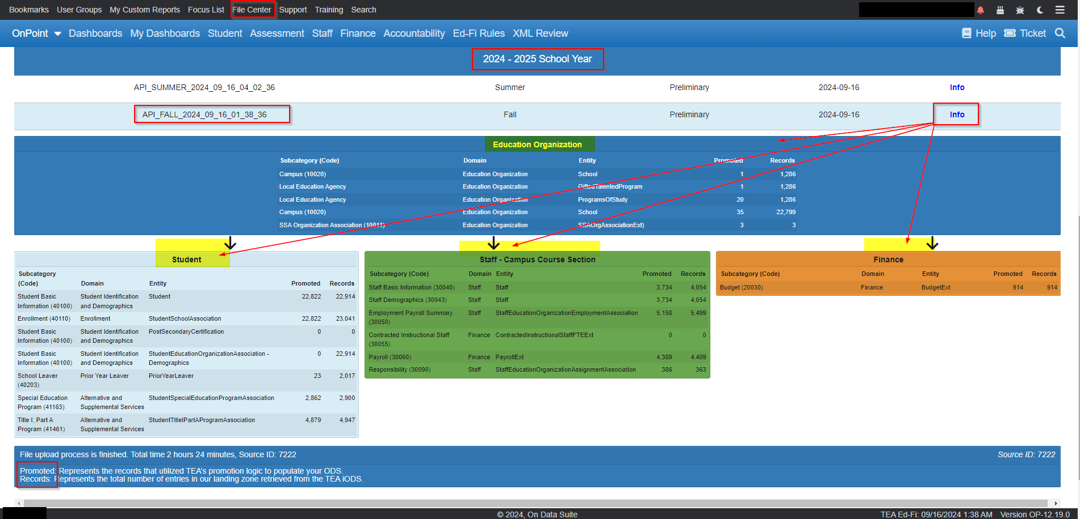
ODS 24-25 Finance related reporting status (How Do I Know?)
How to identify latest Ed-Fi “promoted” data
File Center _ TSDS Ed-Fi _API_FALL Info Ex:

Slide 10
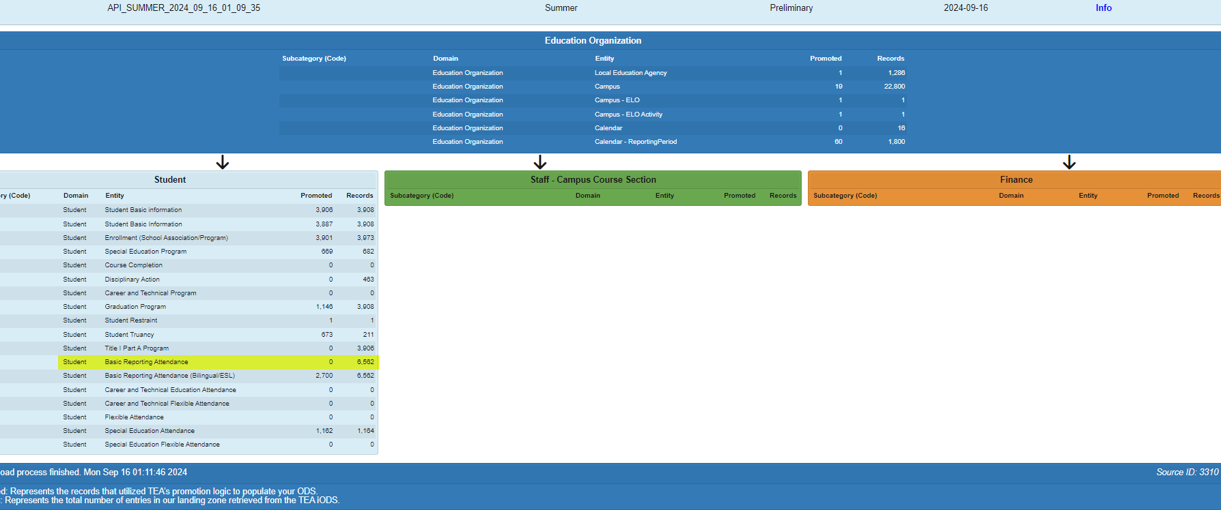
ODS 24-25 Finance related reporting status (How Do I Know?)
How to identify latest Ed-Fi “promoted” data
File Center _ TSDS Ed-Fi _API_Summer Info Ex:

Slide 11
Resources for ODS Finance Reporting
Best Practices:
Communicate/Collaborate with your ODS Administrator/PEIMS Coordinator/Vendor Coordinator.
Utilize the OnDataSuite Knowledge Base
Utilize the Tools Menu / Report Notes/Info on each report
Search the OnDataSuite Knowledge Base for assistance - https://kb.ondatasuite.com/
Specifically follow the Go Live2024-2025 Status updates

Slide 12
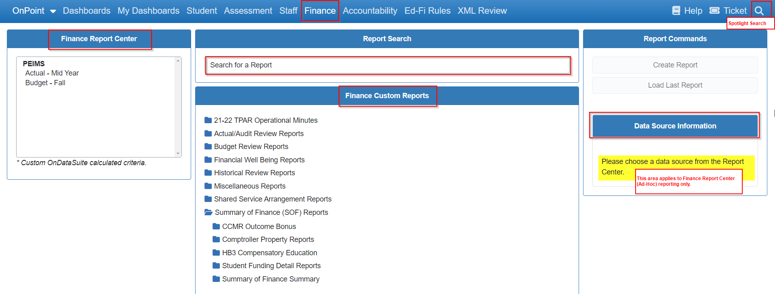
Resources for ODS Finance Reporting
Components of Finance reporting in OnDataSuite:

Slide 13
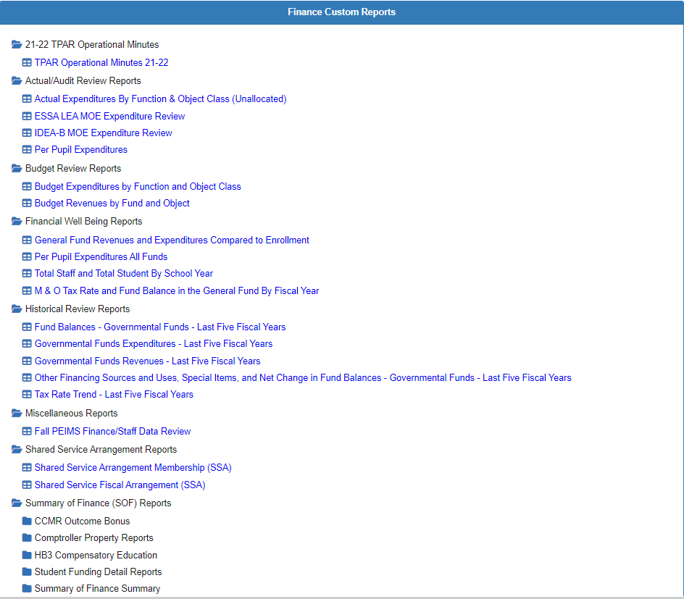
Resources for ODS Finance Reporting
Summary of OnDataSuite Finance Custom Report Menu

Slide 14
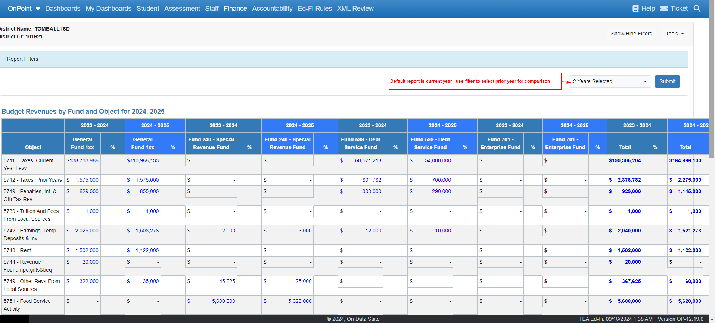
Example for Fall PEIMS Review: Budget Revenues By Fund & Object

Slide 15
Example for Fall PEIMS Review: Budget Expenditures By Function & Object Class Code
Blue Hyperlinks will open up details on what makes up those amounts!

Slide 16
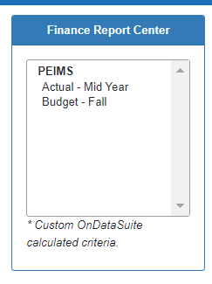
Create Your Own Reports to Verify Data
Finance Report Center (Ad-Hoc Reporting)
Create reports for Budget-Fall data and Actual - Mid-Year data
Add Charts!
Filter Data!
Bookmark and Share Data!
Export to Excel!

Slide 17
Resources for 24-25 ONLY - XML Review
If your Vendor allows a 24-25 XML file to be created, ODS accepts it and provides a limited comparison view to 24-25 Ed-Fi Promoted Data:

Slide 18
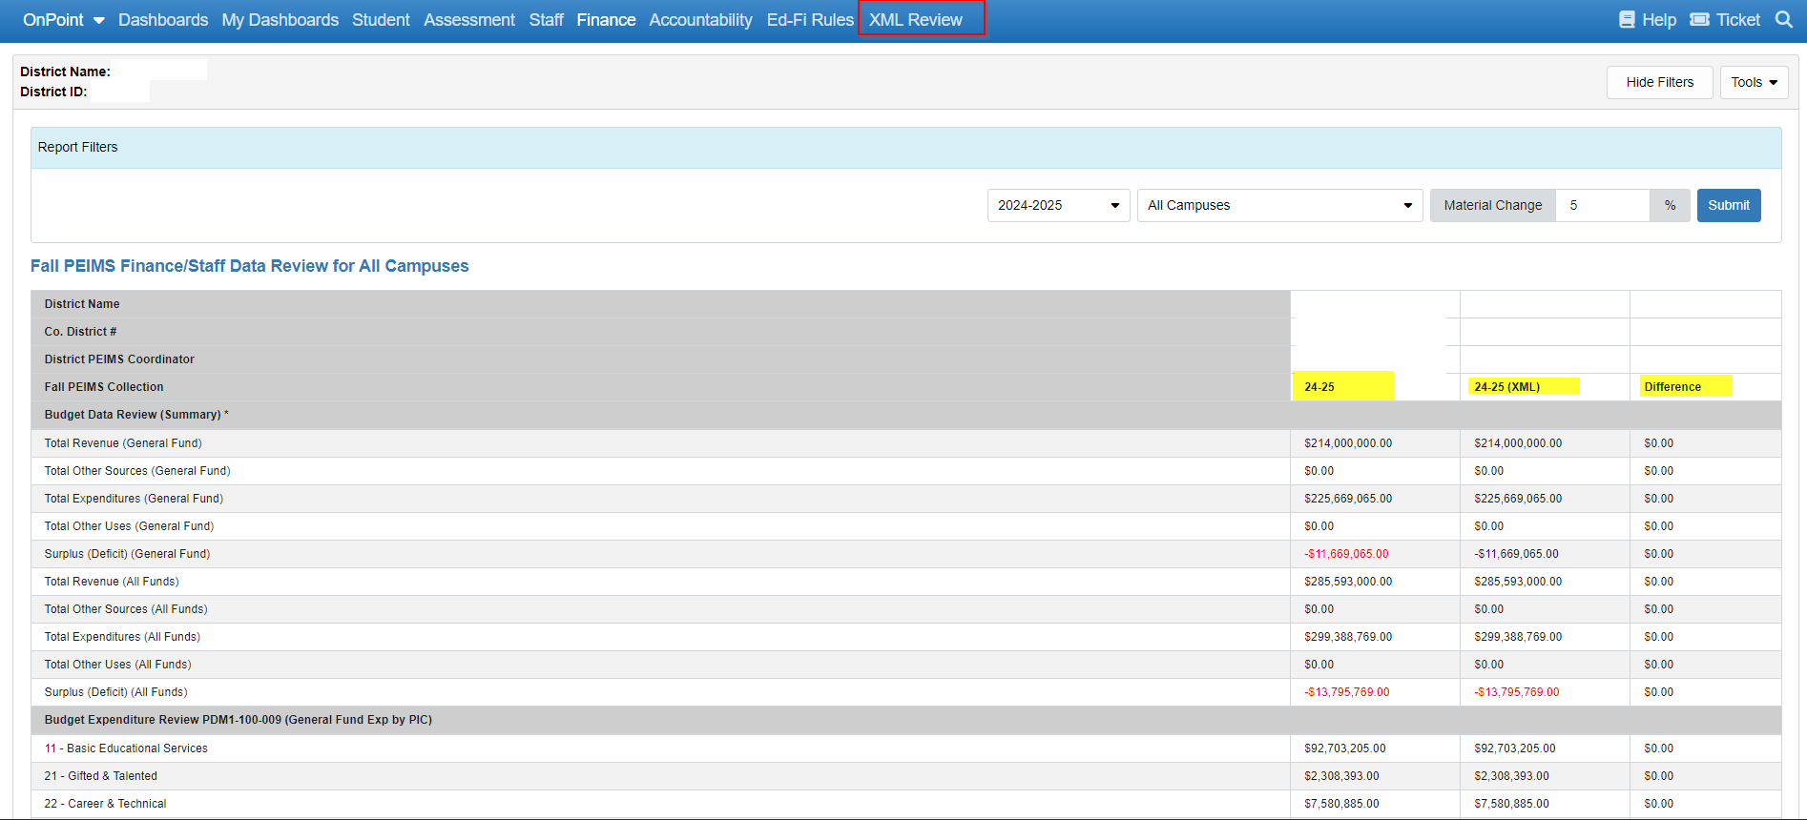
Resources for ODS Finance Reporting – 24-25 ONLY XML Comparision
The XML Comparison Report requires both Fall PEIMS Staff and Finance data in the Ed-Fi Promoted Data AND in the XML file loaded:

Slide 19
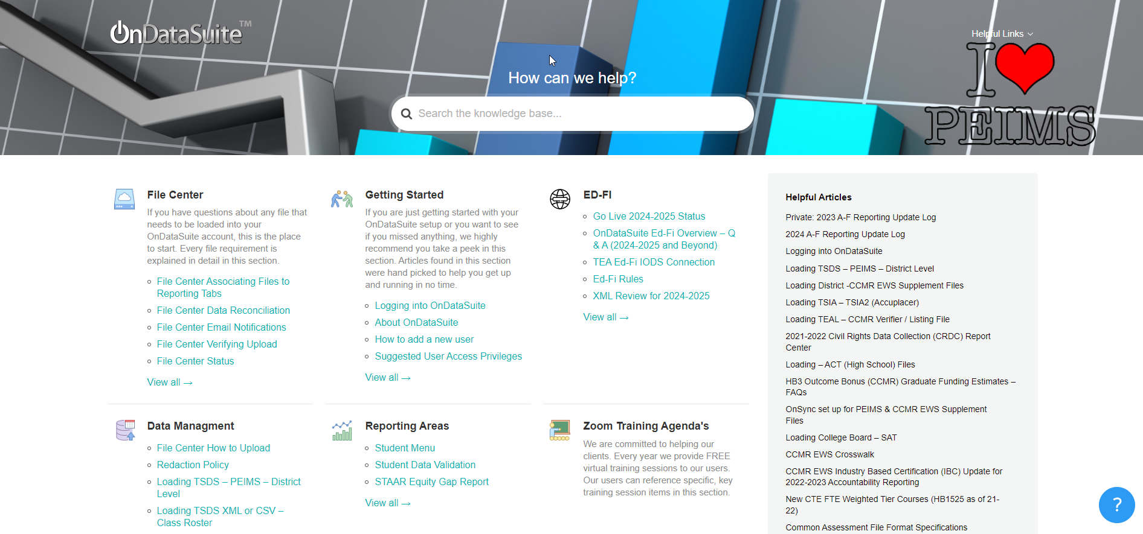
ODS HELP Resources
Utilize the Help Center Resource!
Found in upper right-hand corner of the screen

Slide 20
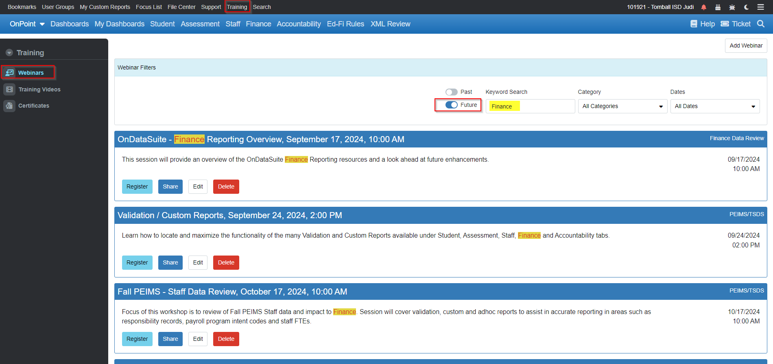
Upcoming Finance Sessions
Additional deep dives into specific Finance area reporting are scheduled.
Use the Training – Webinars (Future search for Finance) to identify sessions.

Slide 21
Q&A / Follow-Up
We thank you for your time today and appreciate your feedback.
Utilize the ODS Ticket System for on-going follow-up/questions/issues/requests!

