Slide 1
New to PEIMS
New to OnDataSuite
August - 2026 Training

Slide 2

Getting Started with PEIMS & OnDataSuite
WELCOME!
Housekeeping
  Forrest Gump – Skyward Q / Munis
  Ask QUESTIONS – no question is stupid!
  Kindness for others…we will move slower through topics
This Photo by Unknown Author is licensed under CC BY-NC
Notes:
Sign in with Full Name Visible and SIS/ERP – easy to identify so that others with the same systems can help you
It is OK to ask questions – that is why we are here
Intentionally moving slow through topics – other training sessions available if not your cup of tea. ☺

Slide 3
Understand What PEIMS Is (and Why It Matters)
PEIMS
(Public Education Information Management System)
is how Texas school districts report student, staff, financial, and organizational data to the state. That data determines:
State funding
Accountability ratings
Federal reporting
Program compliance
Public reporting

Slide 4

What you need to know:
PEIMS is much more than "student records."
Every data element tells part of the district's story.
Accuracy is far more important than speed…
but speed matters!
In OnDataSuite:
Think of OnDataSuite as your early warning system. It helps you find and fix problems before they are submitted to TEA.

Slide 5
Learn Where Your Data Comes From
Your data comes from your district's systems, such as:
Student Information System (SIS)
HR/Payroll (ERP)
Finance system (ERP)
Other connected applications

Slide 6

Nightly Sync
SIS
(student information system)
ERP
(enterprise resource planning)
TEA
District IODS
data lake
OnDataSuite
https://kb.ondatasuite.com/knowledge-base/tea-ed-fi-iods-connection-2/

Slide 7
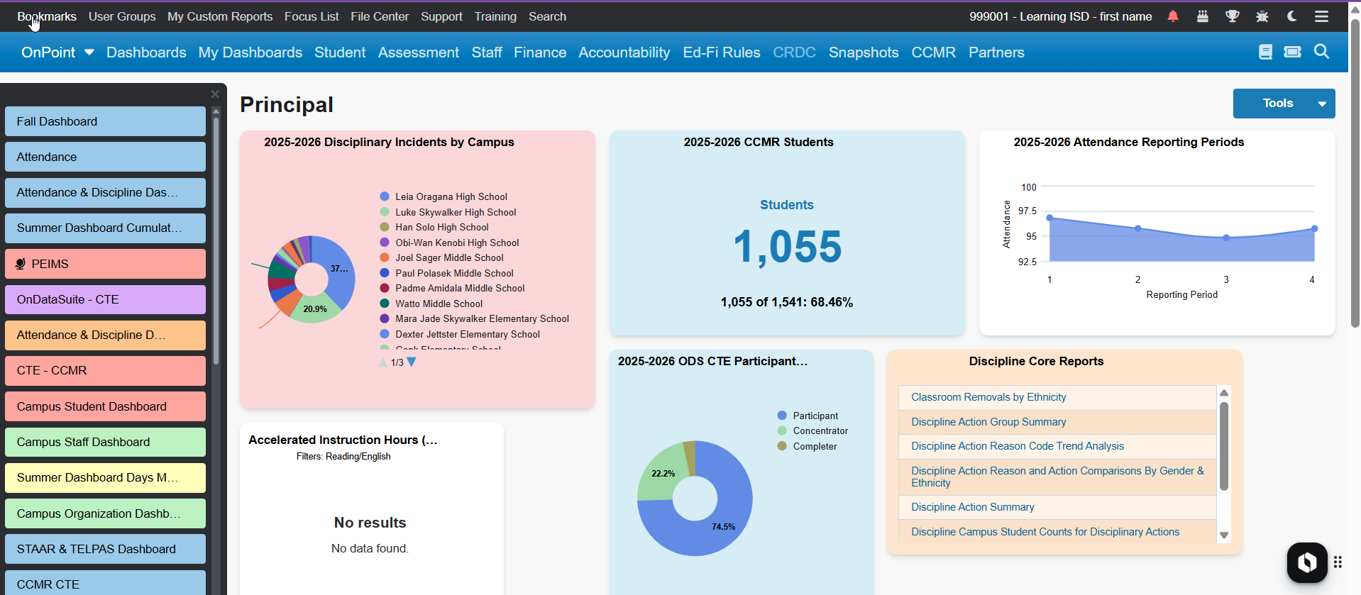
Nightly Sync = fresh visuals daily
OnDataSuite

Slide 8
How is my data in ODS (OnDataSuite) different than my SIS / ERP?
Promotion Logic
Does not include data stuck in Level 1 errors
EXACTLY how TEA will see my data in the PEIMS Data Mart

Slide 9
QUESTIONS?

Slide 10
Survey in Zoom

Slide 11
What?
PEIMS at a Glance
“What if my special programs staff are telling me the data looks wrong?”
“I want it to be perfect before they see it.”
“I know I have errors!”
This is YOUR opportunity to dig into the data and improve the data QUALITY prior to submissions.
Get district data into the hands of the decision makers

Slide 12

Your Story…your data
Data is protected
Data can be shared within the system
Users can only see the data they are allowed to see
Allows you to run data for entire district and share to many at one time
This Photo by Unknown Author is licensed under CC BY

Slide 13
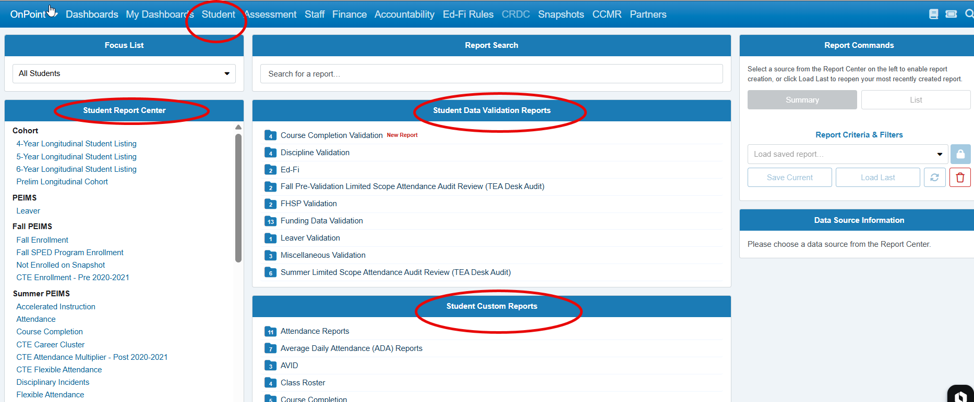
Learn the Difference Between Dashboards, Reports, and Validation Reports
Everything in OnDataSuite generally falls into one of these categories.

Slide 14
Dashboards – Answer “What’s happening?”
Enrollment
Attendance
CCMR
Finance
Accountability
Use them EVERY day!

Slide 15
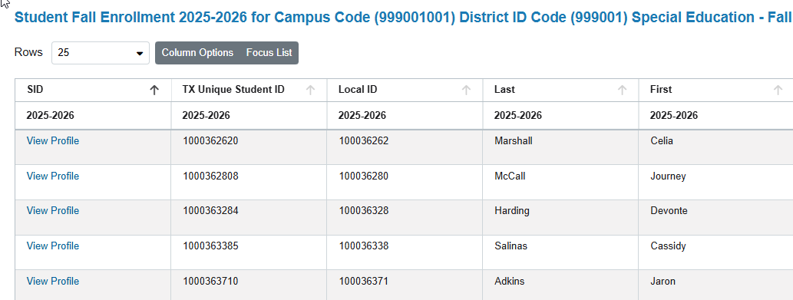
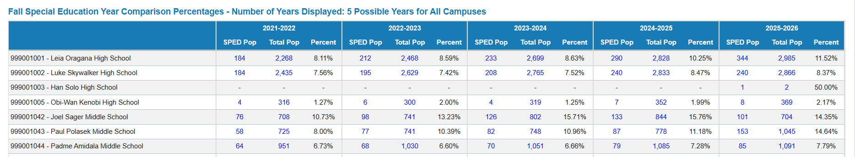
Reports Answer: "Show me the details."
Examples:
  Student lists
  Staff lists
  ADA reports
  Special Program reports
  Financial reports
Reports help you research individual records.

Slide 16
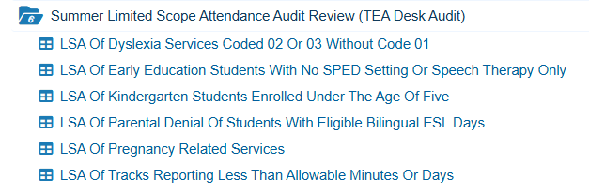
Validation Reports
Answer: "What needs to be fixed?"
Validation reports identify:
  Missing data
  Invalid codes
  Conflicts
  Students who will fail TEA edits
  Potential funding problems
These are the reports PEIMS personnel spend most of their time using.

Slide 17
Validation Reports
Answer: "What needs to be fixed?"
Validation reports identify:
  Missing data
  Invalid codes
  Conflicts
  Students who will fail TEA edits
  Potential funding problems
These are the reports PEIMS personnel spend most of their time using.

Slide 18

Rule of thumb:
Dashboard → See the problem
Report → Investigate the problem
Validation Report → Fix the problem

Slide 19
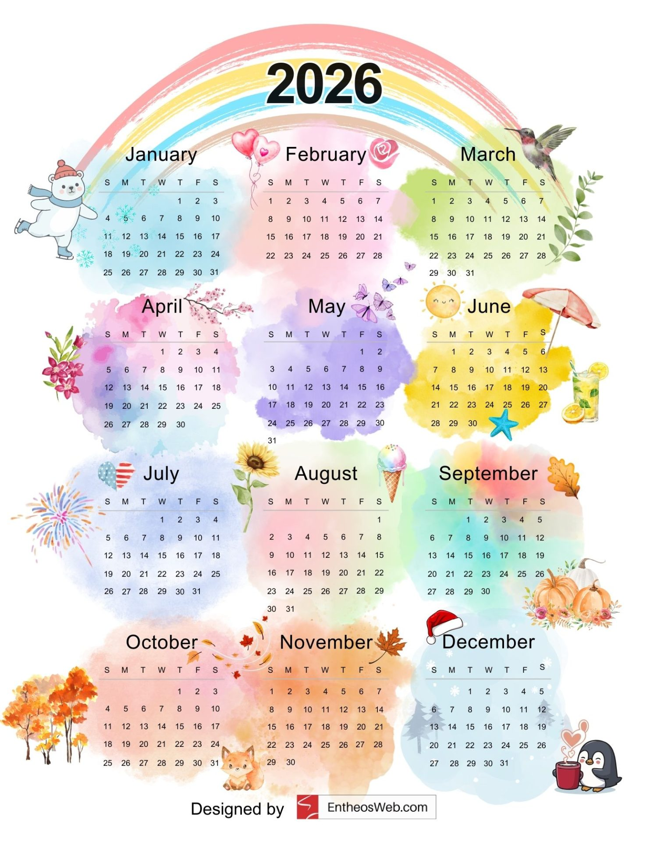
Know That PEIMS Is a Continuous Process
Many new users think PEIMS only happens near a submission deadline.
Waiting until the submission window opens creates unnecessary stress and increases the chance of errors.
It actually happens all year.
A successful district develops a routine such as:
Check validation reports daily or weekly.
Correct data in the source system.
Allow OnDataSuite to refresh.
Verify corrections.
Repeat.

Slide 20
Learn to Use OnDataSuite as a Decision-Making Tool, Not Just a Reporting Tool
New users often think:
"I only log in when I have to submit PEIMS."
Experienced users think:
"I use OnDataSuite every day to monitor my district."

Slide 21
It starts with a Key and Secret…
Principals monitor enrollment.
Counselors monitor CCMR.
Finance monitors Summary of Finance.
Accountability staff monitor A–F indicators.
Curriculum staff monitor assessment growth.
PEIMS staff monitor data quality.
The more departments use OnDataSuite throughout the year, the fewer surprises occur during PEIMS submissions.
It ends with a successful submission…

